Slide 1
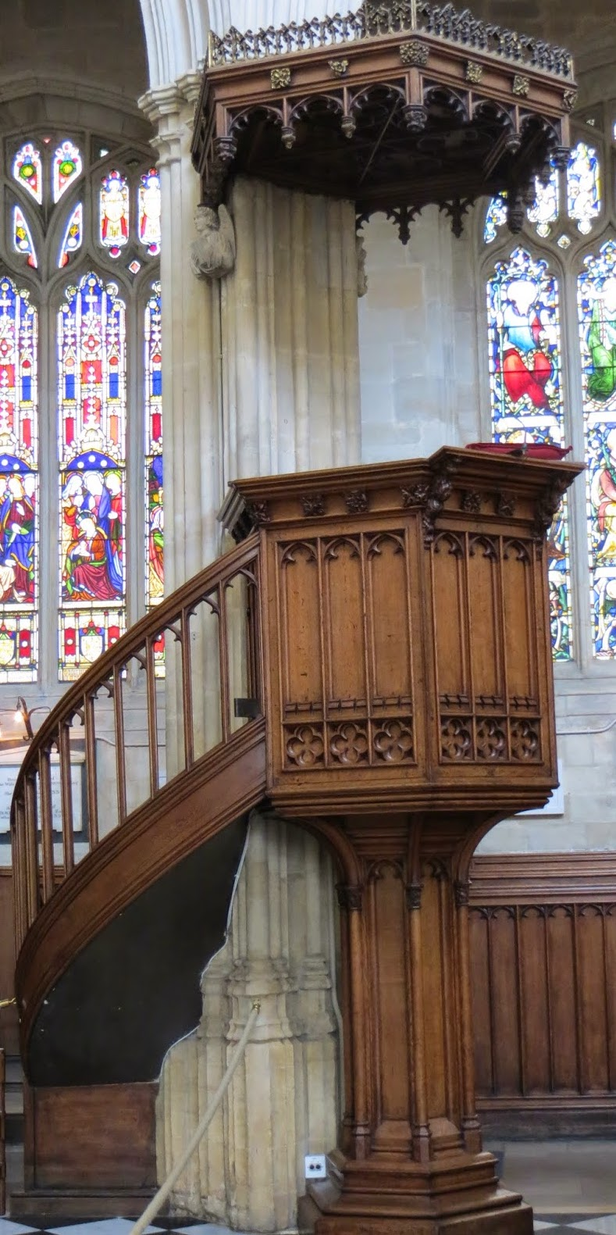
May 15, 2024
St. Philip’s Church
The Rev’d Brian K. McGreevy, J.D., Facilitator

Slide 2
So we do not lose heart. Though our outer self is wasting away, our
inner self is being renewed day by day. For this light momentary
affliction is preparing for us
an eternal weight of glory beyond all comparison,
as we look not to the things that are seen but to the things
that are unseen.
For the things that are seen are transient,
but the things that are unseen are eternal.
2 Corinthians 4:16-18
April 10, 2024
St. Philip’s Church
The Rev’d Brian K. McGreevy, J.D., Facilitator

Slide 3
How to approach this class: --On the beach --Snorkeling --Scuba diving --Email list How to read this book: --Try reading aloud and slowly, looking for layers of meaning
--Look for themes/underline and highlight passages that resonate with you
April 10, 2024
St. Philip’s Church
The Rev’d Brian K. McGreevy, J.D., Facilitator

Slide 4
The Book
A collection of sermons and addresses given by C.S. Lewis during World War II and shortly thereafter
1. The Weight of Glory--June 8, 1941: Church of St. Mary the Virgin, Oxford
2. Learning in War-time--October 22, 1938: Church of St. Mary the Virgin, Oxford
3. Transposition--May 28, 1944: Chapel of Mansfield College, Oxford
4. Is Theology Poetry?--November 6, 1944: Socratic Club, Oxford
5. The Inner Ring-- December 14, 1944: King’s College, University of London
6. Membership—February 10, 1945: Society of St. Alban and St. Sergius, Oxford
7. On Forgiveness--August 28, 1947: Church of St. Mary’s, Sawston, Cambridgeshire
8. A Slip of the Tongue--January 29, 1956:. Chapel of Magdalene College, Cambridge
We will be focusing on only two of these, “Learning in War-time” and “The Weight of Glory,” but all of them are well worth reading!

Slide 5
Context: England in War-time
1939 September 3—Following Hitler’s aggression, England and France declare war on Germany
October 22—Lewis preaches “Learning in War-time” sermon in Oxford 1940
September 7—The Blitz begins, with nightly devastating bombing raids on London for months
1941 February 7—Lewis invited to give talks on BBC April 9—Lewis gives first wartime RAF talk
In the month before Lewis preached “The Weight of Glory,” Greece falls to Hitler, as does Yugoslavia, and bombs continue to fall on London, hitting Parliament and St. Paul’s Cathedral June 8—Lewis delivers The Weight of Glory sermon in Oxford August 6—First BBC talk by Lewis 1944 June 6, 1944—D-Day invasion of Normandy
1945 March 29, 1945—Final German bombing raid on England May 8, 1945—Churchill declares VE Day as Germany surrenders July 16, 1945—Lewis gives last RAF talk

Slide 6
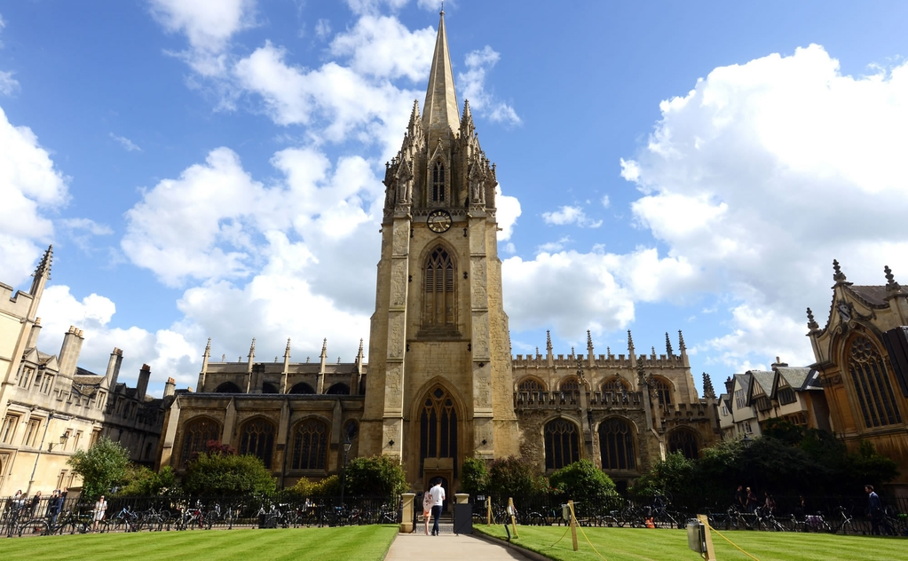
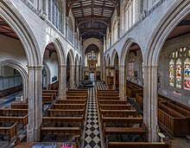
The venue: The University Church of St. Mary the Virgin, Oxford

Slide 7
The two Oxford sermons at the Church of St. Mary the Virgin:
“Learning in War-time” and “The Weight of Glory”
--Canon T. Richard (“Dick”) Milford, Vicar of St Mary’s and Lewis’s contemporary, issued the invitation to Lewis for both these sermons. Milford had been impacted by The Pilgrim’s Regress (1933), Lewis’s first Christian book.
--On October 22, 1939, six weeks after England and France declared war on Germany, Lewis preached “None Other Gods: Culture in War-Time” for Sunday evening Evensong at St. Mary’s, published later as “Learning in War-Time.”
--On June 8, 1941, at the height of the war and after eight months of the Blitz bombings of London, Lewis returned to preach at St. Mary’s at Evensong, this time preaching “The Weight of Glory” to an overflow crowd—perhaps the largest crowd ever assembled there, with every seat taken, people sitting in the aisles and windows, and gathered outside.
“Learning in War-time” – Setting the Stage for “The Weight of Glory”
Lewis asks how any of us can think it worthwhile to begin what we probably cannot finish, or to engage in tranquil or flippant activities when there is life-and-death urgency at hand, but points out that humanity is always facing crises in ways that war amplifies. He has in mind not only that we lurch from wars, to disasters, to tyrannies, but that we at all times have before us the question of our eternal destiny. It is part of our nature, he suggests, to create, reason, and laugh in the midst of pending disaster.

Slide 8
“The Weight of Glory”
Preached June 8, 1941
As Lewis had preached in “Learning in War-time,” man is always on the precipice, and worthy pursuits must be pursued even in times of extremity, especially within the framework of understanding our eternal destiny and the importance of the quest for knowledge and Beauty. In the darkest days of World War II where life was uncertain and death was a present reality, providing a framework for understanding Heaven and Eternity was enormously important, and that is what Lewis addresses in this sermon.
We will cover the sermon in four parts, looking at key themes:
Week 1: Unselfishness versus love, Desire and Rewards, Desire for Heaven, and Desire not attached to its true object
Week 2: Desire, Longing, Beauty, Enchantment, and Heaven
Week 3: Being with Christ, Two Types of Glory, Glory as Good Report, the Weight of Glory, Hoping for Glory
Week 4: Being known by God, Shining with God’s Glory, Living in Joy and eating from the Tree of Life, Following Jesus into eternal life, the glory of our neighbors and the weight of our choices, Real and costly Love for others

Slide 9
“The Weight of Glory”: References in the fourth section
--“beauty born of murmuring sound”: quotation from a 1799 poem by William Wordsworth
“The stars of midnight shall be dear To her; and she shall lean her ear In many a secret place Where rivulets dance their wayward round And beauty born of murmuring sound Shall pass into her face.”
-- Morning Star: generally refers to the planet Venus, which shines brightly in the eastern sky around dawn, but also a Biblical name for Jesus
--“St. Augustine said, the rapture of the saved soul will “flow over” into the glorified body”: from Letter 118: “For God has endowed the soul with a nature so powerful, that from that consummate fullness of joy which is promised to the saints in the end of time, some portion overflows also upon the lower part of our nature, the body – not the blessedness which is proper to the part which enjoys and understands, but the plenitude of health, that is, the vigour of incorruption.”
--torrens voluptatis: “stream of delights” from Latin version of Psalm 35 and 36
-- vere latitat: Latin for “truly hidden,” referencing the 13th century hymn by Thomas Aquinas “Adoro te devote”(Adoro te devote, latens Deitas, Quæ sub his figuris vere latitas), translated in our hymnal as “Humbly I adore thee, Verity unseen, who thy glory hidest ’neath these shadows mean.”

Slide 10
The Weight of Glory, Part 4
Perhaps it seems rather crude to describe glory as the fact of being “noticed” by God. But this is almost the language of the New Testament. St. Paul promises to those who love God not, as we should expect, that they will know Him, but that they will be known by Him (1 Cor. viii. 3). It is a strange promise. Does not God know all things at all times? But it is dreadfully re-echoed in another passage of the New Testament. There we are warned that it may happen to any one of us to appear at last before the face of God and hear only the appalling words: “I never knew you. Depart from Me.” In some sense, as dark to the intellect as it is unendurable to the feelings, we can be both banished from the presence of Him who is present everywhere and erased from the knowledge of Him who knows all. We can be left utterly and absolutely outside ― repelled, exiled, estranged, finally and unspeakably ignored. On the other hand, we can be called in, welcomed, received, acknowledged. We walk every day on the razor edge between these two incredible possibilities. Apparently, then, our lifelong nostalgia, our longing to be reunited with something in the universe from which we now feel cut off, to be on the inside of some door which we have always seen from the outside, is no mere neurotic fancy, but the truest index of our real situation. and to be at last summoned inside would be both glory and honour beyond all our merits and also the healing of that old ache.
And this brings me to the other sense of glory ― glory as brightness, splendour, luminosity. We are to shine as the sun, we are to be given the Morning Star. I think I begin to see what it means. In one way, of course, God has given us the Morning Star already: you can go and enjoy the gift on many fine mornings if you
get up early enough. What more, you may ask, do we want? Ah, but we want so much more ― something
the books on aesthetics take little notice of. But the poets and the mythologies know all about it. We do
not want merely to see beauty, though, God knows, even that is bounty enough. We want something else

Slide 11
which can hardly be put into words ― to be united with the beauty we see, to pass into it, to receive it into ourselves, to bathe in it, to become part of it. That is why we have peopled air and earth and water with gods and goddesses and nymphs and elves ― that, though we cannot, yet these projections can, enjoy in themselves that beauty, grace, and power of which nature is the image. That is why the poets tell us such lovely falsehoods. They talk as if the west wind could really sweep into a human soul; but it can’t. They tell us that “beauty born of murmuring sound” will pass into a human face; but it won’t. Or not yet. For if we take the imagery of Scripture seriously, if we believe that God will one day give us the Morning Star and cause us to put on the splendour of the sun, then we may surmise that both the ancient myths and the modern poetry, so false as history, may be very near the truth as prophecy.
At present we are on the outside of the world, the wrong side of the door. We discern the freshness and purity of morning, but they do not make us fresh and pure. We cannot mingle with the splendours we see. But all the leaves of the New Testament are rustling with the rumour that it will not always be so. Some day, God willing, we shall get in. When human souls have become as perfect in voluntary obedience as the inanimate creation is in its lifeless obedience, then they will put on its glory, or rather that greater glory of which nature is only the first sketch. For you must not think that I am putting forward any heathen fancy of being absorbed into nature. Nature is mortal; we shall outlive her. When all the suns and nebulae have passed away, each one of you will still be alive. Nature is only the image, the symbol; but it is the symbol Scripture invites me to use. We are summoned to pass in through nature, beyond her, into that
splendour which she fitfully reflects.
And in there, in beyond nature, we shall eat of the tree of life. At present, if we are reborn in Christ, the

Slide 12
spirit in us lives directly on God; but the mind, and still more the body, receives life from Him at a thousand removes ― through our ancestors, through our food, through the elements. The faint, far-off results of those energies which God’s creative rapture implanted in matter when He made the worlds are what we now call physical pleasures; and even thus filtered, they are too much for our present management. What would it be to taste at the fountain-head that stream of which even these lower reaches prove so intoxicating? Yet that, I believe, is what lies before us. The whole man is to drink joy from the fountain of joy. As St. Augustine said, the rapture of the saved soul will “flow over” into the glorified body. In the light of our present specialized and depraved appetites we cannot imagine this torrens voluptatis, and I warn everyone most seriously not to try. But it must be mentioned, to drive out thoughts even more misleading ― thoughts that what is saved is a mere ghost, or that the risen body lives in numb insensibility. The body was made for the Lord, and these dismal fancies are wide of the mark.
Meanwhile the Cross comes before the crown and tomorrow is a Monday morning. A cleft has opened in the pitiless walls of the world, and we are invited to follow our great Captain inside. The following Him is, of course, the essential point. That being so, it may be asked what practical use there is in the speculations which I have been indulging. I can think of at least one such use. It may be possible for each to think too much of his own potential glory hereafter; it is hardly possible for him to think too often or too deeply about that of his neighbour. The load, or weight, or of my neighbour’s glory should be laid daily on my back, a load so heavy that only humility can carry it, and the backs of the proud will be broken. It is a serious
thing to live in a society of possible gods and goddesses, to remember that the dullest and most
uninteresting person you talk to may one day be a creature which, if you saw it now, you would be
strongly tempted to worship, or else a horror and a corruption such as you now meet, if at all, only in

Slide 13
a nightmare. All day long we are, in some degree, helping each other to one or other of these destinations. It is in the light of these overwhelming possibilities, it is with the awe and the circumspection proper to them, that we should conduct all our dealings with one another, all friendships, all loves, all play, all politics.
There are no ordinary people. You have never talked to a mere mortal. Nations, cultures, arts, civilizations ― these are mortal, and their life is to ours as the life of a gnat. But it is immortals whom we joke with, work with, marry, snub, and exploit ― immortal horrors or everlasting splendours. This does not mean that we are to be perpetually solemn. We must play. But our merriment must be of that kind (and it is, in fact, the merriest kind) which exists between people who have, from the outset, taken each other seriously ― no flippancy, no superiority, no presumption. and our charity must be a real and costly love, with deep feeling for the sins in spite of which we love the sinner ― no mere tolerance or indulgence which parodies love as flippancy parodies merriment. Next to the Blessed Sacrament itself, your neighbour is the holiest object presented to your senses. If he is your Christian neighbour he is holy in almost the same way, for in him also Christ vere latitat ― the glorifier and the glorified, Glory Himself, is truly hidden.

Slide 14
Being known by God
“Perhaps it seems rather crude to describe glory as the fact of being “noticed” by God. But this is almost the language of the New Testament. St. Paul promises to those who love God not, as we should expect, that they will know Him, but that they will be known by Him (1 Cor. viii. 3). It is a strange promise. Does not God know all things at all times? But it is dreadfully re-echoed in another passage of the New Testament. There we are warned that it may happen to any one of us to appear at last before the face of God and hear only the appalling words: “I never knew you. Depart from Me.” In some sense, as dark to the intellect as it is unendurable to the feelings, we can be both banished from the presence of Him who is present everywhere and erased from the knowledge of Him who knows all. We can be left utterly and absolutely outside ― repelled, exiled, estranged, finally and unspeakably ignored. On the other hand, we can be called in, welcomed, received, acknowledged. We walk every day on the razor edge between these two incredible possibilities. Apparently, then, our lifelong nostalgia, our longing to be reunited with something in the universe from which we now feel cut off, to be on the inside of some door which we have always seen from the outside, is no mere neurotic fancy, but the truest index of our real situation. and to be at last summoned inside would be both glory and honour beyond all our merits and also the healing of that old ache.”
Before I formed you in the womb I knew you, before you were born I set you apart; I appointed you as a prophet to the nations.” Jeremiah 1:5 For you created my inmost being; you knit me together in my mother’s womb. Psalm 139:13 I am the good shepherd. I know my own and my own know me, just as the Father knows me and I know the Father; and I lay down my life for the sheep. Jn. 10:14-15 But if anyone loves God, he is known by God. I Cor. 8:3 Not everyone who says to me, ‘Lord, Lord,’ will enter the kingdom of heaven, but the one who does the will of my Father who is in heaven. On
that day many will say to me, ‘Lord, Lord, did we not prophesy in your name, and cast out demons in your name and
do many mighty works in your name?’ And then will I declare to them, ‘I never knew you; depart from me. Mt. 7:21-23

Slide 15
Shining with God’s Glory
“And this brings me to the other sense of glory ― glory as brightness, splendour, luminosity. We are to shine as the sun, we are to be given the Morning Star. I think I begin to see what it means. In one way, of course, God has given us the Morning Star already: you can go and enjoy the gift on many fine mornings if you
get up early enough. What more, you may ask, do we want? Ah, but we want so much more ― something
the books on aesthetics take little notice of. But the poets and the mythologies know all about it. We do
not want merely to see beauty, though, God knows, even that is bounty enough. We want something else which can hardly be put into words ― to be united with the beauty we see, to pass into it, to receive it into ourselves, to bathe in it, to become part of it. That is why we have peopled air and earth and water with gods and goddesses and nymphs and elves ― that, though we cannot, yet these projections can, enjoy in themselves that beauty, grace, and power of which nature is the image. That is why the poets tell us such lovely falsehoods. They talk as if the west wind could really sweep into a human soul; but it can’t. They tell us that “beauty born of murmuring sound” will pass into a human face; but it won’t. Or not yet. For if we take the imagery of Scripture seriously, if we believe that God will one day give us the Morning Star and cause us to put on the splendour of the sun, then we may surmise that both the ancient myths and the modern poetry, so false as history, may be very near the truth as prophecy.”
Then the righteous will shine like the sun in the kingdom of their Father. He who has ears, let him hear. Mt. 14:43 Let your light shine before others, so that they may see your good deeds and glorify your Father in heaven. Mt. 5:16 Those who have insight will shine brightly like the brightness of the expanse of heaven, and those who lead the many to righteousness, like the stars forever and ever. Daniel 12:3 Do all things without grumbling or disputing, that you may be blameless
and innocent, children of God without blemish in the midst of a crooked and twisted generation, among whom you shine as lights in the world, holding fast to the word of life. Phil. 2:14-15

Slide 16
Living in Joy and eating from the Tree of Life
“At present we are on the outside of the world, the wrong side of the door. We discern the freshness and purity of morning, but they do not make us fresh and pure. We cannot mingle with the splendours we see. But all the leaves of the New Testament are rustling with the rumour that it will not always be so. Some day, God willing, we shall get in. When human souls have become as perfect in voluntary obedience as the inanimate creation is in its lifeless obedience, then they will put on its glory, or rather that greater glory of which nature is only the first sketch. For you must not think that I am putting forward any heathen fancy of being absorbed into nature. Nature is mortal; we shall outlive her. When all the suns and nebulae have passed away, each one of you will still be alive. Nature is only the image, the symbol; but it is the symbol Scripture invites me to use. We are summoned to pass in through nature, beyond her, into that
splendour which she fitfully reflects. And in there, in beyond nature, we shall eat of the tree of life. At present, if we are reborn in Christ, the spirit in us lives directly on God; but the mind, and still more the body, receives life from Him at a thousand removes ― through our ancestors, through our food, through the elements. The faint, far-off results of those energies which God’s creative rapture implanted in matter when He made the worlds are what we now call physical pleasures; and even thus filtered, they are too much for our present management. What would it be to taste at the fountain-head that stream of which even these lower reaches prove so intoxicating? Yet that, I believe, is what lies before us. The whole man is to drink joy from the fountain of joy. As St. Augustine said, the rapture of the saved soul will “flow over” into the glorified body. In the light of our present specialized and depraved appetites we cannot imagine this
torrens voluptatis, and I warn everyone most seriously not to try. But it must be mentioned, to drive out thoughts even more misleading--thoughts that what is saved is a mere ghost, or that the risen body lives
in numb insensibility. The body was made for the Lord, and these dismal fancies are wide of the mark.”

Slide 17
Beloved, now we are children of God, and it has not appeared as yet what we shall be. We know that, when He appears, we shall be like Him, because we shall see Him just as He is. 1 Jn. 3:2 Christ will transform our lowly body that it may be conformed to His glorious body, according to the working by which He is able even to subdue all things to Himself. Phil. 3:21 If the Spirit of Him who raised Jesus from the dead dwells in you, He who raised Christ from the dead will give life to your mortal bodies also through His Spirit that dwells in you. Rom. 8:11 Behold! I tell you a mystery. We shall not all sleep, but we shall all be changed, in a moment, in the twinkling of an eye, at the last trumpet. For the trumpet will sound, and the dead will be raised imperishable, and we shall be changed. For this perishable body must put on the imperishable, and this mortal body must put on immortality. When the perishable puts on the imperishable, and the mortal puts on immortality, then shall come to pass the saying that is written: “Death is swallowed up in victory. O death, where is your victory? O death, where is your sting?” I Cor. 15 He who has an ear, let him hear what the Spirit says to the churches. To the one who conquers I will grant to eat of the tree of life, which is in the paradise of God.’ Rev. 2:7 Then the angel showed me the river of the water of life, bright as crystal, flowing from the throne of God and of the Lamb through the middle of the street of the city; also, on either side of the river, the tree of life with its twelve kinds of fruit, yielding its fruit each month. The leaves of the tree were for the healing of the nations. Rev. 22:1 Blessed are those who wash their robes, so that they may have the right to the tree of life and that they may enter the city by the gates. Rev.22:14 You make known to me the path of life; in your presence there is fullness of joy; at your right hand are pleasures forevermore. Ps. 16:1 So also you have sorrow now, but I will see you again, and your hearts will rejoice, and no one will take your joy from you. Jn. 16:22

Slide 18
Following Jesus into eternal life
“Meanwhile the Cross comes before the crown and tomorrow is a Monday morning. A cleft has opened in the pitiless walls of the world, and we are invited to follow our great Captain inside. The following Him is, of course, the essential point.”
And if I go and prepare a place for you, I will come again and will take you to myself, that where I am you may be also. Jn. 14:3 For to this you have been called, because Christ also suffered for you, leaving you an example, so that you might follow in his steps. I Peter 2:21 Then Jesus told his disciples, “If anyone would come after me, let him deny himself and take up his cross and follow me. Mt. 16:24 Therefore, brothers, since we have confidence to enter the holy places by the blood of Jesus, by the new and living way that he opened for us through the curtain, that is, through his flesh, and since we have a great priest over the house of God, let us draw near with a true heart in full assurance of faith, with our hearts sprinkled clean from an evil conscience and our bodies washed with pure water. Heb. 10:19-22 If anyone serves me, he must follow me; and where I am, there will my servant be also. If anyone serves me, the Father will honor him. Jn. 12:26 And calling the crowd to him with his disciples, he said to them, “If anyone would come after me, let him deny himself and take up his cross and follow me. For whoever would save his life will lose it, but whoever loses his life for my sake and the gospel's will save it. For what does it profit a man to gain the whole world and forfeit his soul? For what can a man give in return for his soul? Mk. 8:34-37 Therefore, since we are surrounded by so great a cloud of witnesses, let us also lay aside every weight, and sin which clings so closely, and let us run with endurance the race that is set before us, looking to Jesus, the founder and perfecter of our faith, who for the joy that was set before him endured the cross, despising the shame, and is seated at the right hand of the throne of God. Heb. 12:1-2

Slide 19
The glory of our neighbors and the weight of our choices
“It may be possible for each to think too much of his own potential glory hereafter; it is hardly possible for him to think too often or too deeply about that of his neighbour. The load, or weight, or of my neighbour’s glory should be laid daily on my back, a load so heavy that only humility can carry it, and the backs of the proud will be broken. It is a serious thing to live in a society of possible gods and goddesses, to remember that the dullest and most uninteresting person you talk to may one day be a creature which, if you saw it now, you would be strongly tempted to worship, or else a horror and a corruption such as you now meet, if at all, only in a nightmare. All day long we are, in some degree, helping each other to one or other of these destinations. It is in the light of these overwhelming possibilities, it is with the awe and the circumspection proper to them, that we should conduct all our dealings with one another, all friendships, all loves, all play, all politics.”
Whoever does not have the Son of God does not have life. I write these things to you who believe in the name of the Son of God so that you may know that you have eternal life I Jn 5:11-13 And many of those who sleep in the dust of the earth shall awake, some to everlasting life, and some to shame and everlasting contempt. Dn. 12:2 And these will go away into eternal punishment, but the righteous into eternal life. Mt. 25:46 The poor man died and was carried by the angels to Abraham's side. The rich man also died and was buried, and in Hades, being in torment, he lifted up his eyes and saw Abraham far off and Lazarus at his side Lk. 16 For if anyone sees you who have knowledge eating in an idol's temple, will he not be encouraged, if his conscience is weak, to eat food offered to idols? And so by your knowledge this weak person is destroyed, the brother for whom Christ died. Thus, sinning against your brothers and wounding their conscience when it is weak, you sin against Christ. 1 Cor. 8:10-12 In the same way, let your light shine before others, that they may see your good deeds and glorify your Father in heaven. Mt. 5:16 Love your enemies, do good to them, and lend to them without expecting to get anything back. Then your reward will be great, and you will be children of the Most High, because he is kind to the ungrateful and wicked. Be merciful, just as your Father is merciful.” Lk. 6:35-36

Slide 20
Real and costly Love for others
“There are no ordinary people. You have never talked to a mere mortal. Nations, cultures, arts, civilizations ― these are mortal, and their life is to ours as the life of a gnat. But it is immortals whom we joke with, work with, marry, snub, and exploit ― immortal horrors or everlasting splendours. This does not mean that we are to be perpetually solemn. We must play. But our merriment must be of that kind (and it is, in fact, the merriest kind) which exists between people who have, from the outset, taken each other seriously ― no flippancy, no superiority, no presumption. and our charity must be a real and costly love, with deep feeling for the sins in spite of which we love the sinner ― no mere tolerance or indulgence which parodies love as flippancy parodies merriment. Next to the Blessed Sacrament itself, your neighbour is the holiest object presented to your senses. if he is your Christian neighbour he is holy in almost the same way, for in him also Christ vere latitat ― the glorifier and the glorified, Glory Himself, is truly hidden.”
My command is this: Love each other as I have loved you. Greater love has no one than this: to lay down one’s life for one’s friends. Jn 15:12-13 Love must be sincere. Hate what is evil; cling to what is good. Be devoted to one another in love. Honor one another above yourselves. Rom. 12:9-10 Carry each other’s burdens, and in this way you will fulfill the law of Christ. Gal. 6:2 Do nothing out of selfish ambition or vain conceit. Rather, in humility value others above yourselves, not looking to your own interests but each of you to the interests of the others. Phil. 2:3-4 This is how we know what love is: Jesus Christ laid down his life for us. And we ought to lay down our lives for our brothers and sisters 1 Jn 3:16 Teacher, which is the great commandment in the Law?” And he said to him, “You shall love the Lord your God with all your heart and with all your soul and with all your mind. This is the great and first commandment. And a second is like it: You shall love your neighbor as yourself. On these two commandments depend all the Law and the Prophets.” Mt. 22:36-40

Slide 21
“Imagine yourself as a living house. God comes in to rebuild that house. At first, perhaps, you can understand what He is doing. He is getting the drains right and stopping the leaks in the roof and so on; you knew that those jobs needed doing and so you are not surprised. But presently He starts knocking the house about in a way that hurts abominably and does not seem
to make any sense.
What on earth is He up to? The explanation is that He is building quite a different house from the one you thought of - throwing out a new wing here, putting on an extra floor there, running up towers, making courtyards.
You thought you were being made into a decent little cottage: but
He is building a palace. He intends to come and live in it Himself.”
--C.S. Lewis, Mere Christianity

Slide 22
“At present we are on the outside of the world, the wrong side of the door.
We discern the freshness and purity of morning,
but they do not make us fresh and pure.
We cannot mingle with the splendours we see.
But all the leaves of the New Testament are rustling
with the rumour that it will not always be so.
Some day, God willing, we shall get in.” ― C.S. Lewis, The Weight of Glory

