Slide 1
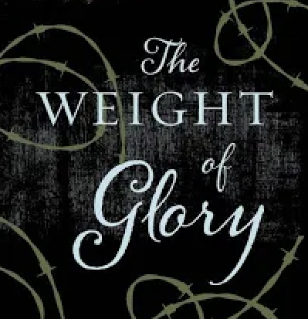
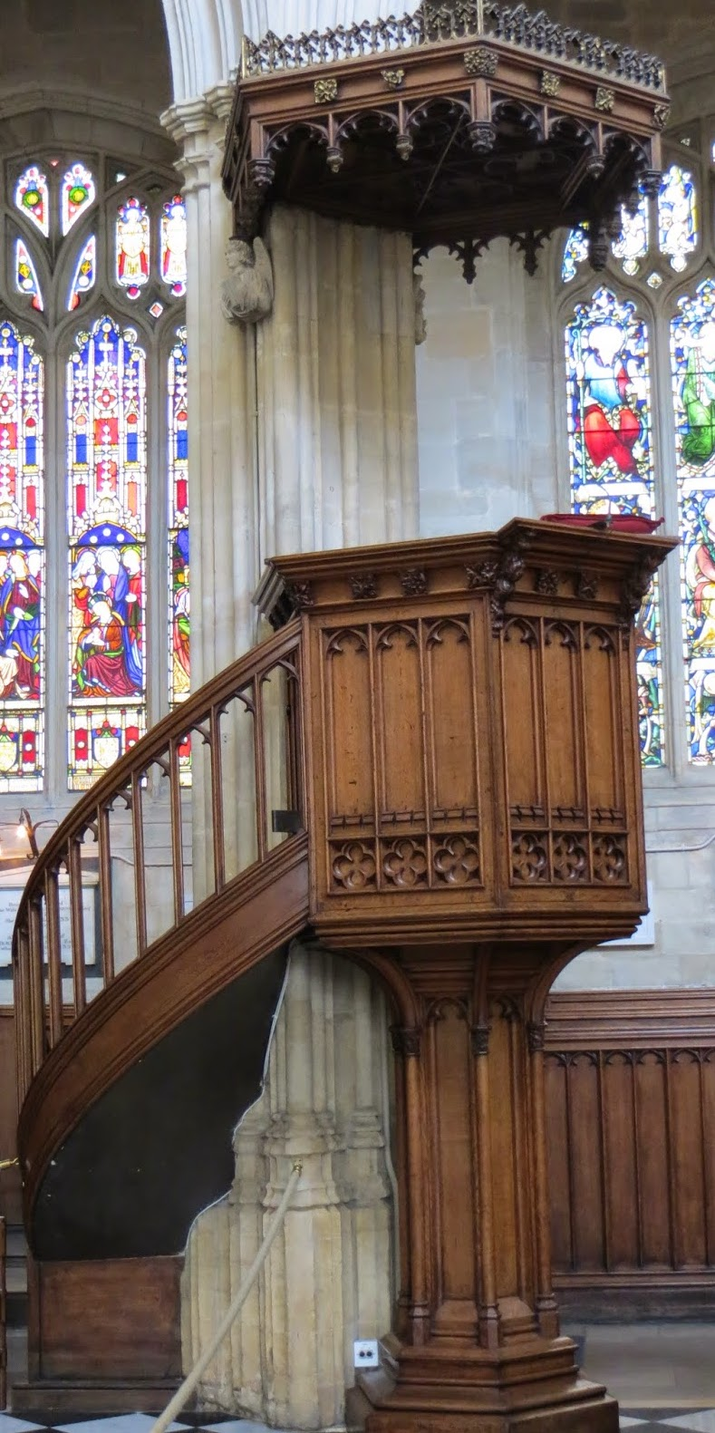
May 1, 2024
St. Philip’s Church
The Rev’d Brian K. McGreevy, J.D., Facilitator

Slide 2
So we do not lose heart. Though our outer self is wasting away, our
inner self is being renewed day by day. For this light momentary
affliction is preparing for us
an eternal weight of glory beyond all comparison,
as we look not to the things that are seen but to the things
that are unseen.
For the things that are seen are transient,
but the things that are unseen are eternal.
2 Corinthians 4:16-18
April 10, 2024
St. Philip’s Church
The Rev’d Brian K. McGreevy, J.D., Facilitator

Slide 3
How to approach this class: --On the beach --Snorkeling --Scuba diving --Email list How to read this book: --Try reading aloud and slowly, looking for layers of meaning
--Look for themes/underline and highlight passages that resonate with you
April 10, 2024
St. Philip’s Church
The Rev’d Brian K. McGreevy, J.D., Facilitator

Slide 4
The Book
A collection of sermons and addresses given by C.S. Lewis during World War II and shortly thereafter
1. The Weight of Glory--June 8, 1941: Church of St. Mary the Virgin, Oxford
2. Learning in War-time--October 22, 1938: Church of St. Mary the Virgin, Oxford
3. Transposition--May 28, 1944: Chapel of Mansfield College, Oxford
4. Is Theology Poetry?--November 6, 1944: Socratic Club, Oxford
5. The Inner Ring-- December 14, 1944: King’s College, University of London
6. Membership—February 10, 1945: Society of St. Alban and St. Sergius, Oxford
7. On Forgiveness--August 28, 1947: Church of St. Mary’s, Sawston, Cambridgeshire
8. A Slip of the Tongue--January 29, 1956:. Chapel of Magdalene College, Cambridge
We will be focusing on only two of these, “Learning in War-time” and “The Weight of Glory,” but all of them are well worth reading!

Slide 5
Context: England in War-time
1939 September 3—Following Hitler’s aggression, England and France declare war on Germany
October 22—Lewis preaches “Learning in War-time” sermon in Oxford 1940
September 7—The Blitz begins, with nightly devastating bombing raids on London for months
1941 February 7—Lewis invited to give talks on BBC April 9—Lewis gives first wartime RAF talk
In the month before Lewis preached “The Weight of Glory,” Greece falls to Hitler, as does Yugoslavia, and bombs continue to fall on London, hitting Parliament and St. Paul’s Cathedral June 8—Lewis delivers The Weight of Glory sermon in Oxford August 6—First BBC talk by Lewis 1944 June 6, 1944—D-Day invasion of Normandy
1945 March 29, 1945—Final German bombing raid on England May 8, 1945—Churchill declares VE Day as Germany surrenders July 16, 1945—Lewis gives last RAF talk

Slide 6
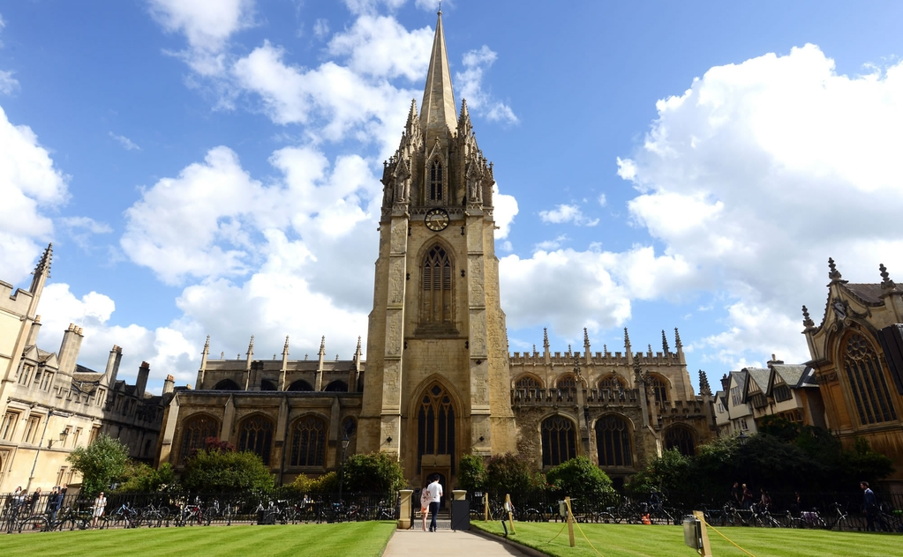
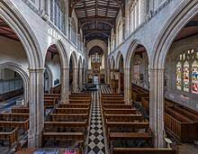
The venue: The University Church of St. Mary the Virgin, Oxford

Slide 7
The two Oxford sermons at the Church of St. Mary the Virgin:
“Learning in War-time” and “The Weight of Glory”
--Canon T. Richard (“Dick”) Milford, Vicar of St Mary’s and Lewis’s contemporary, issued the invitation to Lewis for both these sermons. Milford had been impacted by The Pilgrim’s Regress (1933), Lewis’s first Christian book.
--On October 22, 1939, six weeks after England and France declared war on Germany, Lewis preached “None Other Gods: Culture in War-Time” for Sunday evening Evensong at St. Mary’s, published later as “Learning in War-Time.”
--On June 8, 1941, at the height of the war and after eight months of the Blitz bombings of London, Lewis returned to preach at St. Mary’s at Evensong, this time preaching “The Weight of Glory” to an overflow crowd—perhaps the largest crowd ever assembled there, with every seat taken, people sitting in the aisles and windows, and gathered outside.
“Learning in War-time” – Setting the Stage for “The Weight of Glory”
Lewis asks how any of us can think it worthwhile to begin what we probably cannot finish, or to engage in tranquil or flippant activities when there is life-and-death urgency at hand, but points out that humanity is always facing crises in ways that war amplifies. He has in mind not only that we lurch from wars, to disasters, to tyrannies, but that we at all times have before us the question of our eternal destiny. It is part of our nature, he suggests, to create, reason, and laugh in the midst of pending disaster.

Slide 8
“The Weight of Glory”
Preached June 8, 1941
As Lewis had preached in “Learning in War-time,” man is always on the precipice, and worthy pursuits must be pursued even in times of extremity, especially within the framework of understanding our eternal destiny and the importance of the quest for knowledge and Beauty. In the darkest days of World War II where life was uncertain and death was a present reality, providing a framework for understanding Heaven and Eternity was enormously important, and that is what Lewis addresses in this sermon.
We will cover the sermon in four parts, looking at key themes. Last week we began with the first section, looking at the themes of Unselfishness versus love, Desire and Rewards, Desire for Heaven, and Desire not attached to its true object. This week we move onto the second section and the themes of Desire, Longing, Beauty, Enchantment, and Heaven.

Slide 9
“The Weight of Glory”: References in the second section
--William Wordsworth (1770-1850) English poet and exponent of Romanticism with a deep affinity for nature and Beauty, whose walk with Coleridge by a waterfall is recounted in Lewis’s Abolition of Man. In this sermon, Lewis says Wordsworth’s “expedient was to identify it [longing for our far-off country] with certain moments in his own past.”
George Bernard Shaw (1856-1950) Irish playwright and critic. In his play Back to Methuselah (1921) the final speech of Lilith muses on the fate of humanity in these words: “I say, let them dread, of all things, stagnation; for from the moment I, Lilith, lose hope and faith in them, they are doomed. In that hope and faith I have let them live for a moment; and in that moment I have spared them many times. But mightier creatures than they have killed hope and faith, and perished from the earth; and I may not spare them for ever.”
Henri Bergson (1859-1941) Prominent French philosopher who coined the term élan vital in his 1907 work Creative Evolution, where he speculates that this “life force” from which all things came is capable of surmounting all obstacles, even death.
Second Law of Thermodynamics Matter and energy have the tendency to reach a state of uniformity or internal and external equilibrium, a state of maximum disorder (entropy), or as Yeats puts it in his poem “Things fall apart.”
Matthew Arnold (1822-1888) Victorian poet and critic. “It is not enough to want to get rid of one’s sins… Not only do we need to recognize that we are sinners; we need to believe in a Savior who takes away sin. Matthew Arnold once wrote, ‘Nor does the being hungry prove that we have bread.’ Because we know we are sinners, it does not follow that we are saved.” CSL Interview 5-7-1963

Slide 10
The Weight of Glory, Part 2
“In speaking of this desire for our own far-off country, which we find in ourselves even now, I feel a certain shyness. I am almost committing an indecency. I am trying to rip open the inconsolable secret in each one of you ― the secret which hurts so much that you take your revenge on it by calling it names like nostalgia and romanticism and adolescence; the secret also which pierces with such sweetness that when, in very intimate conversation, the mention of it becomes imminent, we grow awkward and affect to laugh at ourselves; the secret we cannot hide and cannot tell, though we desire to do both. We cannot tell it because it is a desire for something that has never actually appeared in our experience. We cannot hide it because our experience is constantly suggesting it, and we betray ourselves like lovers at the mention of a name. our commonest expedient is to call it Beauty and behave as if that had settled the matter. Wordsworth’s expedient was to identify it with certain moments in his own past. But all this is a cheat. If Wordsworth had gone back to those moments in the past, he would not have found the thing itself, but only the reminder of it; what he remembered would turn out to be itself a remembering. The books or the music in which we thought the beauty was located will betray us if we trust to them; it was not in them, it only came through them, and what came through them was longing. These things ― the beauty, the memory of our own past ― are good images of what we really desire; but if they are mistaken for the thing itself they turn into dumb idols, breaking the hearts of their worshippers. For they are not the thing itself; they are only the scent of a flower we have not found, the echo of a tune we have not heard, news from a country we have never yet visited.
“Do you think I am trying to weave a spell? Perhaps I am; but remember your fairy tales. spells are used
for breaking enchantments as well as for inducing them. and you and I have need of the strongest spell
that can be found to wake us from the evil enchantment of worldliness which has been laid upon us for

Slide 11
nearly a hundred years. almost our whole education has been directed to silencing this shy, persistent, inner voice; almost all our modern philosophies have been devised to convince us that the good of man is to be found on this earth. and yet it is a remarkable thing that such philosophies of progress or Creative Evolution themselves bear reluctant witness to the truth that our real goal is elsewhere. When they want to convince you that earth is your home, notice how they set about it. They begin by trying to persuade you that earth can be made into heaven, thus giving a sop to your sense of exile in earth as it is. next, they tell you that this fortunate event is still a good way off in the future, thus giving a sop to your knowledge that the fatherland is not here and now. Finally, lest your longing for the transtemporal should awake and spoil the whole affair, they use any rhetoric that comes to hand to keep out of your mind the recollection that even if all the happiness they promised could come to man on earth, yet still each generation would lose it by death, including the last generation of all, and the whole story would be nothing, not even a story, for ever and ever. Hence all the nonsense that Mr. Shaw puts into the final speech of Lilith, and Bergson’s remark that the Èlan vital is capable of surmounting all obstacles, perhaps even death ― as if we could believe that any social or biological development on this planet will delay the senility of the sun or reverse the second law of thermodynamics.
“Do what they will, then, we remain conscious of a desire which no natural happiness will satisfy. But is there any reason to suppose that reality offers any satisfaction to it? “Nor does the being hungry prove that we have bread.” But i think it may be urged that this misses the point. a man’s physical hunger does not prove
that that man will get any bread; he may die of starvation on a raft in the Atlantic. But surely a man’s
hunger does prove that he comes of a race which repairs its body by eating and inhabits a world where eatable substances exist. In the same way, though I do not believe (I wish I did) that my desire for

Slide 12
Paradise proves that I shall enjoy it, I think it a pretty good indication that such a thing exists and that some men will. A man may love a woman and not win her; but it would be very odd if the phenomenon called “falling in love” occurred in a sexless world.
“Here, then, is the desire, still wandering and uncertain of its object and still largely unable to see that object in the direction where it really lies. Our sacred books give us some account of the object. It is, of course, a symbolical account. Heaven is, by definition, outside our experience, but all intelligible descriptions must be of things within our experience. The scriptural picture of heaven is therefore just as symbolical as the picture which our desire, unaided, invents for itself; Heaven is not really full of jewelry any more than it is really the beauty of nature, or a fine piece of music. The difference is that the scriptural imagery has authority. It comes to us from writers who were closer to God than we, and it has stood the test of Christian experience down the centuries. The natural appeal of this authoritative imagery is to me, at first, very small. At first sight it chills, rather than awakes, my desire. And that is just what I ought to expect. If Christianity could tell me no more of the far-off land than my own temperament led me to surmise already, then Christianity would be no higher than myself. If it has more to give me, I must expect it to be less immediately attractive than “my own stuff”. Sophocles at first seems dull and cold to the boy who has only reached Shelley. If our religion is something objective, then we must never avert our eyes from those elements in it which seem puzzling or repellent; for it will be precisely the puzzling or the repellent which conceals what we do not yet know and need to know.”

Slide 13
Desire and Longing
“In speaking of this desire for our own far-off country, which we find in ourselves even now, I feel a certain shyness. I am almost committing an indecency. I am trying to rip open the inconsolable secret in each one of you ― the secret which hurts so much that you take your revenge on it by calling it names like nostalgia and romanticism and adolescence; the secret also which pierces with such sweetness that when, in very intimate conversation, the mention of it becomes imminent, we grow awkward and affect to laugh at ourselves; the secret we cannot hide and cannot tell, though we desire to do both. We cannot tell it because it is a desire for something that has never actually appeared in our experience. We cannot hide it because our experience is constantly suggesting it, and we betray ourselves like lovers at the mention of a name. Our commonest expedient is to call it Beauty and behave as if that had settled the matter. Wordsworth’s expedient was to identify it with certain moments in his own past. But all this is a cheat. If Wordsworth had gone back to those moments in the past, he would not have found the thing itself, but only the reminder of it; what he remembered would turn out to be itself a remembering. The books or the music in which we thought the beauty was located will betray us if we trust to them; it was not in them, it only came through them, and what came through them was longing. These things ― the beauty, the memory of our own past ― are good images of what we really desire; but if they are mistaken for the thing itself they turn into dumb idols, breaking the hearts of their worshippers. For they are not the thing itself; they are only the scent of a flower we have not found, the echo of a tune we have not heard, news from a country we have never yet visited."

Slide 14
Delight yourself in the Lord, and he will give you the desires of your heart. Commit your way to the Lord; trust in him, and he will act. Ps. 37:4-5 One thing have I desired of the LORD, that will I seek after; that I may dwell in the house of the LORD all the days of my life, to behold the beauty of the LORD, and to inquire in his temple. Ps. 27:4 These all died in faith, not having received the things promised, but having seen them and greeted them from afar, and having acknowledged that they were strangers and exiles on the earth. For people who speak thus make it clear that they are seeking a homeland. If they had been thinking of that land from which they had gone out, they would have had opportunity to return. But as it is, they desire a better country, that is, a heavenly one. Therefore God is not ashamed to be called their God, for he has prepared for them a city. Hebrews 11:13-16 As a deer longs for streams of water, so I long for You, God. Ps. 42:1

Slide 15
Desire and Longing
Deeper Dive: Sehnsucht
“[Joy, or Sehnsucht is] a special kind of longing . . . surrounded by a misty indefiniteness which seems essential to its very nature . . . it encompasses not only . . . Germanic longing . . . but also the more turbulent, passionate aspiration associated with what [Matthew] Arnold calls “Celtic Titanism” . . . At times one sees it clearly, at other times it seems to recede before one’s eyes . . . Thus, the exploring of this mystery has turned out to be a quest in itself. . . .For many writers it is simply there and they make no attempt to explain it. Some of them – especially poets like Wordsworth and Traherne – have expressed this attitude primarily as an ecstatic desire for union with nature; some have spoken of a “sweet melancholy” which seems to have no cause. . . .In several places Lewis has referred to the state of mind under discussion as Sehnsucht . . . the German word has overtones of nostalgia and longing not to be found in any English word . . . The crucial concept in defining this attitude is best expressed in English by the word “nostalgia.” Even though Sehnsucht may be made up of several different components or appear in different forms (melancholy, wonder, yearning, etc.), basic to its various manifestations is an underlying sense of displacement or alienation from what is desired. . .” --(from author and apologist Dave Armstrong)
Sehnsucht for Lewis was to experience of a sense of longing, yearning, and wonder or ‘an unsatisfied desire which is itself more desirable than any other satisfaction,’ which he called Joy. Often summoned by the memory of a memory, the ‘longing for the longing that had just ceased,’ one such boyhood memory was of his brother’s bringing a toy garden into the nursery. ‘As long as I live, my imagination of Paradise will retain something of my brother’s toy garden.’ This longing also came to him through Beatrix Potter’s Squirrel Nutkin, associated with the idea of Autumn, and then through poetry. The quality common to all three experiences was Joy.

Slide 16
“The wonder of spring . . . may bring feelings of ecstasy which cause the individual for the moment to transcend himself . . . Such moments are rare; they may come with a mounting sense of grandeur in the presence of natural beauty or with piercing sweetness on hearing a certain strain of music . . . an experience of “enormous bliss,” of being transported to awesome heights which make the close-by world seem far away. The individual feels that he is becoming one with the universe and desires an even closer union. There was the charm, as we went on, of running out into evening sunlight, but still in a deep gulley – as if the train were swimming in earth instead of either sailing on it like a real train or worming beneath it like a real tube. There was the charm of sudden silence at station I had never heard of, and where we seemed to stop for a long time. There was the novelty of being in that kind of carriage without a crowd and without artificial light. But I need not try to enumerate all the ingredients. The point is that all these things between them built up for me a degree of happiness which I must not try to assess because, if I did, you would think I was exaggerating…
“But wait. ‘Build up’ is the wrong expression. They did not actually impost this happiness; they offered it. I was free to take it or not as I chose – like distant music which you need not listen to unless you wish, like a delicious faint wind on your face which you can easily silenced this inward wiseacre. I accepted the invitation – threw myself open to this feather, impalpable, tingling invitation. The rest of the journey I passed in a state which can be described only as Joy.”
— from “Hedonics” (1945), published in Present Concerns

Slide 17
Desire and Beauty
“Our commonest expedient is to call it Beauty and behave as if that had settled the matter. Wordsworth’s expedient was to identify it with certain moments in his own past. But all this is a cheat. If Wordsworth had gone back to those moments in the past, he would not have found the thing itself, but only the reminder of it; what he remembered would turn out to be itself a remembering. The books or the music in which we thought the beauty was located will betray us if we trust to them; it was not in them, it only came through them…”
He has made everything beautiful in its time. He has also set eternity in the human heart; yet no one can fathom what God has done from beginning to end. Eccl. 3:11 The Lord is my chosen portion and my cup; you hold my lot. The lines have fallen for me in pleasant places; indeed, I have a beautiful inheritance. I bless the Lord who gives me counsel; in the night also my heart instructs me. I have set the Lord always before me; because he is at my right hand, I shall not be shaken. Therefore my heart is glad, and my whole being rejoices; my flesh also dwells secure. Psalm 16:5-9 For the Lord your God is bringing you into a good land—a land with brooks, streams, and deep springs gushing out into the valleys and hills; a land with wheat and barley, vines and fig trees, pomegranates, olive oil and honey; a land where bread will not be scarce and you will lack nothing; a land where the rocks are iron and you can dig copper out of the hills. When you have eaten and are satisfied, praise the Lord your God for the good land he has given you. Be careful that you do not forget the Lord your God. Deut. 8:7-11 And why are you anxious about clothing? Consider the lilies of the field, how they grow: they neither toil nor spin, yet I tell you, even Solomon in all his glory was not arrayed like one of these. Matthew 6:26-29 The heavens declare the glory of God, and the sky above proclaims his handiwork. Day to day pours out speech, and night to night reveals knowledge. There is no speech, nor are there words, whose voice is not heard. Their voice goes out through all the earth, and their words to the end of the world. In them he has set a tent for the sun, which comes out like a bridegroom leaving his chamber, and, like a strong man, runs its course with joy. Psalm 19:1-5

Slide 18
Enchantment
“Do you think I am trying to weave a spell? Perhaps I am; but remember your fairy tales. spells are used for breaking enchantments as well as for inducing them. and you and I have need of the strongest spell that can be found to wake us from the evil enchantment of worldliness which has been laid upon us for nearly a hundred years. almost our whole education has been directed to silencing this shy, persistent, inner voice; almost all our modern philosophies have been devised to convince us that the good of man is to be found on this earth. and yet it is a remarkable thing that such philosophies of progress or Creative Evolution themselves bear reluctant witness to the truth that our real goal is elsewhere. When they want to convince you that earth is your home, notice how they set about it. They begin by trying to persuade you that earth can be made into heaven, thus giving a sop to your sense of exile in earth as it is. next, they tell you that this fortunate event is still a good way off in the future, thus giving a sop to your knowledge that the fatherland is not here and now. Finally, lest your longing for the transtemporal should awake and spoil the whole affair, they use any rhetoric that comes to hand to keep out of your mind the recollection that even if all the happiness they promised could come to man on earth, yet still each generation would lose it by death, including the last generation of all, and the whole story would be nothing, not even a story, for ever and ever. Hence all the nonsense that Mr. Shaw puts into the final speech of Lilith, and Bergson’s remark that the Èlan vital is capable of surmounting all obstacles, perhaps even death ― as if we could believe that any social or biological development on this planet will delay the senility of the sun or reverse the second law of thermodynamics.”

Slide 19
O foolish Galatians! Who has bewitched you? It was before your eyes that Jesus Christ was publicly portrayed as crucified. Let me ask you only this: Did you receive the Spirit by works of the law or by hearing with faith? Gal. 3:1-2 Beloved, do not believe every spirit, but test the spirits to see whether they are from God, for many false prophets have gone out into the world. I Jn. 4:1 The coming of the lawless one is by the activity of Satan with all power and false signs and wonders, 2 Thess. 2:9 See to it that no one takes you captive by philosophy and empty deceit, according to human tradition, according to the elemental spirits of the world, and not according to Christ. Col. 2:8 For we do not wrestle against flesh and blood, but against principalities, against powers, against the rulers of the darkness of this age, against spiritual hosts of wickedness in the heavenly places. Ephesians 6:12 This is how you can know the Spirit of God: every spirit that acknowledges Jesus Christ come in the flesh belongs to God, and every spirit that does not acknowledge Jesus does not belong to God. This is the spirit of the antichrist that, as you heard, is to come, but in fact is already in the world. You belong to God, children, and you have conquered them, for the one who is in you is greater than the one who is in the world. They belong to the world; accordingly, their teaching belongs to the world, and the world listens to them. We belong to God, and anyone who knows God listens to us, while anyone who does not belong to God refuses to hear us. This is how we know the spirit of truth and the spirit of deceit. I Jn. 4:2-6

Slide 20
Heaven
“Here, then, is the desire, still wandering and uncertain of its object and still largely unable to see that object in the direction where it really lies. Our sacred books give us some account of the object. It is, of course, a symbolical account. Heaven is, by definition, outside our experience, but all intelligible descriptions must be of things within our experience. The scriptural picture of heaven is therefore just as symbolical as the picture which our desire, unaided, invents for itself; Heaven is not really full of jewelry any more than it is really the beauty of nature, or a fine piece of music. The difference is that the scriptural imagery has authority. It comes to us from writers who were closer to God than we, and it has stood the test of Christian experience down the centuries. The natural appeal of this authoritative imagery is to me, at first, very small. At first sight it chills, rather than awakes, my desire. And that is just what I ought to expect. If Christianity could tell me no more of the far-off land than my own temperament led me to surmise already, then Christianity would be no higher than myself. If it has more to give me, I must expect it to be less immediately attractive than “my own stuff”. Sophocles at first seems dull and cold to the boy who has only reached Shelley. If our religion is something objective, then we must never avert our eyes from those elements in it which seem puzzling or repellent; for it will be precisely the puzzling or the repellent which conceals what we do not yet know and need to know.”

Slide 21
For he was looking forward to the city that has foundations, whose designer and builder is God. Heb:11:10 But you have come to Mount Zion, to the city of the living God, the heavenly Jerusalem. You have come to thousands upon thousands of angels in joyful assembly, to the church of the firstborn, whose names are written in heaven. You have come to God, the Judge of all, to the spirits of the righteous made perfect, to Jesus the mediator of a new covenant, and to the sprinkled blood that speaks a better word than the blood of Abel... Therefore, since we are receiving a kingdom that cannot be shaken, let us be thankful, and so worship God acceptably with reverence and awe. Heb. 12:24-28 Then I saw a new heaven and a new earth; for the first heaven and the first earth passed away, and there is no longer any sea. Revelation 21:1 All the stars in the sky will be dissolved and the heavens rolled up like a scroll; all the starry host will fall like withered leaves from the vine, like shriveled figs from the fig tree. Isaiah 34:4 Better a day in Your courts than a thousand anywhere else. I would rather be at the door of the house of my God than to live in the tents of wicked people. Ps. 84:10 The wall was built of jasper, while the city was pure gold, like clear glass. The foundations of the wall of the city were adorned with every kind of jewel. The first was jasper, the second sapphire, the third agate, the fourth emerald, the fifth onyx, the sixth carnelian, the seventh chrysolite, the eighth beryl, the ninth topaz, the tenth chrysoprase, the eleventh jacinth, the twelfth amethyst. And the twelve gates were twelve pearls, each of the gates made of a single pearl, and the street of the city was pure gold, like transparent glass. Rev. 21:18-21

Slide 22
“At present we are on the outside of the world, the wrong side of the door.
We discern the freshness and purity of morning,
but they do not make us fresh and pure.
We cannot mingle with the splendours we see.
But all the leaves of the New Testament are rustling
with the rumour that it will not always be so.
Some day, God willing, we shall get in.” ― C.S. Lewis, The Weight of Glory

