Slide 1


April 10, 2024
St. Philip’s Church
The Rev’d Brian K. McGreevy, J.D., Facilitator

Slide 2
So we do not lose heart. Though our outer self is wasting away, our
inner self is being renewed day by day. For this light momentary
affliction is preparing for us
an eternal weight of glory beyond all comparison,
as we look not to the things that are seen but to the things
that are unseen.
For the things that are seen are transient,
but the things that are unseen are eternal.
2 Corinthians 4:16-18
April 10, 2024
St. Philip’s Church
The Rev’d Brian K. McGreevy, J.D., Facilitator

Slide 3
How to approach this class:
--On the beach
--Snorkeling
--Scuba diving
--Email list
How to read this book:
--Try reading aloud and slowly, looking for layers of meaning
--Look for themes/underline and highlight passages that resonate with you
April 10, 2024
St. Philip’s Church
The Rev’d Brian K. McGreevy, J.D., Facilitator

Slide 4
The Book
A collection of sermons and addresses given by C.S. Lewis during World War II and shortly thereafter
1. The Weight of Glory--June 8, 1941: Church of St. Mary the Virgin, Oxford
2. Learning in War-time--October 22, 1938: Church of St. Mary the Virgin, Oxford
3. Transposition--May 28, 1944: Chapel of Mansfield College, Oxford
4. Is Theology Poetry?--November 6, 1944: Socratic Club, Oxford
5. The Inner Ring-- December 14, 1944: King’s College, University of London
6. Membership—February 10, 1945: Society of St. Alban and St. Sergius, Oxford
7. On Forgiveness--August 28, 1947: Church of St. Mary’s, Sawston, Cambridgeshire
8. A Slip of the Tongue--January 29, 1956:. Chapel of Magdalene College, Cambridge
We will be focusing on only two of these, “Learning in War-time” and “The Weight of Glory,” but all of them are well worth reading!

Slide 5
Context: England in War-time
1939
Lewis begins writing The Problem of Pain at the request of Ashley Sampson of Centenary Press
March 29—Tolkien does three day program of code and cipher training
August 31--Civilian evacuations from London begin
September 1—Germany invades Poland; Warnie Lewis begins active duty in British Armed Forces
September 2—Four evacuee children from London arrive at the Kilns; various children will be housed there through 1945
September 3—Following Hitler’s aggression, England and France declare war on Germany
October 22—Lewis preaches “Learning in War-time” sermon in Oxford
1940
January 8—Rationing begins in England
March—Lewis publishes The Problem of Pain, which is read and lauded by the Rev. James Welch, Head of Religious Broadcasting for the BBC
May 10—Nazis invade France, Belgium, and the Netherlands; Churchill named Prime Minister
May 26--Dunkirk evacuation begins
June 3—Germans bomb Paris; Dunkirk evacuation ends
July 5—Lewis has the idea for The Screwtape Letters
July 10—Battle of Britain begins
August 23—First German air raids on London
August 25—British air raids on Germany begin

Slide 6
September 7—German Blitz against Britain begins with 348 bombers and 617 fighter planes, continuing until May 1941
During the 8 months of the Blitz, 43,000 civilians were killed. One of every six Londoners was made homeless and at least 1.1 million houses and flats were damaged or destroyed.
September 16—Langham Hotel adjacent to BBC bombed
October 15—BBC Broadcasting House struck by bomb; seven killed
November 14—Massive German bombing of Coventry
December 8—BBC Broadcasting House and All Souls struck by bombs
December 29—Massive German bombing of London
1941
February 7—Lewis invited to give talks on BBC
April 9—Lewis gives first wartime RAF talk
May 2—Lewis publishes The Screwtape Letters in serial form
May 10—Massive German bombing of London; Queen’s Hall adjacent to Broadcasting House destroyed
June 8—Lewis delivers The Weight of Glory sermon in Oxford
August 6—First BBC talk by Lewis

Slide 7
1944
June 6, 1944—D-Day invasion of Normandy
1945
March 29, 1945—Final German bombing raid on England
May 8, 1945—Churchill declares VE Day as Germany surrenders
July 16, 1945—Lewis gives last RAF talk

Slide 8
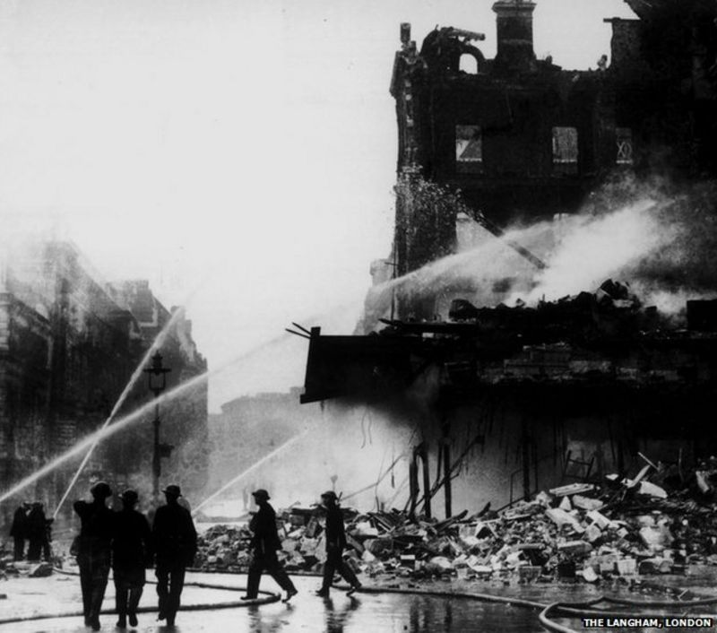
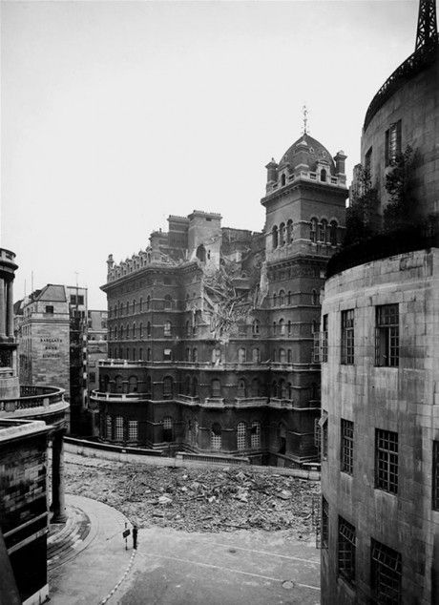
Context: England in War-time
Context--Lewis and the Inklings in Wartime:
1939
Lewis begins writing The Problem of Pain at the request of Ashley Sampson of Centenary Press
March 29—Tolkien does three day program of code and cipher training for the government in London
August 31--Civilian evacuations from London begin
September 1—Germany invades Poland; Warnie Lewis called up for active duty in British Armed Forces
September 2—Four evacuee children from London arrive at the Kilns; various evacuee children will be there off and on until 1945
September 2--Charles Williams and the Oxford University Press move to Oxford from London because of the imminent war
September 3—Responding to Hitler’s aggression, England and France declare war on Germany
1940
January 8—Rationing begins in England
February—Charles Williams becomes a lecturer at Oxford University
March—Lewis publishes The Problem of Pain, which is read and lauded by the Rev. James Welch, Head of Religious Broadcasting for the BBC
May 10—Nazis invade France, Belgium, and the Netherlands; Churchill named Prime MinisterMay 26--Dunkirk evacuation begins
June 3—Germans bomb Paris; Dunkirk evacuation ends
July 5—Lewis has the idea for The Screwtape Letters
July 10—Battle of Britain begins
August 23—First German air raids on London
August 25—British air raids on Germany begin
September 7—German Blitz against Britain begins with 348 bombers and 617 fighter planes, continuing until May 11, 1941;
During the 8 months of the Blitz, 43,000 civilians were killed. One of every six Londoners was made homeless and at least 1.1 million houses and flats were damaged or destroyed.
September 16—Langham Hotel adjacent to BBC bombed
October 15—BBC Broadcasting House struck by bomb; seven killed
November 14—Massive German bombing of Coventry
December 8—BBC Broadcasting House and All Souls struck by bombs
December 29—Massive German bombing of London
1941
February 7—Lewis invited to give talks on BBC
April 9—Lewis gives first wartime RAF talk
May 2—Lewis publishes The Screwtape Letters in serial form
May 10—Massive German bombing of London; Queen’s Hall adjacent to Broadcasting House destroyed
June 8—Lewis delivers The Weight of Glory sermon in Oxford
August 6—First BBC talk by Lewis1944
June 6, 1944—D-Day invasion of Normandy
1945
March 29, 1945—Final German bombing raid on England
May 8, 1945—Churchill declares VE Day as Germany surrenders
July 16, 1945—Lewis gives last RAF talk

Slide 9
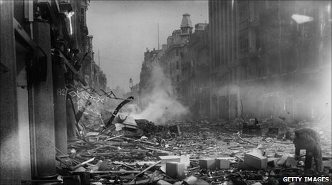
Context: England in War-time
Context--Lewis and the Inklings in Wartime:
1939
Lewis begins writing The Problem of Pain at the request of Ashley Sampson of Centenary Press
March 29—Tolkien does three day program of code and cipher training for the government in London
August 31--Civilian evacuations from London begin
September 1—Germany invades Poland; Warnie Lewis called up for active duty in British Armed Forces
September 2—Four evacuee children from London arrive at the Kilns; various evacuee children will be there off and on until 1945
September 2--Charles Williams and the Oxford University Press move to Oxford from London because of the imminent war
September 3—Responding to Hitler’s aggression, England and France declare war on Germany
1940
January 8—Rationing begins in England
February—Charles Williams becomes a lecturer at Oxford University
March—Lewis publishes The Problem of Pain, which is read and lauded by the Rev. James Welch, Head of Religious Broadcasting for the BBC
May 10—Nazis invade France, Belgium, and the Netherlands; Churchill named Prime MinisterMay 26--Dunkirk evacuation begins
June 3—Germans bomb Paris; Dunkirk evacuation ends
July 5—Lewis has the idea for The Screwtape Letters
July 10—Battle of Britain begins
August 23—First German air raids on London
August 25—British air raids on Germany begin
September 7—German Blitz against Britain begins with 348 bombers and 617 fighter planes, continuing until May 11, 1941;
During the 8 months of the Blitz, 43,000 civilians were killed. One of every six Londoners was made homeless and at least 1.1 million houses and flats were damaged or destroyed.
September 16—Langham Hotel adjacent to BBC bombed
October 15—BBC Broadcasting House struck by bomb; seven killed
November 14—Massive German bombing of Coventry
December 8—BBC Broadcasting House and All Souls struck by bombs
December 29—Massive German bombing of London
1941
February 7—Lewis invited to give talks on BBC
April 9—Lewis gives first wartime RAF talk
May 2—Lewis publishes The Screwtape Letters in serial form
May 10—Massive German bombing of London; Queen’s Hall adjacent to Broadcasting House destroyed
June 8—Lewis delivers The Weight of Glory sermon in Oxford
August 6—First BBC talk by Lewis1944
June 6, 1944—D-Day invasion of Normandy
1945
March 29, 1945—Final German bombing raid on England
May 8, 1945—Churchill declares VE Day as Germany surrenders
July 16, 1945—Lewis gives last RAF talk

Slide 10
Oxford in Wartime
Very few students—many colleges taken over by government so that only two housed actual students
Brasenose College—military officers’ training
Balliol College—international affairs
St. John’s College—director of fish supplies
St. Hugh’s—hospital for wounded soldiers (over 13,000 treated during the war)
Keble College—security services
Merton College—transportation services
All undergraduates had to take their turn in nightly fire-watching, sitting on College roofs, and on the watch if an incendiary device fell. Water tanks were even dug in the College quads and gardens, so that water would be to hand should an incendiary bomb fall.
13,000 children billeted in Oxford

Slide 11
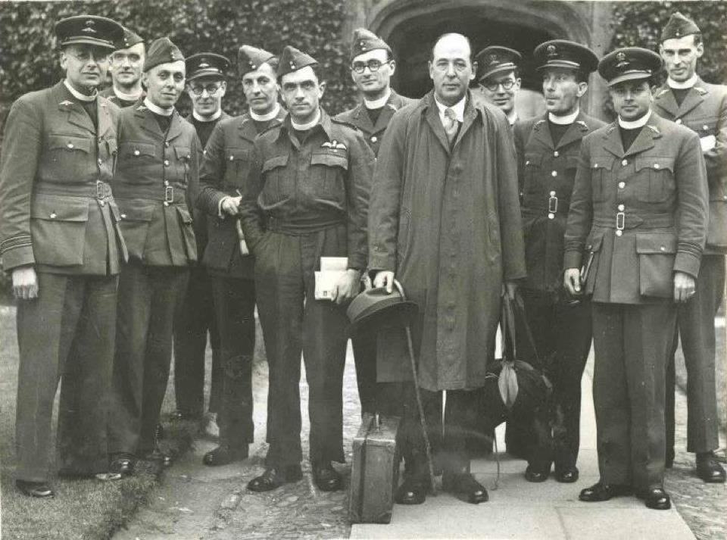
Lewis and the War Effort—Royal Air Force Ministry and more
- Early in 1941, the Very Rev. Maurice Edwards traveled to Oxford to personally urge C.S. Lewis to undertake an evangelistic and encouragement ministry within the RAF. Edwards was sent by the Very Rev. Dr. Walter Roberts Matthews, Dean of St. Paul’s Cathedral in London, who came up with the idea of this new ministry and insisted Lewis was the man to do it. Lewis did not feel he was qualified but ultimately agreed.
--For the next four years Lewis traveled throughout England, Scotland, and Wales speaking to RAF pilots and crews and encouraging chaplains. He spoke in a wide variety of settings: hangers, Nissen huts, parade grounds, libraries, YMCA buildings, and station chapels. He also delivered different types of presentations: lectures, discussions, live Brains Trusts (based on the BBC’s ‘Brains Trust’ radio show), and sermons.
--The RAF mission caused Lewis to drastically alter his speaking style so as to be able to connect with the air crews, a very different audience from effete Oxford dons and sophisticated students. His very first address (“Pauline Soteriology and Linguistic Analysis”) was a disaster until he departed from his notes and embarked on a more conversational style
--In February 1941, the Rev. James Welch, director of the Religious Broadcasting Department of the BBC, wrote Lewis asking him to undertake live broadcast talks on the Christian faith from BBC headquarters to encourage the nation. Broadcasting House, in the heart of London, had been hit by bombs on two occasions, once when they could be heard during a broadcast. Lewis replied on February 10, 1941, agreeing to the idea, and spent the summer months fleshing out the project and getting coaching from the BBC. Beginning in August of that year he began a series of live talks over the airwaves, each 10 to 15 minutes in length. He would eventually agree to do four series, from August of 1941 to April of 1944. All told, he gave 25 addresses, which adds up to nearly six hours of audio, which were later gathered together to form the book Mere Christianity.

Slide 12
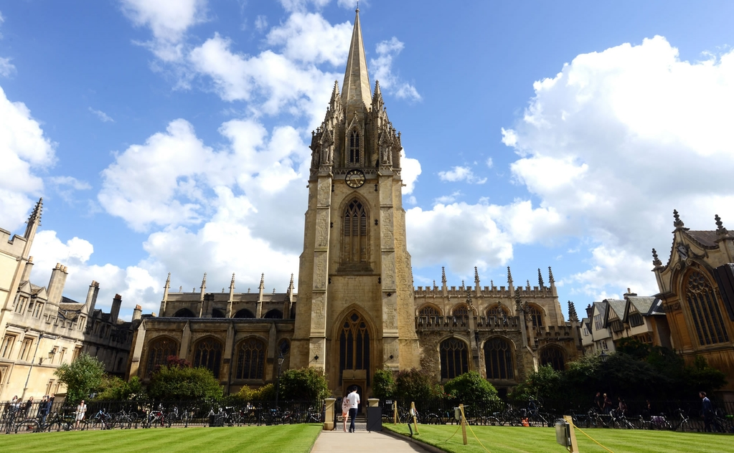

The venue: The University Church of St. Mary the Virgin, Oxford

Slide 13
The venue: The University Church of St. Mary the Virgin, Oxford
Church on this site for over 1000 years
Parts of current church building constructed originally by 1086; tower dates from the 1200s
First classes at Oxford held in the church prior to 1252
First library of Oxford University established here in the 13th century
The Oxford Martyrs (Cranmer, Latimer, Ridley) tried for heresy here and convicted in 1555; led to the stake
John Wesley preached several important sermons here in the 18th century
The Anglo-Catholic Oxford Movement began here in the late 1820s with John Keble and John Henry Newman
Site of all Oxford graduations through the 17th century
University chapel vs. college chapel—major events and speakers

Slide 14
The two Oxford sermons at the Church of St. Mary the Virgin:
“Learning in War-time” and “The Weight of Glory”
--Canon T. Richard (“Dick”) Milford, Vicar of St Mary’s and Lewis’s contemporary, issued the invitation to Lewis for both these sermons. Milford had been impacted by The Pilgrim’s Regress (1933), Lewis’s first Christian book.
--On October 22, 1939, six weeks after England and France declared war on Germany, Lewis preached “None Other Gods: Culture in War-Time” for Sunday evening Evensong at St. Mary’s, published later as “Learning in War-Time.”
--On June 8, 1941, at the height of the war and after eight months of the Blitz bombings of London, Lewis returned to preach at St. Mary’s at Evensong, this time preaching “The Weight of Glory” to an overflow crowd—perhaps the largest crowd ever assembled there, with every seat taken, people sitting in the aisles and windows, and gathered outside.

Slide 15
“Learning in War-time” – Setting the Stage for “The Weight of Glory” Summary from Rev. Dr. Harriet Harris, University of Edinburgh
"A University is a society for the pursuit of learning. As students, you will be expected to make yourselves, or to start making yourselves, in to what the Middle Ages called clerks: into philosophers, scientists, scholars, critics, or historians. And at first sight this seems to be an odd thing to do during a great war. What is the use of beginning a task which we have so little chance of finishing? Or, even if we ourselves should happen not to be interrupted by death or military service, why should we -- indeed how can we -- continue to take an interest in these placid occupations when the lives of our friends and the liberties of Europe are in the balance? Is it not like fiddling while Rome burns?"
Lewis asks how any of us can think it worthwhile to begin what we probably cannot finish, or to engage in tranquil or flippant activities when there is life-and-death urgency at hand. However, humanity is always facing crises in ways that war amplifies.
"The war creates no absolutely new situation: it simply aggravates the permanent human situation so that we can no longer ignore it. Human life has always been lived on the edge of a precipice. Human culture has always had to exist under the shadow of something infinitely more important than itself. If men had postponed the search for knowledge and beauty until they were secure the search would never have begun."
He has in mind not only that we lurch from wars, to disasters, to tyrannies, but that we at all times have before us the question of our eternal destiny. It is part of our nature, he suggests, to create, reason, and laugh in the midst of pending disaster: to ‘propound mathematical theorems in beleaguered cities, conduct metaphysical arguments in condemned cells, make jokes on scaffold, discuss the last new poem while advancing to the walls of Quebec, and comb [our] hair at Thermopylae…Plausible reasons have never been lacking for putting off all merely cultural activities until some imminent danger has been averted or some crying injustice put right. But humanity long ago chose to neglect those plausible reasons. They wanted knowledge and beauty now, and would not wait for the suitable moment that never came.”

Slide 16
“It may seem frivolous and selfish to think of anything but the war, but it is not so. It may seem frivolous and selfish to think of anything but the salvation of souls, Lewis adds, but it is also not so. We may indeed have to die to save others, or die for our country and our freedom, but these are not what the whole of our lives are for. Moreover, if you ‘suspend your whole intellectual and aesthetic activity, you would only succeed in substituting a worse cultural life for a better.: if you don't read good books you will read bad ones. If you don't go on thinking rationally, you will think irrationally. If you reject aesthetic satisfactions you will fall into sensual satisfactions.’ Let us not throw down our intellectual weapons just when they are most needed against our enemies: ‘Good philosophy must exist, if for no other reason, because bad philosophy needs to be answered.’
We also need knowledge of the past, and of other places, because otherwise we have nothing to set against our current situation. What Lewis most wants to say to the students before him is: ‘do not let your nerves and emotions lead you into thinking your present predicament more abnormal than it really is.’ He admits to his own nerves and emotions being rattled by the war and offers ‘defenses against the three enemies which war raises up against the scholar’: excitement, frustration, and fear.
--Excitement – the tendency to think and feel about the war when we had intended to think about our work.’ Favourable conditions never come for doing our scholarly work, Lewis says. Those who achieve much are those who want knowledge so badly that they seek it even when the conditions are unfavourable.
--Frustration -- the feeling that we shall not have time to finish.’ It is ever so. The present is the only time in which any work can be done or any grace received. ‘Never, in peace or war, commit your virtue or your happiness to the future. Happy work is best done by the man who takes his long-term plans somewhat lightly and works from moment to moment "as to the Lord". It is only our daily bread that we are encouraged to ask for.’
--Fear--because war threatens us with death and pain. Lewis does not encourage stoic indifference, but a very grounded reality. He welcomes the shattering of any illusions we might have had that humanity is building heaven on earth. We need to be disillusioned in order to be real. We can hold that for some people at some times the life of learning is in its small way an appointed approach to Divine reality. And if we find ourselves for the time-being with the skills and resources to be in a place of learning, and are not called away from that, this is where we are to carry out our activities.

Slide 17
“The Weight of Glory”—Preview
Unselfishness, love, desire, and rewards
Longing and unfulfilled desire
Beauty, desire, and the heavenly country
The nature of Glory and its different meanings
Fame versus Luminosity and seeing face to face
The burden of our neighbor’s Glory
Merriment, Joy, and the Tree of Life

Slide 18
“God has given us the Morning Star already: you can go and enjoy the gift on many fine mornings if you get up early enough. What more, you may ask, do we want? Ah, but we want so much more—something the books on aesthetics take little notice of. But the poets and the mythologies know all about it.
“We do not want merely to see beauty, though, God knows, even that is bounty enough. We want something else which can hardly be put into words—to be united with the beauty we see, to pass into it, to receive it into ourselves, to bathe in it, to become part of it.
“That is why we have peopled air and earth and water with gods and goddesses and nymphs and elves—that, though we cannot, yet these projections can, enjoy in themselves that beauty, grace, and power of which Nature is the image. That is why the poets tell us such lovely falsehoods. They talks as if the west wind could really sweep into a human soul; but it can’t. They tell us the ‘beauty born of murmuring sound’ will pass into a human face; but it won’t. Or not yet. For if we take the imagery of Scripture seriously, if we believe that God will one day give us the Morning Star and cause us to put on the splendour of the sun, then we may surmise that both the ancient myths and the modern poetry, so false as history, may be very near the truth as prophecy. At present we are on the outside of the world, the wrong side of the door. We discern the freshness and purity of morning but they do not make us fresh and pure. We cannot mingle with the splendours we see. But all the leaves of the New Testament are rustling with the rumour that it will not always be so. Some day, God willing, we shall get in.”

