Slide 1
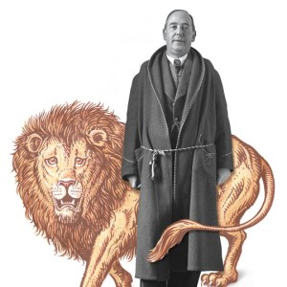
C.S. Lewis’s
The Last Battle
Book VII of
The Chronicles of Narnia
September 27, 2023
St. Philip’s Church
The Rev’d Brian K. McGreevy, J.D., Facilitator

Slide 2
It is for freedom that Christ has set us free. Stand firm, therefore, and do not submit again to a yoke of slavery. For you were called to freedom, brothers. Only do not use your freedom as an opportunity for the flesh, but through love serve one another.
For the whole law is fulfilled in one word: “You shall love your neighbor as yourself.”
--Galatians 3: 1, 13-14

Slide 3
How to approach this class:
--On the beach
--Snorkeling
--Scuba diving
--Email list
How to read this book:
--Try reading aloud and slowly, looking for layers of meaning
--Fine to read ahead

Slide 4
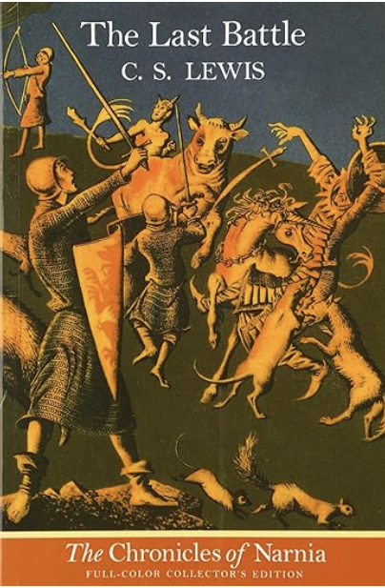

The Last Battle
Book VII in
The Chronicles of Narnia
Completed in 1953 but first published in 1956, with illustrations by Pauline Baynes
Is it a marvelous capstone work that draws all the children’s Narnia stories to a fitting close?
Or is it a profound reflection on the sin of Eden, the means of Grace, and the Glory of Heaven?
Or is it a parable about following Jesus that is particularly applicable to 21st century America and the importance of Word and Truth?

Slide 5
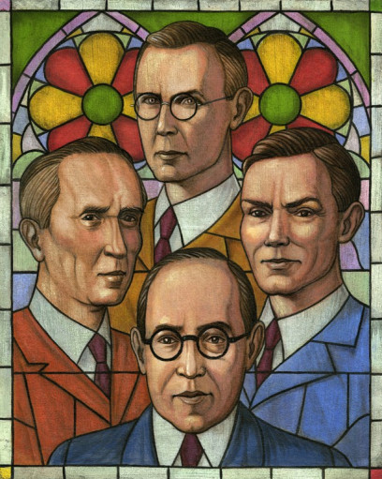
Review: Lewis and the Inklings and the Power of Story
Finally, brothers, whatever is true, whatever is honorable, whatever is just, whatever is pure, whatever is lovely, whatever is commendable, if there is any excellence, if there is anything worthy of praise, think about these things. What you have learned and received and heard and seen in me—practice these things, and the God of peace will be with you. (Philippians 4:8-9)
In a letter to his friend Sister Penelope in 1939, Lewis said “Any amount of theology can now be smuggled into people’s minds under cover of romance without their knowing it.”
The Chronicles of Narnia
Written in a very brief period of time after World War II
The Lion, the Witch and the Wardrobe (1950)
Prince Caspian (1951)
The Voyage of the Dawn Treader (1952)
The Silver Chair (1953)
The Horse and His Boy (1954)
The Magician's Nephew (1955)
The Last Battle (1956)
--“The Last Battle” was awarded the Carnegie Award, the highest award for children’s literature
--Enduring popularity--over 100 million copies sold in 47 languages
--Waterstones survey—best English children’s story of all time is The Lion, the Witch, and the Wardrobe
--In 2018, Netflix paid over $250 million for the rights to develop more Narnia films

Slide 6
Main Characters from earlier stories who appear in The Last Battle: Background of Aslan, Tirian, Eustace, Jill
Aslan: from the Turkish word for “lion,” he is introduced in the first book as the Great Lion, the Son of the Emperor-beyond-the-Sea. He is the Great Lion, the Christ figure for Narnia, and he is the Creator of Narnia, who sings it into being in The Magician’s Nephew. Aslan dies on the Stone Table in The Lion, the Witch, and the Wardrobe, but is resurrected by the Deep Magic.
Tirian: Tirian is a young man in his 20s and the rightful King of Narnia, being the seventh king descended from King Rilian, who was the son of King Caspian X. He has never seen Aslan “in the flesh” but believes in him wholeheartedly, as well as in all the stories of the Old Narnia which he was told as a child.
Eustace Scrubb: Eustace is a principal character in The Voyage of the Dawn Treader and is the odious schoolboy cousin of the Pevensie children. He is utterly transformed by Aslan, becoming one of the heroes of The Silver Chair.
Jill Pole: We first meet Jill Pole in the opening scene of The Silver Chair. She is an unpopular middle school girl who is hiding away from bullies at school and crying behind the gym. She is transformed by Aslan and becomes one of the heroes of The Silver Chair.

Slide 7
Chapter 1: By Caldron Pool
Setting:
--the last days of Narnia
--a Wood in the West beyond Lantern Waste near the great waterfall
--few Talking Beasts or Men or Dwarfs
--an Ape named Shift and a Donkey named Puzzle: significance of names
Apes and Monkeys
--clever and mischievous
--nearly human according to Darwinian theory
--Trousered Apes
Take my advice, when you meet anything that’s going to be human and isn’t yet, or used to be human once and isn’t now, or ought to be human and isn’t, you keep your eyes on it and feel for your hatchet. (Mr. Beaver in LWW)
Donkeys
“No one in his senses can either revere or hate a donkey. It is a useful, sturdy, lazy, obstinate, patient, lovable and infuriating beast; deserving now the stick and now a carrot; both pathetically and absurdly beautiful…There's no living with it till we recognize that one of its functions in our lives is to play the part of buffoon.” Lewis in The Four Loves
--Bottom in A Midsummer Night’s Dream
--Balaam’s ass in Numbers 22
Genesis 3 parallels

Slide 8
THEMES IN CHAPTER ONE
Bullying and Consequences
Manipulation and Temptation
Truth, Sins of Omission, Holiness, and Doing What’s Right
Secret Sin
Passive Aggression and Manipulation, Deception, and Pride
The Danger of False Prophets and Failing to Stand Up for the Truth

Slide 9
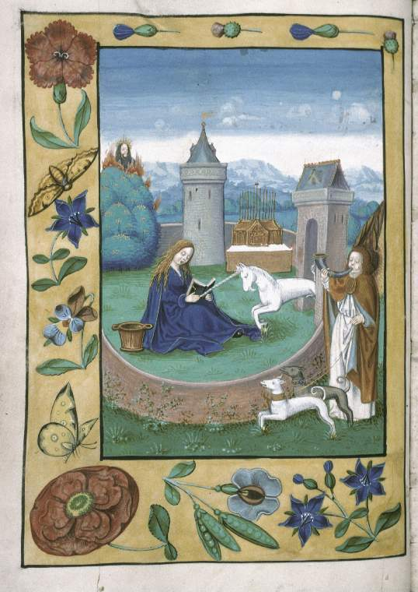
Chapter 2: The Rashness of the King
Setting:
--the King’s hunting lodge in spring, near Lantern Waste, in a wood
--the King at leisure, away from Cair Paravel, the royal city
--accompanied by his best friend, Jewel the Unicorn, and some servants
Unicorns
--The Physiologus,a Christian work of the 2nd century, was a catalog of beasts and fantastic creatures and their moral qualities. Here, unicorns are depicted as wild horned beasts who can only be captured in the lap of a pure virgin, and came to represent a type of the Incarnation, being symbols of grace and purity and thus depicted as a large white horse/stag. The Vulgate includes the word “unicorn,” a mistranslation of the word for wild ox. The phoenix, the pelican, and the unicorn all had deep spiritual symbolism that was expanded upon greatly in the Medieval period. The unicorn’s horn was believed to have magical powers, and hence the idea of hunting the unicorn became popular in legend and was soon associated with the Passion of Christ.

Slide 10
Woods and Trees in the Works of Lewis and Tolkien
Lewis and Tolkien both shared a deep reverence for Nature and especially for trees and forests. They both decried the despoiling of woodlands in the name of “Progress,” and both the Narnia stories and The Lord of the Rings books include many trees as anthropomorphized characters. The spoiling and corruption of Nature is a major theme in Lewis’s The Abolition of Man and That Hideous Strength as well as in Tolkien’s The Lord of the Rings, especially when the wizard Saruman’s turn to the Dark Power of Mordor is shown by his wholesale devastation of ancient forests and trees.
“Every tree has its enemy, few have an advocate. In all my works, I take the part of trees against their enemies.”—J.R.R. Tolkien letter, 1962
“We do not look at trees either as Dryads or as beautiful objects while we cut them into beams: the first man who did so may have felt the price keenly, and the bleeding trees in Virgil and Spenser may be far-off echoes of that primeval sense of impiety. The stars lost their divinity as astronomy developed, and the Dying God has no place in chemical agriculture. [...] From this point of view the conquest of Nature appears in a new light. We reduce things to mere Nature in order that we may 'conquer' them. We are always conquering Nature, because 'Nature' is the name for what we have, to some extent, conquered.”
― C.S. Lewis, The Abolition of Man

Slide 11
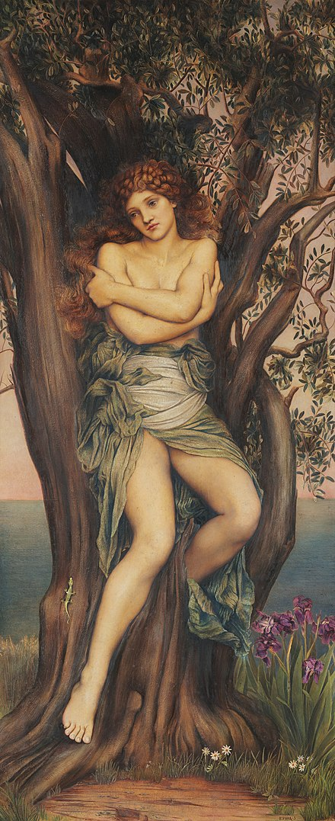
Dryads are tree spirits, nymphs who personify trees and may inhabit them. They are benign pagan beings, female, and sometimes referred to as “wood-women” in Narnia. In the Narnia books, Lewis describes both male and female tree spirits, but he only uses “dryad” to refer to female spirits. When the Telmarines arrive in Narnia, magical creatures are hunted down and the dryads retreat deep within their trees, to the point that it is only Aslan who has the ability to wake them. Dryads were an important part of Greek mythology, the name coming from the Greek word for “oak.” The dryads make their first appearance in The Lion, the Witch, and the Wardrobe on Mr. Tumnus’s bookshelf and play an important role in many of the Narnia stories as messengers associated with Aslan Himself.
Dryads were originally considered the nymphs of oak trees specifically, but the term has evolved towards tree nymphs in general. Often their life force was connected to the tree in which they resided and they were usually found in sacred groves of the gods. They were considered to be very shy creatures except around the goddess Artemis, who was known to be a friend to most nymphs. Dryads were supernaturally long-lived and tied to their homes, but some were a step beyond most nymphs. These were the hamadryads, who were an integral part of their trees, such that if the tree died, the hamadryad associated with it also died. For these reasons, dryads and the Greek gods punished any mortal who harmed trees. (Wikipedia)

Slide 12
Key Passages and Themes in Chapter Two
Tirian (from the Welsh, meaning gentle and kind) and Jewel open the chapter in the royal hunting lodge, where they are happily imagining that Aslan may finally have come to Narnia.
Hope for the Return of the King
"I cannot set myself to any work or sport to-day, Jewel," said the King. "I can think of nothing but this wonderful news. Think you we shall hear more of them to-day?" "They are the most wonderful tidings ever heard in our days or our father's or our grandfathers' days, Sire," said Jewel, "if they are true." "How can they choose but be true?" said the King. "It is more than a week ago that the first birds came flying over us saying, Aslan is here, Aslan has come to Narnia again. And after that it was the squirrels. They had not seen him, but they said it was certain he was in the woods. Then came the Stag. He said he had seen him with his own eyes, a great way off, by moonlight, in Lantern Waste. Then came that dark Man with the beard, the merchant from Calormen. The Calormenes care nothing for Aslan as we do; but the man spoke of it as a thing beyond doubt. And there was the Badger last night; he too had seen Aslan." "Indeed, Sire," answered Jewel, "I believe it all. If I seem not to, it is only that my joy is too great to let my belief settle itself. It is almost too beautiful to believe." "Yes," said the King with a great sigh, almost a shiver, of delight. "It is beyond all that I ever hoped for in all my life.”
“Be patient, therefore, brothers, until the coming of the Lord.” James 5:7 After this I looked, and behold, a great multitude that no one could number, from every nation, from all tribes and peoples and languages, standing before the throne and before the Lamb, clothed in white robes, with palm branches in their hands, and crying out with a loud voice, ‘Salvation belongs to our God who sits on the throne, and to the Lamb!’” Rev. 7:9-10

Slide 13
A Kingdom Characterized by Hospitality
A great, golden-bearded Centaur, with man's sweat on his forehead and horse's sweat on his chestnut flanks, dashed up to the King, stopped, and bowed low. "Hail, King," it cried in a voice as deep as a bull's. "Ho, there!" said the King, looking over his shoulder towards the door of the hunting lodge. "A bowl of wine for the noble Centaur. Welcome, Roonwit. When you have found your breath, you shall tell us your errand." A page came out of the house carrying a great wooden bowl, curiously carved, and handed it to the Centaur. The Centaur raised the bowl and said, "I drink first to Aslan and truth, Sire, and secondly to your Majesty." He finished the wine (enough for six strong men) at one draught and handed the empty bowl back to the page.
Share with the Lord’s people who are in need. Practice hospitality. Romans 12:13 Do not neglect to show hospitality to strangers, for thereby some have entertained angels unawares. Hebrews 13:2 And the Lord appeared to him by the oaks of Mamre, as he sat at the door of his tent in the heat of the day. He lifted up his eyes and looked, and behold, three men were standing in front of him. When he saw them, he ran from the tent door to meet them and bowed himself to the earth and said, “O Lord, if I have found favor in your sight, do not pass by your servant. Let a little water be brought, and wash your feet, and rest yourselves under the tree, while I bring a morsel of bread, that you may refresh yourselves, and after that you may pass on—since you have come to your servant.” So they said, “Do as you have said.” Genesis 18:1-8

Slide 14
Signs in the Heavens
"Sire," he said. "You know how long I have lived and studied the Clive Staples Lewis 10 stars; for we Centaurs live longer than you Men, and even longer than your kind, Unicorn. Never in all my days have I seen such terrible things written in the skies as there have been nightly since this year began. The stars say nothing of the coming of Aslan, nor of peace, nor of joy. I know by my art that there have not been such disastrous conjunctions of the planets for five hundred years. It was already in my mind to come and warn your Majesty that some great evil hangs over Narnia. But last night the rumour reached me that Aslan is abroad in Narnia. Sire, do not believe this tale. It cannot be. The stars never lie, but Men and Beasts do. If Aslan were really coming to Narnia, the sky would have foretold it. If he were really come, all the most gracious stars would be assembled in his honour. It is all a lie. “
There will be signs in the sun, moon, and stars. On the earth, nations will be in anguish and perplexity at the roaring and tossing of the sea. Men will faint from terror, apprehensive of what is coming on the world, for the heavenly bodies will be shaken.”” Luke 21:25-26 And then the sign of the Son of Man will appear in the sky, and then all the tribes of the earth will mourn, and they will see the Son of Man coming on the clouds of the sky with power and great glory. Matthew 24:30 Now after Jesus was born in Bethlehem of Judea in the days of Herod the king, behold, wise men from the east came to Jerusalem, saying, “Where is he who has been born king of the Jews? For we saw his star in the east and have come to worship him.” Matthew 2:1-2

Slide 15
Lies and the Sacred and Discerning Truth
"A lie!" said the King fiercely. "What creature in Narnia or all the world would dare to lie on such a matter?" And, without knowing it, he laid his hand on his sword hilt. "That I know not, Lord King," said the Centaur. "But I know there are liars on earth; there are none among the stars." "I wonder," said Jewel, "whether Aslan might not come though all the stars foretold otherwise. He is not the slave of the stars but their Maker. Is it not said in all the old stories that He is not a Tame Lion?" "Well said, well said, Jewel," cried the King. "Those are the very words: not a tame lion. It comes in many tales.”
Jesus answered: “Watch out that no one deceives you. For many will come in my name, claiming, 'I am the Messiah,' and will deceive many. Matthew 24:4-5 Beloved, do not believe every spirit, but test the spirits to see whether they are from God, for many false prophets have gone out. I John 4:1 Then Peter said, “Ananias, how is it that Satan has so filled your heart that you have lied to the Holy Spirit and have kept for yourself some of the money you received for the land?Acts 5:3 Lying lips are an abomination to the Lord, but those who act faithfully are his delight. Proverbs 12:22
“Mark you this, Bassanio, The devil can cite Scripture for his purpose.”
--Shakespeare’s The Merchant of Venice, referring to the temptation of Christ (Matthew 4)

Slide 16
The Holiness of Nature and of Life
"Woe, woe, woe!" called the voice. "Woe for my brothers and sisters! Woe for the holy trees! The woods are laid waste. The axe is loosed against us. We are being felled. Great trees are falling, falling, falling." With the last "falling," the speaker came in sight. She was like a woman but so tall that her head was on a level with the Centaur's: yet she was like a tree too. It is hard to explain if you have never seen a Dryad but quite unmistakable once you have — something different in the colour, the voice, and the hair. King Tirian and the two Beasts knew at once that she was the nymph of a beech-tree. "Justice, Lord King!" she cried. "Come to our aid. Protect your people. They are felling us in Lantern Waste. Forty great trunks of brothers and sisters are already on the ground." "What, Lady! Felling Lantern Waste? Murdering the talking trees?" cried the King leaping to his feet and drawing his sword. "How dare they? And who dares it? Now by the Mane of Aslan — " "A-a-a-h," gasped the Dryad shuddering as if in pain — shuddering time after time as if under repeated blows Then all at once she fell sideways as suddenly as if both her feet had been cut from under her. For a second they saw her lying dead on the grass and then she vanished. They knew what had happened. Her tree, miles away, had been cut down. For a moment the King's grief and anger were so great that he could not speak.
The LORD God then took the man and settled him in the garden of Eden, to cultivate and care for it. Genesis 2:15 For you shall go out in joy and be led forth in peace; the mountains and the hills before you shall break forth into singing, and all the trees of the field shall clap their hands. Is. 55:12 I brought you into a fertile land to eat its fruit and rich produce. But you came and defiled my land and made my inheritance detestable. Jeremiah 2:7But the land you are crossing the Jordan to take possession of is a land of mountains and valleys that drinks rain from heaven. It is a land the LORD your God cares for; the eyes of the LORD your God are continually on it from the beginning of the year to its end. Deut. 11:11-12

Slide 17
The Danger of Hasty Outrage
"Come, friends. We must go up river and find the villains who have done this, with all the speed we can. I will leave not one of them alive." "Sire, with a good will," said Jewel. But Roonwit said, "Sire, be wary even in your just wrath. There are strange doings on foot. If there should be rebels in arms further up the valley, we three are too few to meet them. If it would please you to wait while — " "I will not wait the tenth part of a second," said the King. "But while Jewel and I go forward, do you gallop as hard as you may to Cair Paravel. Here is my ring for your token. Get me a score of men-at-arms, all well-mounted, and a score of Talking Dogs, and ten Dwarfs (let them all be fell archers), and a Leopard or so, and Stonefoot the Giant. Bring all these after us as quickly as can be."
"With a good will, Sire," said Roonwit. And at once he turned and galloped Eastward down the valley.
Let every person be quick to hear, slow to speak, slow to anger; for the anger of man does not produce the righteousness of God. James 1:19-20 Whoever is slow to anger is better than the mighty, and he who rules his spirit than he who takes a city. Proverbs 16:32

Slide 18
Sacrificing Nature for Money
The King said "What have we here" and Jewel said "Look!" "It is a raft," said King Tirian. And so it was. Half a dozen splendid tree trunks, all newly cut and newly lopped of their branches, had been lashed together to make a raft, and were gliding swiftly down the River. On the front of the raft there was a water rat with a pole to steer it. "Hey! Water Rat! What are you about?" cried the King. "Taking logs down to sell to the Calormenes, Sire," said the Rat, touching his ear as he might have touched his cap if he had had one. "Calormenes!" thundered Tirian. "What do you mean? Who gave order for these trees to be felled?" The River flows so swiftly at that time of the year that the raft had already glided past the King and Jewel. But the Water Rat looked back over its shoulders and shouted: "The Lion's orders, Sire. Aslan himself." He added something more but they couldn't hear it.
But those who desire to be rich fall into temptation, into a snare, into many senseless and harmful desires that plunge people into ruin and destruction. For the love of money is a root of all kinds of evils. I Timothy 6:9-10 Behold, their heroes cry in the streets; the envoys of peace weep bitterly. The highways lie waste; the traveler ceases. Covenants are broken; cities are despised; there is no regard for man. The land mourns and languishes; Lebanon is confounded and withers away; Sharon is like a desert, and Bashan and Carmel shake off their leaves. Isaiah 33:7-9

Slide 19
Can Aslan Do Evil? Doubting the Goodness of God
The King and the Unicorn stared at one another and both looked more frightened than they had ever been in any battle. "Aslan," said the King at last, in a very low voice. "Aslan. Could it be true? Could he be felling the holy trees and murdering the Dryads?" "Unless the Dryads have all done something dreadfully wrong — " murmured Jewel. "But selling them to Calormenes!" said the King. "Is it possible?" "I don't know," said Jewel miserably. "He's not a tame Lion." "Well," said the King at last, "we must go on and take the adventure that comes to us." "It is the only thing left for us to do, Sire," said the Unicorn. He did not see at the moment how foolish it was for two of them to go alone; nor did the King. They were too angry to think clearly. But much evil came of their rashness in the end. Suddenly the King leaned hard on his friend's neck and bowed his head. "Jewel," he said, "What lies before us? Horrible thoughts arise in my heart. If we had died before to-day we should have been happy." "Yes," said Jewel. "We have lived too long. The worst thing in the world has come upon us." They stood like that for a minute or two and then went on.
God cannot be tempted by evil, and He Himself does not tempt anyone James 1:13 Let no one deceive you in any way. For that day will not come, unless the rebellion comes first, and the man of lawlessness is revealed, the son of destruction, who opposes and exalts himself against every so-called god or object of worship, so that he takes his seat in the temple of God, proclaiming himself to be God 2 Thessalonians 2:3-4

Slide 20
Destruction of Beauty
When they had reached the top of it they could see right into Lantern Waste itself. And the King's face turned white when he saw it. Right through the middle of that ancient forest — that forest where the trees of gold and of silver had once grown and where a child from our world had once planted the Tree of Protection — a broad lane had already been opened. It was a hideous lane like a raw gash in the land, full of muddy ruts where felled trees had been dragged down to the river. There was a great crowd of people at work, and a cracking of whips, and horses tugging and straining as they dragged at the logs. The first thing that struck the King and the Unicorn was that about half the people in the crowd were not Talking Beasts but Men. The next thing was that these men were not the fair-haired men of Narnia: they were dark, bearded men from Calormen, that great and cruel country that lies beyond Archenland across the desert to the south. There was no reason…why one should not meet a Calormene or two in Narnia…for there was peace between Narnia and Calormen in those days. But Tirian could not understand why there are so many of them: nor why they were cutting down a Narnian forest.
But ask the animals, and they will teach you, or the birds in the sky, and they will tell you; or speak to the earth, and it will teach you, or let the fish in the sea inform you. Which of all these does not know that the hand of the LORD has done this? In his hand is the life of every creature and the breath of all mankind Job 12:7-10 The earth dries up and withers, the world languishes and withers, the heavens languish with the earth. The earth is defiled by its people; they have disobeyed the laws, violated the statutes and broken the everlasting covenant. Therefore a curse consumes the earth; its people must bear their guilt. Isaiah 24:4-6.

Slide 21
Slavery, Abuse, and Vengeance
Two Calormenes were driving a horse which was harnessed to a log. Just as the King reached them, the log got stuck in a bad muddy place. "Get on, son of sloth! Pull, you lazy pig!" cried the Calormenes, cracking their whips. The horse was already straining himself as hard as he could; his eyes were red and he was covered with foam.Clive Staples Lewis 14 "Work, lazy brute," shouted one of the Calormenes: and as he spoke he struck the horse savagely with his whip. It was then that the really dreadful thing happened. Up till now Tirian had taken it for granted that the horses which the Calormenes were driving were their own horses; dumb, witless animals like the horses of our own world. And though he hated to see even a dumb horse overdriven, he was of course thinking more about the murder of the Trees. It had never crossed his mind that anyone would dare to harness one of the free Talking Horses of Narnia, much less to use a whip on it. But as that savage blow fell the horse reared up and said, half screaming: "Fool and tyrant! Do you not see I am doing all I can?" When Tirian knew that the Horse was one of his own Narnians, there came over him and over Jewel such a rage that they did not know what they were doing. The King's sword went up, the Unicorn's horn went down. They rushed forward together. Next moment both the Calormenes lay dead, the one beheaded by Tirian's sword and the other gored through the heart by Jewel's horn
Masters, treat your bondservants justly and fairly, knowing that you also have a Master in heaven. Col. 4:1 “You shall not oppress a hired worker who is poor and needy, whether he is one of your brothers or one of the sojourners who are in your land Deut. 24:14 Beloved, never avenge yourselves, but leave it to the wrath of God, for it is written, “Vengeance is mine, I will repay, says the Lord.” To the contrary, “if your enemy is hungry, feed him; if he is thirsty, give him something to drink; for by so doing you will heap burning coals on his head.” Do not be overcome by evil, but overcome evil with good. Romans 12:19-21

Slide 22
The Song of the Tree of Life
Unto them that overcometh shall be given of the tree of life, which is in the midst of the paradise of God.
On either side of the river groweth the tree of life, the leaves of the tree are for thy healing.
In the midst of that fair city flows the river of water of life clear as crystal.
Whoso will, let them take of the water of life freely.
Whoso drinketh of this water shall never thirst.
Take thou the leaves of the tree of life.
So shalt thou enter in through the gates of the city.
--Ralph Vaughan Williams
(Adapted from Revelation 22 and Pilgrim’s Progress)

