Slide 1
C.S. Lewis’s The Last Battle Book VII of The Chronicles of Narnia
September 13, 2023
St. Philip’s Church
The Rev’d Brian K. McGreevy, J.D., Facilitator

Slide 2
It is for freedom that Christ has set us free. Stand firm, therefore, and do not submit again to a yoke of slavery. For you were called to freedom, brothers. Only do not use your freedom as an opportunity for the flesh, but through love serve one another. For the whole law is fulfilled in one word: “You shall love your neighbor as yourself.” --Galatians 3: 1, 13-14

Slide 3
How to approach this class: --On the beach --Snorkeling --Scuba diving --Email list How to read this book: --Try reading aloud and slowly, looking for layers of meaning --Fine to read ahead

Slide 4
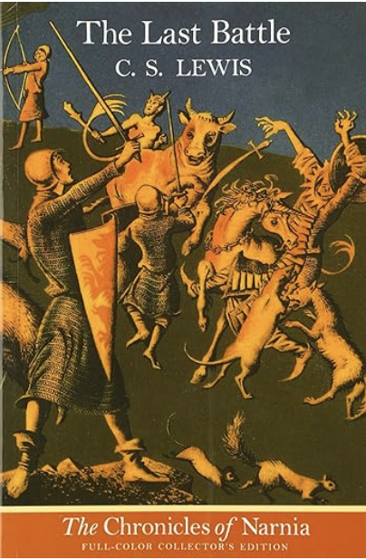
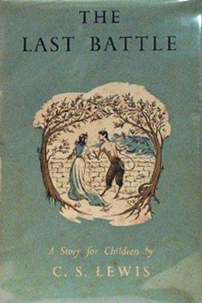
The Last Battle
Book VII in
The Chronicles of Narnia
Completed in 1953 but first published in 1956, with illustrations by Pauline Baynes
Is it a marvelous capstone work that draws all the children’s Narnia stories to a fitting close?
Or is it a profound reflection on the sin of Eden, the means of Grace, and the Glory of Heaven?
Or is it a parable about following Jesus that is particularly applicable to 21st century America and the importance of Word and Truth?

Slide 5
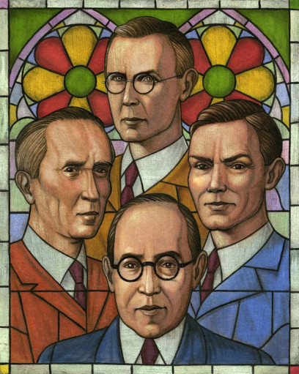
Context: Lewis and the Inklings and the Power of Story Finally, brothers, whatever is true, whatever is honorable, whatever is just, whatever is pure, whatever is lovely, whatever is commendable, if there is any excellence, if there is anything worthy of praise, think about these things. What you have learned and received and heard and seen in me—practice these things, and the God of peace will be with you. (Philippians 4:8-9) A group that gathered around C.S. Lewis and J.R.R. Tolkien beginning in the 1930s and lasting for several decades, defined by Lewis as “…an informal club, whose qualifications are a tendency to write, and Christianity.” Building upon a deep Christian faith and a recovery of the transcendentals of Truth, Goodness, and Beauty, the Inklings were unafraid to boldly engage the culture and mounted a counter-cultural offensive about how to live and think Christianly in a post-Christian world. They were deeply invested in recovering a Biblical understanding of fellowship and the power of community. According to scholar Bruce Edwards, “'Romance’ was Lewis’s catch-all term for the genre most congenial to the science fiction and fairy tale genre he and J. R. R. Tolkien hoped to reinvent for a 20th Century audience—an audience they felt was too easily subverted by rampant literary naturalism and modern scientism. For Lewis, as for Tolkien, such stories of derring-do, daunting quests, vistas populated by fantastic yet credible characters accomplished what mere philosophical argument could not. Their narratives proffered central themes that simultaneously uplifted the spirit while challenging the conventional wisdom, our “disenchantment,” of the present age, pushing readers toward the true reality now made visible.” In a letter to his friend Sister Penelope in 1939, Lewis said “Any amount of theology can now be smuggled into people’s minds under cover of romance without their knowing it.”

Slide 6
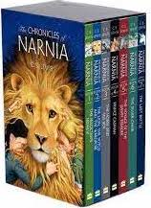
The Chronicles of Narnia Written in a very brief period of time after World War II The Lion, the Witch and the Wardrobe (1950) Prince Caspian (1951) The Voyage of the Dawn Treader (1952) The Silver Chair (1953) The Horse and His Boy (1954) The Magician's Nephew (1955) The Last Battle (1956) “The Last Battle” was awarded the Carnegie Award, the highest award for children’s literature Enduring popularity--over 100 million copies sold in 47 languages Waterstones survey—best English children’s story of all time is The Lion, the Witch, and the Wardrobe In 2018, Netflix paid over $250 million for the rights to develop more Narnia films The 2023 May Ball at Magdalen

Slide 7
Origins of Narnia 1907—Lewis writes to his brother Warnie that he is writing “A History of Mouse-land,” which is eventually combined with Warnie’s love of India to form the imaginary realm of Boxen, whose main characters are dressed and talking animals. Lewis developed a history of Boxen and a political structure for it in his early teens. 1914—The image of a Faun carrying an umbrella and parcels in a snowy wood came to Lewis’s imagination, and he made a sketch of it which continued to reappear in his memory over the next decades 1939—On September 2, the day before Britain declares war on Germany, four evacuee children arrived at Lewis’s home, the Kilns, the first of various groups of children Lewis will house continually through the war up through 1945. Around this time, Lewis begins a story, later set aside, about four evacuee children from London sent to stay with an old professor. Surprised to find how few imaginative stories his young guests seemed to know, he decided to write one for them and scribbled down the opening sentences of a story about four children—then named Ann, Martin, Rose and Peter—who were sent away from London because of the air raids, and went to stay with a very old professor who lived by himself in the country.

Slide 8
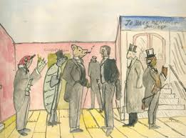
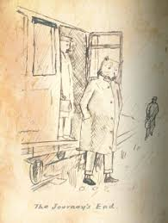
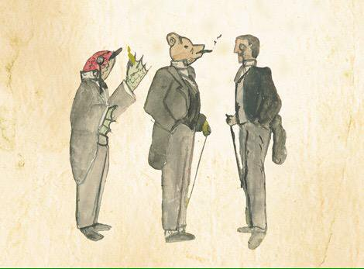
Some illustrations for Boxen drawn by Lewis around age 10

Slide 9
1948—Lewis begins to work seriously on the Narnia books, following his publication of Miracles and his famous debate about it with Elizabeth Anscombe at the Oxford Socratic Club. “All my seven Narnian books began with seeing pictures in my head. The Lion, the Witch, and the Wardrobe began with a picture of a Faun carrying an umbrella and parcels in a snowy wood. This picture had been in my mind since I was about sixteen. Then one day, when I was about forty, I said to myself: ‘Let's try to make a story about it.’ At first I had very little idea how the story would go. But then suddenly Aslan came bounding into it. I think I had been having a good many dreams of lions about that time. Once He was there He pulled the whole story together.”—Radio Times interview, 1960 1954--“I did not say to myself ‘Let us represent Jesus as He really is in our world by a Lion in Narnia’: I said ‘Let us suppose that there were a land like Narnia and that the Son of God, as He became a Man in our world, became a Lion there, and then imagine what would happen.” --letter to a fifth grade class in Maryland Lewis was passionate in his views about children’s stories: “A children's story that can only be enjoyed by children is not a good children's story in the slightest.” “No book is really worth reading at the age of ten which is not equally – and often far more – worth reading at the age of fifty and beyond.”

Slide 10
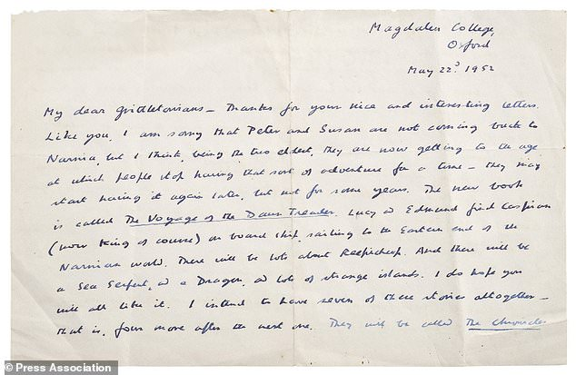
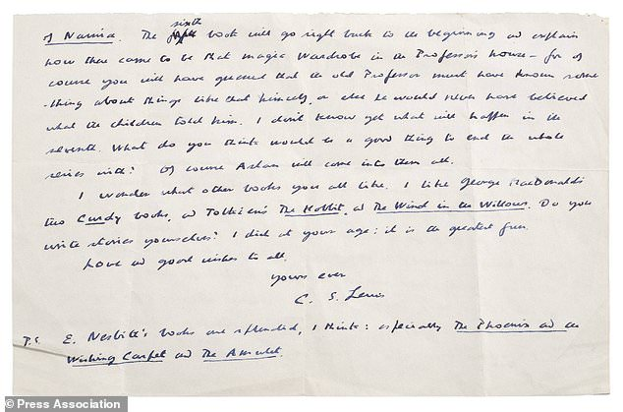
Lewis wrote a letter to some schoolchildren at Grittleton House School in Wiltshire, dated May 22, 1952, where he indicates he has already sketched out the framework for all seven of The Chronicles of Narnia, and other letters show he had finished the first draft of The Last Battle in the spring of 1953.
(--A Pilgrim in Narnia, Prof. Brenton Dickieson)

Slide 11
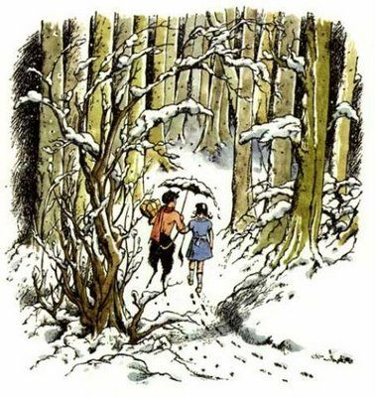
Perhaps the most iconic of the Narnia illustrations by the gifted illustrator Pauline Baynes “C.S. Lewis told me that he had actually gone into a bookshop and asked the assistant there if she could recommend someone who could draw children and animals. I don’t know whether he was just being kind to me and making me feel that I was more important than I was, or whether he’d simply heard about me from his friend Tolkien. Lewis was the most kindly and tolerant of authors—who seemed happy to leave everything in my completely inexperienced hands. Once or twice I queried the sort of character he had in mind, as with Puddleglum, and then he replied, but otherwise he made no remarks or criticisms. I had rather the feeling that, having got the story written down and out of his mind, that the rest was someone else’s job and he wouldn’t interfere.” Letter from Pauline Baynes to Walter Hooper, August 15, 1967

Slide 12
Main Characters from earlier stories who appear in The Last Battle: Background of Aslan, Tirian, Eustace, Jill Aslan: from the Turkish word for “lion,” he is introduced in the first book as the Great Lion, the Son of the Emperor-beyond-the-Sea. He is the Great Lion, the Christ figure for Narnia, and he is the Creator of Narnia, who sings it into being in The Magician’s Nephew. Aslan dies on the Stone Table in The Lion, the Witch, and the Wardrobe, but is resurrected by the Deep Magic. “At the name of Aslan each one of the children felt something jump in his inside. Edmund felt a sensation of mysterious horror. Peter felt suddenly brave and adventurous. Susan felt as if some delicious smell or some delightful strain of music had just floated by her. And Lucy got the feeling you have when you wake up in the morning and realise that it is the beginning of the holidays. ‘Aslan is a lion- the Lion, the great Lion.’ ‘Ooh’ said Susan. ‘I'd thought he was a man. Is he-quite safe? I shall feel rather nervous about meeting a lion’... ‘Safe?’ said Mr Beaver ... ‘Who said anything about safe? 'Course he isn't safe. But he's good. He's the King, I tell you.’” Tirian: Tirian is a young man in his 20s and the rightful King of Narnia, being the seventh king descended from King Rilian, who was the son of King Caspian X. He has never seen Aslan “in the flesh” but believes in him wholeheartedly, as well as in all the stories of the Old Narnia which he was told as a child.

Slide 13
Main Characters: Background of Aslan, Tirian, Eustace, Jill, Eustace Scrubb Eustace is one of the principal characters in The Voyage of the Dawn Treader and is the odious cousin of the Pevensie children. In the Oxford English Dictionary, the third definition of “scrub” is as follows: “an insignificant or contemptible person, or a player not among the best or most skilled.” Eustace is introduced as follows: “There was a boy called Eustace Clarence Scrubb, and he almost deserved it. His parents called him Eustace Clarence and masters called him “Scrubb”. I can't tell you how his friends spoke to him, for he had none. He didn't call his father and mother ‘Father’ and ‘Mother’, but ‘Harold’ and ‘Alberta’. They were very up-to-date and advanced people. They were vegetarians, non-smokers, and teetotalers and wore a special kind of underclothes. And in their house there was very little furniture and very few clothes on beds and the windows were always open.” --Eustace the Dragon and encountering Aslan ---“Back in our own world, everyone started saying how Eustace had improved and how ‘You’d never know him for the same boy; everyone except Aunt Alberta, who said he had become very commonplace and tiresome and it must have been the influence of those Pevensie children.” --Eustace becomes the hero of The Silver Chair, along with Jill Pole, another student at Experiment House

Slide 14
Main Characters: Background of Aslan, Tirian, Eustace, Jill, Jill Pole We first meet Jill Pole in the opening scene of The Silver Chair. She is an unpopular middle school girl who is hiding away from bullies at school and crying behind the gym. She is alone at first, desperate, sad, and hopeless. “Jill looked round and saw the dull autumn sky and heard the drip off the leaves and thought of all the hopelessness of Experiment House (it was a thirteen-week term and there were still eleven weeks to come).” The bullies are referred to, ominously, as “Them”, and the expectation at the school seems to be that one ought to spend all one’s time “…sucking up to “Them” and currying favor and dancing attendance upon “Them.” Jill and Eustace, who refer to each other only by their last names (Pole and Scrubb), become allies through their fear of “Them”, literally shuddering with fear at the thought of how “They” will torture them if caught. YET these frightened outcasts go on to be the Heroes of The Silver Chair and used by Aslan to accomplish a vital quest.

Slide 15
Themes in The Last Battle The importance of Faith The nature of Evil The danger of Theological innovation The essentiality of Truth and the danger of deceit The power of language and the gift of speech Loyalty The danger of cynicism Worldly power and politics and the danger of corrupt leaders The Reality of Heaven and the JOY of eternal life Linkages with The Great Divorce and That Hideous Strength

Slide 16
A tidbit of what we have to look forward to: “It is as hard to explain how this sunlit land was different from the old Narnia as it would be to tell you how the fruits of that country taste. Perhaps you will get some idea of it if you think like this. You may have been in a room in which there was a window that looked out on a lovely bay of the sea or a green valley that wound away among mountains. And in the wall of that room opposite to the window there may have been a looking-glass. And as you turned away from the window you suddenly caught sight of that sea or that valley, all over again, in the looking glass. And the sea in the mirror, or the valley in the mirror, were in one sense just the same as the real ones: yet at the same time there were somehow different — deeper, more wonderful, more like places in a story: in a story you have never heard but very much want to know. The difference between the old Narnia and the new Narnia was like that. The new one was a deeper country: every rock and flower and blade of grass looked as if it meant more. I can’t describe it any better than that: if ever you get there you will know what I mean. It was the Unicorn who summed up what everyone was feeling. He stamped his right fore-hoof on the ground and neighed, and then he cried: “I have come home at last! This is my real country! I belong here. This is the land I have been looking for all my life, though I never knew it till now. The reason why we loved the old Narnia is that is sometimes looked a little like this. Bree-hee-hee! Come further up, come further in!” C.S. Lewis, The Last Battle Chapter 15

