Slide 1

Dec, April 19, 2023
St. Philip’s Church
The Rev’d Brian K. McGreevy, J.D., Facilitator
The Great Divorce:
C.S. Lewis on God’s Truth
or Your Truth

Slide 2
In the presence of God and of Christ Jesus, who will judge the living and the dead, and in view of his appearing and his kingdom, I give you this charge: Preach the word; be prepared in season and out of season; correct, rebuke and encourage—with great patience and careful instruction.
For the time will come when people will not put up with sound doctrine. Instead, to suit their own desires, they will gather around them a great number of teachers to say what their itching ears want to hear. They will turn their ears away from the truth and turn aside to myths. But you, keep your head in all situations, endure hardship, do the work of an evangelist, discharge all the duties of your ministry.
(2 Timothy 4:1-4)

Slide 3
How to approach this class:
--On the beach
--Snorkeling
--Scuba diving
--Email list
How to read this book:
--Try reading aloud
--One chapter at a time

Slide 4
THEMES IN CHAPTER 11, PART 3
The Creation rejoices
“The whole plain and forest were shaking with a sound which in our world would be too large to hear, but there I could take it with joy. I knew it was not the Solid People who were singing. It was the voice of that earth, those woods and those waters. A strange archaic, inorganic noise, that came from all directions at once.”
Just so, I tell you, there will be more joy in heaven over one sinner who repents than over ninety-nine righteous persons who need no repentance. (Lk. 15:7) For the creation waits with eager longing for the revealing of the sons of God. For the creation was subjected to futility, not willingly, but because of him who subjected it, in hope that the creation itself will be set free from its bondage to corruption and obtain the freedom of the glory of the children of God. (Rom. 8:19-21) “For you shall go out in joy and be led forth in peace; the mountains and the hills before you shall break forth into singing, and all the trees of the field shall clap their hands. (Is. 55:12)

Slide 5
MUSIC AND REJOICING IN THE CREATION
Job: “Where were you when I laid the foundation of the earth? Tell me, if you have understanding. Who determined its measurements—surely you know! Or who stretched the line upon it? On what were its bases sunk, or who laid its cornerstone, when the morning stars sang together and all the sons of God shouted for joy?
Habakkuk: God came from Teman, and the Holy One from Mount Paran. His splendor covered the heavens, and the earth was full of his praise. His brightness was like the light; rays flashed from his hand; and there he veiled his power.
Psalm 96: Let the heavens be glad, and let the earth rejoice; let the sea roar, and all that fills it; let the field exult, and everything in it! Then shall all the trees of the forest sing for joy before the Lord, for he comes, for he comes to judge the earth.
Dante: The earth shaking and the singing of a psalm of praise at the release of soul is reminiscent of the earthquake that greats the release of the soul of Statius in Canto XX of Dante’s Purgatorio and the singing that accompanies each advance up Purgatory’s cornices.

Slide 6
And in Narnia—the Creation narrative in The Magician’s Nephew
“Hush!’ said the Cabby. They all listened.
In the darkness something was happening at last. A voice had begun to sing. It was very far away and Digory found it hard to decide from what direction it was coming. Sometimes it seemed to come from all directions at once. Sometimes he almost thought it was coming out of the earth beneath them. Its lower notes were deep enough to be the voice of the earth herself. There were no words. There was hardly even a tune. But it was, beyond comparison, the most beautiful noise he had ever heard. It was so beautiful he could hardly bear it…‘Gawd!’ said the Cabby. ‘Ain’t it lovely?’

Slide 7
Obedient Fire
“The Nature or Arch-nature of that land rejoiced to have been once more ridden, and therefore consummated, in the person of the horse. It sang, "The Master says to our master, Come up. Share my rest and splendour till all natures that were your enemies become slaves to dance before you; …obedient fire in your blood and heavenly thunder in your voice. "Overcome us that, so overcome, we may be ourselves: we desire the beginning of your reign as we desire dawn and dew, wetness at the birth of light.
Delight yourself in the Lord, and he will give you the desires of your heart. Commit your way to the Lord; trust in him, and he will act. (Ps. 37:4-5) Do not be conformed to this world, but be transformed by the renewal of your mind, that by testing you may discern what is the will of God, what is good and acceptable and perfect. (Rom. 12:2) Whoever does not take his cross and follow me is not worthy of me. Whoever finds his life will lose it, and whoever loses his life for my sake will find it. (Mt. 10:38-39) How much more, then, will the blood of Christ, who through the eternal Spirit offered himself unblemished to God, cleanse our consciences from acts that lead to death, so that we may serve the living God! (Heb. 9:14)

Slide 8
Being raised to Heaven first requires Death
“But does it mean that everything that is in us can go on to the Mountains?" "Nothing, not even the best and noblest, can go on as it now is. Nothing, not even what is lowest and most bestial, will not be raised again if it submits to death.”
If then you have been raised with Christ, seek the things that are above, where Christ is, seated at the right hand of God. Set your minds on things that are above, not on things that are on earth. For you have died, and your life is hidden with Christ in God. When Christ who is your life appears, then you also will appear with him in glory. Put to death therefore what is earthly in you: sexual immorality, impurity, passion, evil desire, and covetousness, which is idolatry. On account of these the wrath of God is coming. In these you too once walked, when you were living in them. (Col. 3:1-7)

Slide 9
The Glory of Risen Love
“Ye must ask, if the risen body even of appetite is as grand a horse as ye saw, what would the risen body of maternal love or friendship be?”
This is how we know what love is: Jesus Christ laid down his life for us. (I Jn. 3:16) This is love for God: to obey his commands. And his commands are not burdensome. (I Jn. 5:3) No eye has seen, no ear has heard, no heart has imagined, what God has prepared for those who love Him. (I Cor. 2:9) He will wipe away every tear from their eyes, and death shall be no more, neither shall there be mourning, nor crying, nor pain anymore, for the former things have passed away. (Rev. 21:4)

Slide 10
KEY PASSAGES IN CHAPTER 12, PART 1
Honor and Glory in Heaven
“The reason why I asked if there were another river was this. All down one long aisle of the forest the under-sides of the leafy branches had begun to tremble with dancing light; and on earth I knew nothing so likely to produce this appearance as the reflected lights cast upward by moving water. A few moments later I realised my mistake. Some kind of procession was approaching us, and the light came from the persons who composed it. First came bright Spirits, not the Spirits of men, who danced and scattered flowers-soundlessly falling, lightly drifting flowers, though by the standards of the ghost-world each petal would have weighed a hundred-weight and their fall would have been like the crashing of boulders. Then, on the left and right, at each side of the forest avenue, came youthful shapes, boys upon one hand, and girls upon the other. If I could remember their singing and write down the notes, no man who read that score would ever grow sick or old. Between them went musicians: and after these a lady in whose honour all this was being done.”

Slide 11
The spiritual body
“I cannot now remember whether she was naked or clothed. If she were naked, then it must have been the almost visible penumbra of her courtesy and joy which produces in my memory the illusion of a great and shining train that followed her across the happy grass. If she were clothed, then the illusion of nakedness is doubtless due to the clarity with which her inmost spirit shone through the clothes. For clothes in that country are not a disguise: the spiritual body lives along each thread and turns them into living organs. A robe or a crown is there as much one of the wearer's features as a lip or an eye. But I have forgotten. And only partly do I remember the unbearable beauty of her face.”
Earthly fame v. heavenly fame
"Is it? ... is it?" I whispered to my guide. "Not at all," said he. "It's someone ye'll never have heard of. Her name on earth was Sarah Smith and she lived at Golders Green." "She seems to be ... well, a person of particular importance?" "Aye. She is one of the great ones. Ye have heard that fame in this country and fame on Earth are two quite different things."

Slide 12
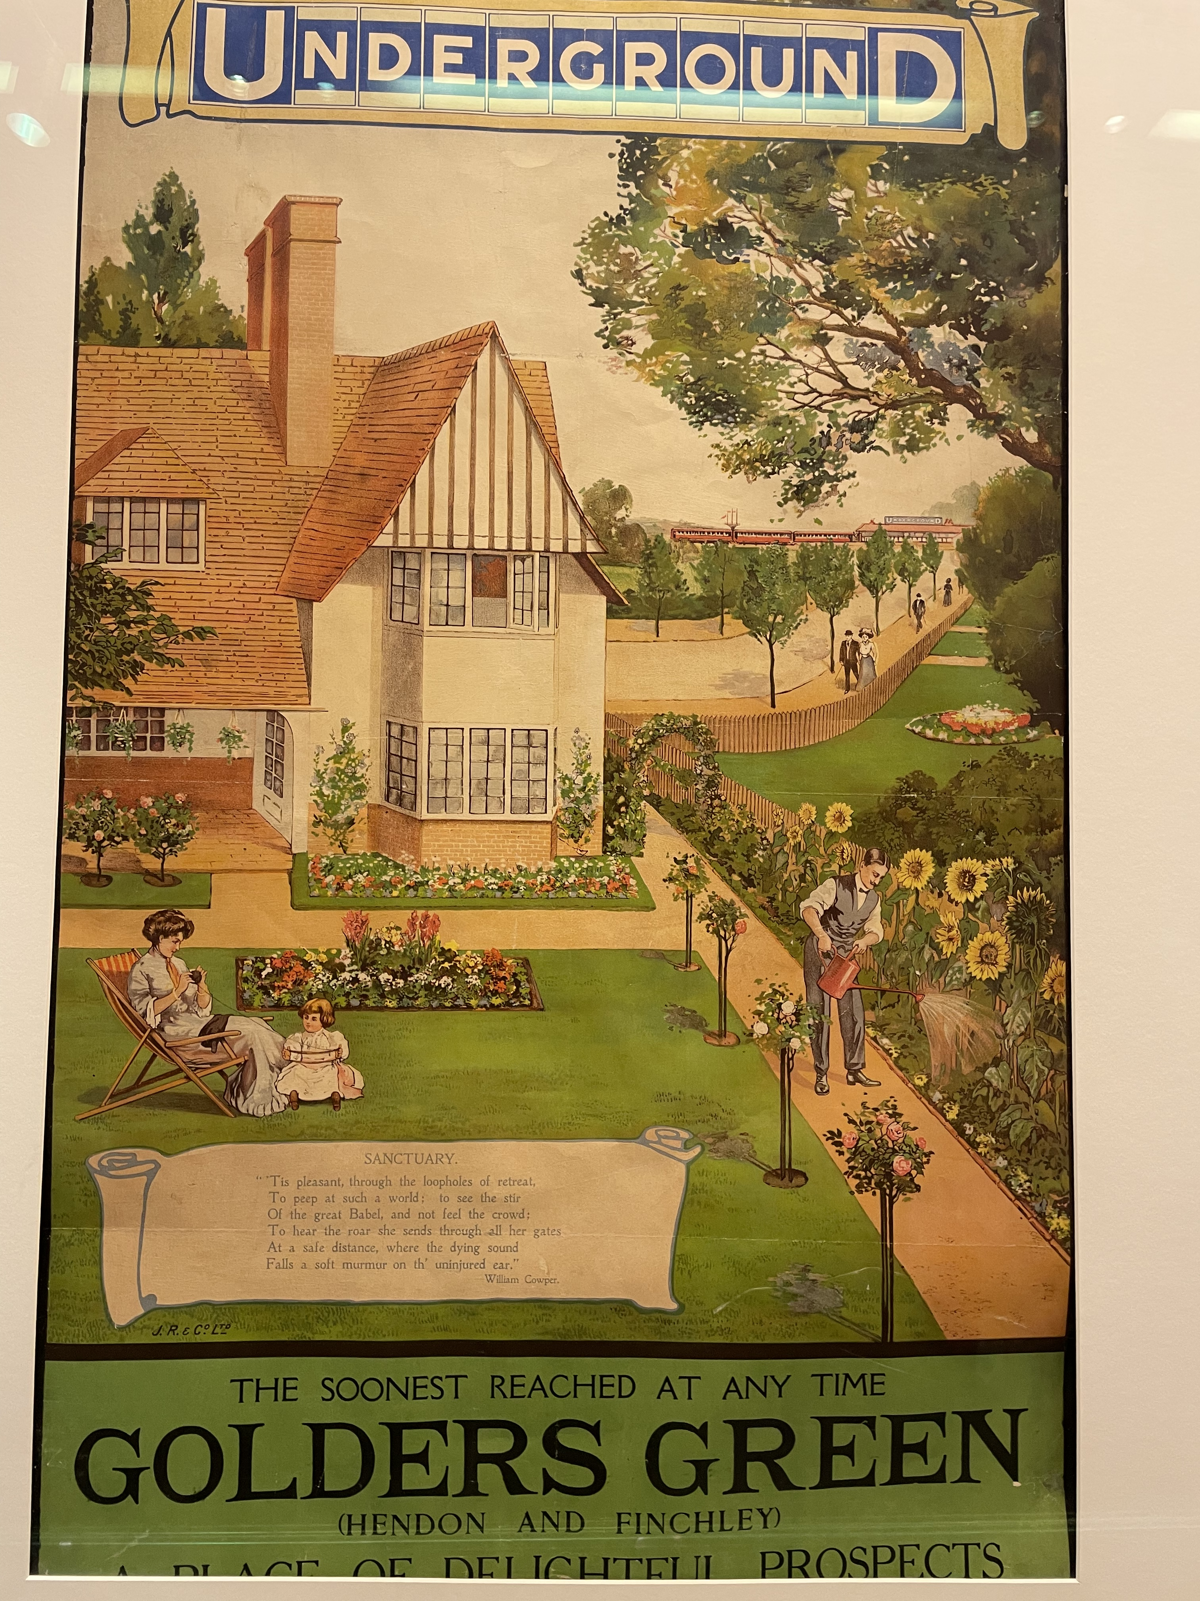

Slide 13
Angels
"And who are these gigantic people: look! They're like emeralds ,who are dancing and throwing flowers before her?" "Haven't ye read your Milton? A thousand livened angels lackey her…"
Relationships and Love in Heaven
"And who are all these young men and women on each side?" "They are her sons and daughters." "She must have had a very large family, Sir." "Every young man or boy that met her became her son--even if it was only the boy that brought the meat to her back door. Every girl that met her was her daughter…Every beast and bird that came near her had its place in her love. In her they became themselves. And now the abundance of life she has in Christ from the Father flows over into them.”
Redeemed humanity, Joy, and Life
“I looked at my Teacher in amazement. "Yes," he said. "It is like when you throw a stone into a pool, and the concentric waves spread out further and further. Who knows where it will end? Redeemed humanity is still young, it has hardly come to its full strength. But already there is joy enough in the little finger of a great saint such as yonder lady to waken all the dead things of the universe into life."

Slide 14
KEY PASSAGES IN CHAPTER 12
1. Honor and Glory in Heaven
“The reason why I asked if there were another river was this. All down one long aisle of the forest the under-sides of the leafy branches had begun to tremble with dancing light; and on earth I knew nothing so likely to produce this appearance as the reflected lights cast upward by moving water. A few moments later I realised my mistake. Some kind of procession was approaching us, and the light came from the persons who composed it. First came bright Spirits, not the Spirits of men, who danced and scattered flowers-soundlessly falling, lightly drifting flowers, though by the standards of the ghost-world each petal would have weighed a hundred-weight and their fall would have been like the crashing of boulders. Then, on the left and right, at each side of the forest avenue, came youthful shapes, boys upon one hand, and girls upon the other. If I could remember their singing and write down the notes, no man who read that score would ever grow sick or old. Between them went musicians: and after these a lady in whose honour all this was being done.”
So we do not lose heart. Though our outer self is wasting away, our inner self is being renewed day by day. For this light momentary affliction is preparing for us an eternal weight of glory beyond all comparison, as we look not to the things that are seen but to the things that are unseen. For the things that are seen are transient, but the things that are unseen are eternal. (2 Cor. 4:16-18)

Slide 15
2. The spiritual body
“I cannot now remember whether she was naked or clothed. If she were naked, then it must have been the almost visible penumbra of her courtesy and joy which produces in my memory the illusion of a great and shining train that followed her across the happy grass. If she were clothed, then the illusion of nakedness is doubtless due to the clarity with which her inmost spirit shone through the clothes. For clothes in that country are not a disguise: the spiritual body lives along each thread and turns them into living organs. A robe or a crown is there as much one of the wearer's features as a lip or an eye. But I have forgotten. And only partly do I remember the unbearable beauty of her face.”
So will it be with the resurrection of the dead. The body that is sown is perishable, it is raised imperish- able; it is sown in dishonor, it is raised in glory; it is sown in weakness, it is raised in power; it is sown a natural body, it is raised a spiritual body…The first man was of the dust of the earth; the second man is of heaven. As was the earthly man, so are those who are of the earth; and as is the heavenly man, so also are those who are of heaven. And just as we have borne the image of the earthly man, so shall we bear the image of the heavenly man. I declare to you, brothers and sisters, that flesh and blood cannot inherit the kingdom of God, nor does the perishable inherit the imperishable. Listen, I tell you a mystery: We will not all sleep, but we will all be changed— in a flash, in the twinkling of an eye, at the last trumpet. For the trumpet will sound, the dead will be raised imperishable, and we will be changed. For the perishable
must clothe itself with the imperishable, and the mortal with immortality. (I Cor. 15:42 ff)

Slide 16
3. Earthly fame v. heavenly fame
"Is it? ... is it?" I whispered to my guide. "Not at all," said he. "It's someone ye'll never have heard of. Her name on earth was Sarah Smith and she lived at Golders Green." "She seems to be ... well, a person of particular importance?" "Aye. She is one of the great ones. Ye have heard that fame in this country and fame on Earth are two quite different things.”
“Be careful not to practice your righteousness in front of others to be seen by them. If you do, you will have no reward from your Father in heaven. So when you give to the needy, do not announce it with trumpets, as the hypocrites do in the synagogues and on the streets, to be honored by others. Truly I tell you, they have received their reward in full. But when you give to the needy, do not let your left hand know what your right hand is doing, so that your giving may be in secret. Then your Father, who sees what is done in secret, will reward you.” (Mt. 6:1-4) “The glory that you have given me I have given to them, that they may be one even as we are one, I in them and you in me, that they may become perfectly one, so that the world may know that you sent me and loved them even as you loved me. Father, I desire that they also, whom you have given me, may be with me where I am, to see my glory that you have given me because you loved me before the foundation of the world.” (Jn. 17:22-24) Now if we are children, then we are heirs—heirs of God and co-heirs with Christ, if indeed we share in his sufferings in order that we may also share in his glory. (Rom. 8:17)

Slide 17
Some thoughts on Glory from Lewis’s sermon/essay The Weight of Glory:
“There is no getting away from the fact that this idea [of Glory] is very prominent in the New Testament and in early Christian writings. Salvation is constantly associated with palms, crowns, white robes, thrones, and splendour like the sun and stars…When I began to look into this matter I was shocked to find such different Christians as Milton, Johnson, and Thomas Aquinas taking heavenly glory quite frankly in the sense of fame or good report. But not fame conferred by our fellow creatures—fame with God, approval or (I might say) “appreciation” by God. And then, when I had thought it over, I saw that this view was scriptural; nothing can eliminate from the parable the divine accolade, “Well done, though good and faithful servant.” With that, a good deal of what I had been thinking all my life fell down like a house of cards. I suddenly remembered that no one can enter heaven except as a child; and nothing is so obvious in a child—not in a conceited child, but in a good child—as its great and undisguised pleasure in being praised, [a moment when] the satisfaction of having pleased those whom I rightly loved and rightly feared was pure. And that is enough to raise our thoughts to what may happen when the redeemed soul, beyond all hope and nearly beyond belief, learns at last that she has pleased Him whom she was created to please. There will be no room for vanity then. She will be free from the miserable illusion that it is her doing. With no taint of what we should now call self-approval she will most innocently rejoice in the thing that God has made her to be…”

Slide 18
4. Angels
"And who are these gigantic people . . . look! They're like emeralds . . . who are dancing and throwing flowers before her?" "Haven't ye read your Milton? A thousand livened angels lackey her…"
I lifted up my eyes and looked, and behold, a man clothed in linen, with a belt of fine gold from Uphaz around his waist. His body was like beryl, his face like the appearance of lightning, his eyes like flaming torches, his arms and legs like the gleam of burnished bronze, and the sound of his words like the sound of a multitude (Dn. 10:5-6) Then I looked, and I heard around the throne and the living creatures and the elders the voice of many angels, numbering myriads of myriads and thousands of thousands, saying with a loud voice, “Worthy is the Lamb who was slain, to receive power and wealth and wisdom and might and honor and glory and blessing!” (Rev. 5:11-12)
Milton’s Comus (1637) tells of a Lady who turns away from fleshly temptation, having discovered what is better as her desires turn more and more to spiritual things:
“So dear to heaven is saintly chastity, that when a soul is found sincerely so,
A thousand liveried angels lackey her, driving far off each thing of sin and guilt,
And in clear dream, and solemn vision tell her of things that no gross ear can hear,
Till oft converse with heavenly habitants begin to cast a beam on the outward shape,
The unpolluted temple of the mind, and turns it by degrees to the soul's essence,
Till all be made immortal”

Slide 19
5. Relationships and Love in Heaven
"And who are all these young men and women on each side?" "They are her sons and daughters." "She must have had a very large family, Sir." "Every young man or boy that met her became her son--even if it was only the boy that brought the meat to her back door. Every girl that met her was her daughter…Every beast and bird that came near her had its place in her love. In her they became themselves. And now the abundance of life she has in Christ from the Father flows over into them.”
Brothers and sisters, we do not want you to be uninformed about those who sleep in death, so that you do not grieve like the rest of mankind, who have no hope. For we believe that Jesus died and rose again, and so we believe that God will bring with Jesus those who have fallen asleep in him. (2 Thess. 4:13-14) And if I go and prepare a place for you, I will come again and will take you to myself, that where I am you may be also. (Jn. 14:3) And he said, “Jesus, remember me when you come into your kingdom.” And he said to him, “Truly, I say to you, today you will be with me in Paradise.” (Lk. 23:42-43)
--Moses, Elijah, Abraham, Lazarus, etc.

Slide 20
6. Redeemed humanity, Joy, and Life
“I looked at my Teacher in amazement. "Yes," he said. "It is like when you throw a stone into a pool, and the concentric waves spread out further and further. Who knows where it will end? Redeemed humanity is still young, it has hardly come to its full strength. But already there is Joy enough in the little finger of a great saint such as yonder lady to waken all the dead things of the universe into life.”
As for the rich in this present age, charge them not to be haughty, nor to set their hopes on the uncertainty of riches, but on God, who richly provides us with everything to enjoy. They are to do good, to be rich in good works, to be generous and ready to share, thus storing up treasure for themselves as a good foundation for the future, so that they may take hold of that which is truly life. (I Tim. 6:16--18) Each one's work will become manifest, for the Day will disclose it, because it will be revealed by fire, and the fire will test what sort of work each one has done. ¹⁴ If the work that anyone has built on the foundation survives, he will receive a reward. ¹⁵ If anyone's work is burned up, he will suffer loss, though he himself will be saved, but only as through fire. (I Cor. 3:13-15) Do the will of God from the heart, rendering service with a good will as to the Lord and not to man, knowing that whatever good anyone does, this he will receive back from the Lord (Eph. 6:5-8) Those who have insight will shine brightly like the brightness of the expanse of heaven, and those who lead the many to righteousness, like the stars forever and ever. (Dan. 12:3)
Source: https://bible.knowing-jesus.com/topics/Heavenly-Rewards

Slide 21
AS KINGFISHERS CATCH FIRE
As kingfishers catch fire, dragonflies draw flame;
As tumbled over rim in roundy wells
Stones ring; like each tucked string tells, each hung bell's
Bow swung finds tongue to fling out broad its name;
Each mortal thing does one thing and the same:
Deals out that being indoors each one dwells;
Selves — goes itself; myself it speaks and spells,
Crying Whát I dó is me: for that I came.
I say móre: the just man justices;
Keeps grace: thát keeps all his goings graces;
Acts in God's eye what in God's eye he is —
Chríst — for Christ plays in ten thousand places,
Lovely in limbs, and lovely in eyes not his
To the Father through the features of men's faces.
--Gerard Manley Hopkins

