Slide 1
Dec, February 8, 2023 St. Philip’s Church The Rev’d Brian K. McGreevy, J.D., Facilitator
The Great Divorce:
C.S. Lewis on God’s Truth
or Your Truth

Slide 2
In the presence of God and of Christ Jesus, who will judge the living and the dead, and in view of his appearing and his kingdom, I give you this charge: Preach the word; be prepared in season and out of season; correct, rebuke and encourage—with great patience and careful instruction.
For the time will come when people will not put up with sound doctrine. Instead, to suit their own desires, they will gather around them a great number of teachers to say what their itching ears want to hear. They will turn their ears away from the truth and turn aside to myths. But you, keep your head in all situations, endure hardship, do the work of an evangelist, discharge all the duties of your ministry. (2 Timothy 4:1-4)

Slide 3
How to approach this class: --On the beach --Snorkeling --Scuba diving --Email list How to read this book: --Try reading aloud --One chapter at a time

Slide 4
Why Is George MacDonald So Important In Understanding Lewis And The Great Divorce?
“I dare not say that he is never in error; but to speak plainly I know hardly any other writer who seems to be closer, or more continually close, to the Spirit of Christ Himself…I have never concealed the fact that I regarded him as my master; indeed I fancy I have never written a book in which I did not quote from him.”
“Macdonald is the greatest genius of this kind [myth maker] whom I know. [This Art]… is in some ways more akin to music than to poetry—or at least to most poetry. It goes beyond the expression of things we have already felt. It arouses in us sensations we have never had before, never anticipated having, as though we had broken out of our normal mode of consciousness and ‘possessed joys not promised to our birth’. It gets under our skin, hits us at a level deeper than our thoughts or even our passions, troubles oldest certainties till all questions are re-opened, and in general shocks us more fully awake than we are for most of our lives.”

Slide 5
“On one of the rocks sat a very tall man, almost a giant, with a flowing beard. I had not yet looked one of the Solid People in the face. Now, when I did so, I discovered that one sees them with a kind of double vision. Here was an enthroned and shining god, whose ageless spirit weighed upon mine like a burden of solid gold: and yet, at the very same moment, here was an old weather-beaten man, one who might have been a shepherd such a man as tourists think simple because he is honest and neighbours think "deep" for the same reason. His eyes had the far-seeing look of one who has lived long in open, solitary places; and somehow I divined the network of wrinkles which must have surrounded them before re-birth had washed him in immortality. "My name is George," he answered. "George Macdonald.”"Oh!" I cried. "Then you can tell me! You at least will not deceive me." Then, supposing that these expressions of confidence needed some explanation, I tried, trembling, to tell this man all that his writings had done for me. I tried to tell how a certain frosty afternoon at Leatherhead Station when I first bought a copy of Phantasies (being then about sixteen years old) had been to me what the first sight of Beatrice had been to Dante: Here begins the New Life. I started to confess how long that Life had delayed in the region of imagination merely: how slowly and reluctantly I had come to admit that his Christendom had more than an accidental connexion with it, how hard I had tried not to see that the true name of the quality which first met me in his books is Holiness.”

Slide 6
CONVERSATION ON HEAVEN, HELL AND PURGATORY THROUGH THE LENS OF CHOICE AND TIME
From the Preface to The Great Divorce:
“I beg readers to remember that this is a fantasy. It has of course--or I intended it to have--a moral. But the transmortal conditions are solely an imaginative supposal: they are not even a guess or a speculation at what may actually await us. The last thing I wish is to arouse factual curiosity about the details of the after-world. C. S. LEWIS April, 1945
“There are only two kinds of people in the end: those who say to God, 'Thy will be done,' and those to whom God says, in the end, 'Thy will be done.' All that are in Hell, choose it. Without that self-choice there could be no Hell. No soul that seriously and constantly desires joy will ever miss it. Those who seek find. To those who knock it is opened.”
Encounters with a variety of Ghosts with various issues

Slide 7
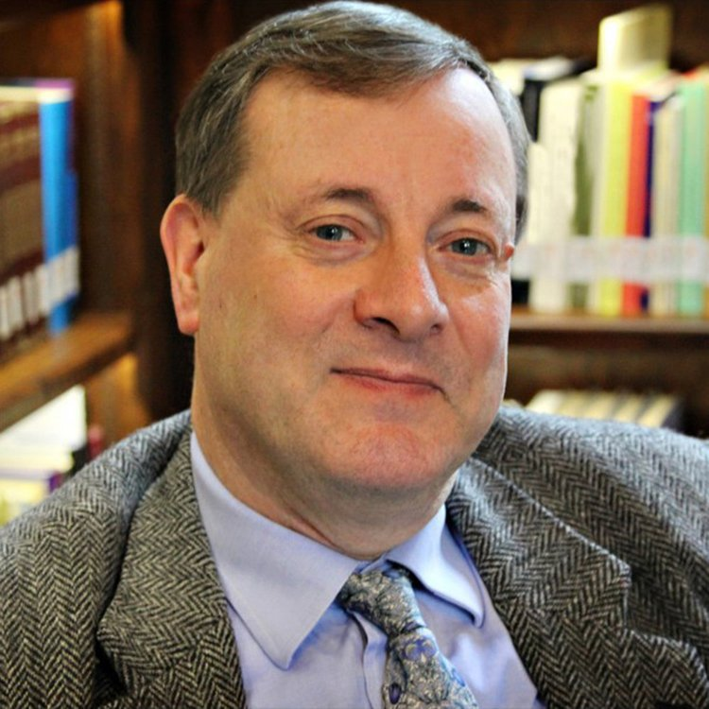
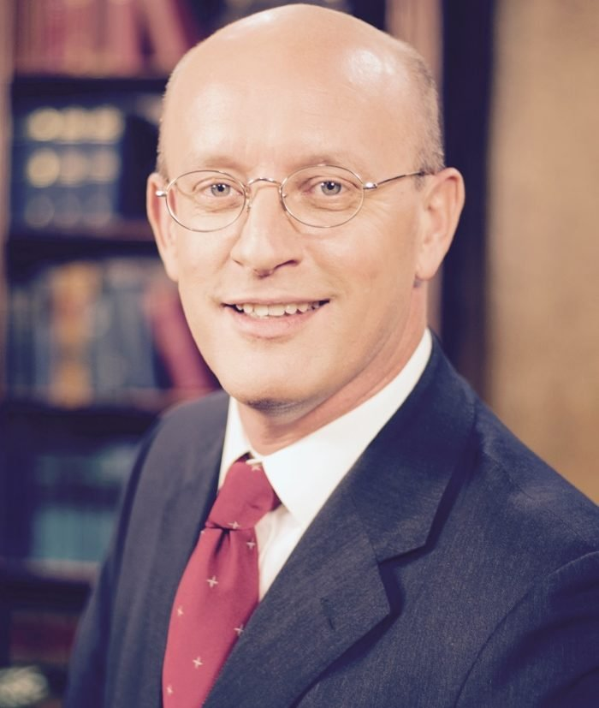
KEY PASSAGES IN CHAPTER 9
"Sir," said I, "I had almost forgotten it, and I have no anxiety about the answer now, though I have still a curiosity. It is about these Ghosts. Do any of them stay? Can they stay? Is any real choice offered to them? How do they come to be here?""Did ye never hear of the Refrigerium? A man with your advantages might have read of it in Prudentius, not to mention Jeremy Taylor.”
"But I don't understand. Is judgment not final? Is there really a way out of Hell into Heaven?" "It depends on the way you're using the words. If they leave that grey town behind it will not have been Hell. To any that leaves it, it is Purgatory. And perhaps ye had better not call this country Heaven. Not Deep Heaven, ye understand." (Here he smiled at me). "Ye can call it the Valley of the Shadow of Life. And yet to those who stay here it will have been Heaven from the first. And ye can call those sad streets in the town yonder the Valley of the Shadow of Death: but to those who remain there they will have been Hell even from the beginning." I suppose he saw that I looked puzzled, for presently he spoke again. "Son," he said, "ye cannot in your present state understand eternity…That is what mortals misunderstand. They say of some temporal suffering, 'No future bliss can make up for it,' not knowing that Heaven, once attained, will work backwards and turn even that agony into a glory. And of some sinful pleasure they say 'Let me but have this and I'll take the consequences': little dreaming how damnation will spread back and back into their past and contaminate the pleasure of the sin. Both processes begin even before death. The good man's past begins to change so that his forgiven sins and remembered sorrows take on the quality of Heaven: the bad man's past already conforms to his badness and is filled only with dreariness.

Slide 8
"Then those people are right who say that Heaven and Hell are only states of mind?" "Hush," said he sternly. "Do not blaspheme. Hell is a state of mind--ye never said a truer word. And every state of mind, left to itself, every shutting up of the creature within the dungeon of its own mind--is, in the end, Hell. But Heaven is not a state of mind. Heaven is reality itself. All that is fully real is Heavenly. For all that can be shaken will be shaken and only the unshakable remains." "But there is a real choice after death? My Roman Catholic friends would be surprised, for to them souls in Purgatory are already saved. And my Protestant friends would like it no better, for they'd say that the tree lies as it falls." "They're both right, maybe. Do not fash yourself with such questions. Ye cannot fully understand the relations of choice and Time until you are beyond both. And ye were not brought here to study such curiosities. What concerns you is the nature of the choice itself: and that ye can watch them making. "Milton was right," said my Teacher. "The choice of every lost soul can be expressed in the words 'Better to reign in Hell than serve in Heaven.' There is always something they insist on keeping, even at the price of misery. There is always something they prefer to joy-- that is, to reality. Ye see it easily enough in a spoiled child that would sooner miss its play and its supper than say it was sorry and be friends. Ye call it the Sulks. "Then is no one lost through…mere sensuality?" "Some are, no doubt. The sensualist..begins by pursuing a real pleasure, though a small one. His sin is the less. But the time comes on when, though the pleasure becomes less and less and the craving fiercer and fiercer, and though he knows that joy can never come that way, yet he prefers to joy the mere fondling of unappeasable lust and would not have it taken from him. He'd fight to the death to keep it.”

Slide 9
"Do ye think so?" said the Teacher with a piercing glance. "It is nearer to such as you than ye think. There have been men before now who got so interested in proving the existence of God that they came to care nothing for God Himself ... as if the good Lord had nothing to do but exist! There have been some who were so occupied in spreading Christianity that they never gave a thought to Christ. Man! Ye see it in smaller matters. Did ye never know a lover of books that with all his first editions and signed copies had lost the power to read them? Or an organiser of charities that had lost all love for the poor? It is the subtlest of all the snares."
Moved by a desire to change the subject, I asked why the Solid People, since they were full of love, did not go down into Hell to rescue the Ghosts. Why were they content simply to meet them on the plain? One would have expected a more militant charity. "Ye will understand that better, perhaps, before ye go," said he. "In the meantime, I must tell ye they have come further for the sake of the Ghosts than ye can understand. Every one of us lives only to journey further and further into the mountains. Every one of us has interrupted that journey and retraced immeasurable distances to come down today on the mere chance of saving some Ghosts. Of course it is also joy to do so, but ye cannot blame us for that! And it would be no use to come further even if it were possible. The sane would do no good if they made themselves mad to help madmen. There are only two kinds of people in the end: those who say to God, 'Thy will be done,' and those to whom God says, in the end, 'Thy will be done.' All that are in Hell, choose it. Without that self-choice there could be no Hell. No soul that seriously and constantly desires joy will ever miss it. Those who seek find. To those who knock it is opened."

Slide 10
KEY THEMES IN CHAPTER 9
1. God’s time is not our time and is beyond our ability to comprehend.
"Sir," said I, "I had almost forgotten it, and I have no anxiety about the answer now, though I have still a curiosity. It is about these Ghosts. Do any of them stay? Can they stay? Is any real choice offered to them? How do they come to be here?""Did ye never hear of the Refrigerium? A man with your advantages might have read of it in Prudentius, not to mention Jeremy Taylor.”
"But I don't understand. Is judgment not final? Is there really a way out of Hell into Heaven?" "It depends on the way you're using the words. If they leave that grey town behind it will not have been Hell. To any that leaves it, it is Purgatory. And perhaps ye had better not call this country Heaven. Not Deep Heaven, ye understand." (Here he smiled at me). "Ye can call it the Valley of the Shadow of Life. And yet to those who stay here it will have been Heaven from the first. And ye can call those sad streets in the town yonder the Valley of the Shadow of Death: but to those who remain there they will have been Hell even from the beginning." I suppose he saw that I looked puzzled, for presently he spoke again. "Son," he said, "ye cannot in your present state understand eternity…That is what mortals misunderstand.”
But do not overlook this one fact, beloved, that with the Lord one day is like a thousand years and a thousand years as one day. (2 Peter 3:8) Jesus said to them, ‘It is not for you to know times or epochs which the Father has fixed by His own authority.’ (Acts 1:7) He has made everything beautiful in its time. He has put eternity into man’s heart, yet so that he cannot find out what God has done from the beginning to the end.” (Eccl. 3:11)

Slide 11
2. Heaven is solid and Real.
Hell is a state of mind--ye never said a truer word. And every state of mind, left to itself, every shutting up of the creature within the dungeon of its own mind--is, in the end, Hell. But Heaven is not a state of mind. Heaven is reality itself. All that is fully real is Heavenly.
For he was looking forward to the city that has foundations, whose designer and builder is God.(Heb:11:10)
But you have come to Mount Zion, to the city of the living God, the heavenly Jerusalem. You have come to thousands upon thousands of angels in joyful assembly, to the church of the firstborn, whose names are written in heaven. You have come to God, the Judge of all, to the spirits of the righteous made perfect, to Jesus the mediator of a new covenant, and to the sprinkled blood that speaks a better word than the blood of Abel... Therefore, since we are receiving a kingdom that cannot be shaken, let us be thankful, and so worship God acceptably with reverence and awe. (Heb. 12:24-28)
3. Lewis is not interested in teaching about the timing/mechanics of how salvation and atonement works but in the nature and importance of Choice.
"But there is a real choice after death? My Roman Catholic friends would be surprised, for to them souls in Purgatory are already saved. And my Protestant friends would like it no better, for they'd say that the tree lies as it falls." "They're both right, maybe. Do not fash yourself with such questions. Ye cannot fully understand the relations of choice and Time until you are beyond both…What concerns you is the nature of the choice itself: and that ye can watch them making.

Slide 12
4. We cannot hold onto anything of this world if we hope to be saved.
"The choice of every lost soul can be expressed in the words 'Better to reign in Hell than serve in Heaven.' There is always something they insist on keeping, even at the price of misery.”
I have been crucified with Christ. It is no longer I who live, but Christ who lives in me. And the life I now live in the flesh I live by faith in the Son of God, who loved me and gave himself for me. (Gal. 2:20) I consider everything a loss because of the surpassing worth of knowing Christ Jesus my Lord, for whose sake I have lost all things. I consider them garbage, that I may gain Christ and be found in him, not having a righteousness of my own that comes from the law, but that which is through faith in Christ—the righteousness that comes from God on the basis of faith. I want to know Christ—yes, to know the power of his resurrection and participation in his sufferings, becoming like him in his death, and so, somehow, attaining to the resurrection from the dead. (Phil. 3:8-11)
Parable of Lazarus and the Rich Man (Lk 16:19-31)
There was a rich man who was dressed in purple and fine linen and lived in luxury every day. At his gate was laid a beggar named Lazarus, covered with sores and longing to eat what fell from the rich man’s table. Even the dogs came and licked his sores. The time came when the beggar died and the angels carried him to Abraham’s side. The rich man also died and was buried. In Hades, where he was in torment, he looked up and saw Abraham far away, with Lazarus by his side. So he called to him, ‘Father Abraham, have pity on me and send Lazarus to dip the tip of his finger in water and cool my tongue, because I am in agony in this fire.’But Abraham replied, ‘Son, remember that in your lifetime you received your good things, while Lazarus received bad things, but now he is comforted here and you are in agony. And besides all this, between us and you a great chasm has been set in place, so that those who want to go from here to you cannot, nor can anyone cross over from there to us.’He answered, ‘Then I beg you, father, send Lazarus to my family, for I have five brothers. Let him warn them, so that they will not also come to this place of torment.’ Abraham replied, ‘They have Moses and the Prophets; let them listen to them.’

Slide 13
“Is this the Region, this the Soil, the Clime, Said then the lost ArchAngel [Satan],
this the seat that we must change for Heav'n, this mournful gloom, for that celestial light?
Be it so, since he Who now is Sovereign can dispose and bid what shall be right:
farthest from him is best, whom reason hath equalled, force hath made supreme above his equals. Farewell, happy Fields where Joy for ever dwells: Hail horrours, hail Infernal world,
and thou profoundest Hell receive thy new Possessor:
One who brings a mind not to be chang'd by Place or Time. The mind is its own place, and in itself Can make a Heav'n of Hell, a Hell of Heav'n. What matter where, if I be still the same, and what I should be, all but less then he whom Thunder hath made greater? Here at least we shall be free;
th' Almighty hath not built here for his envy, will not drive us hence:
Here we may reign secure, and in my choice to reign is worth ambition though in Hell:
Better to reign in Hell, then serve in Heav'n. But wherefore let we then our faithful friends,
th' associates and copartners of our loss Lie thus astonished on th' oblivious Pool,
And call them not to share with us their part in this unhappy Mansion, or
once more with rallied Arms to try what may be yet regaind in Heav’n or what more lost in Hell?”
--John Milton, Paradise Lost, Book 1, Lines 242-270

Slide 14
5. Studying about/working for Christ is not the same as KNOWING Him.
There have been men before now who got so interested in proving the existence of God that they came to care nothing for God Himself ... as if the good Lord had nothing to do but exist! There have been some who were so occupied in spreading Christianity that they never gave a thought to Christ. Man! Ye see it in smaller matters. Did ye never know a lover of books that with all his first editions and signed copies had lost the power to read them? Or an organiser of charities that had lost all love for the poor? It is the subtlest of all the snares."
On that day many will say to me, 'Lord, Lord, did we not prophesy in your name, and cast out demons in your name, and do many mighty works in your name?' And then I will declare to them, 'I never knew you; depart from me, you evildoers'" (Matthew 7:21-23) Now this is eternal life: that they know you, the only true God, and Jesus Christ, whom you have sent. (John 17:3)
6. God does not force salvation upon those who do not wish to follow Him.
There are only two kinds of people in the end: those who say to God, 'Thy will be done,' and those to whom God says, in the end, 'Thy will be done.' All that are in Hell, choose it. Without that self-choice there could be no Hell. No soul that seriously and constantly desires joy will ever miss it. Those who seek find. To those who knock it is opened." For it is impossible…to restore them again to repentance, since they are crucifying once again the Son of God to their own harm and holding him up to contempt. For land that has drunk the rain that often falls on it and produces a crop useful to those for whose sake it is cultivated, receives a blessing from God. But if it bears thorns and thistles, it is worthless and near to being cursed, and its end is to be burned. (Heb. 6:4-8) “Keep on asking, and you will receive what you ask for. Keep on seeking, and you will find. Keep on knocking, and the door will be opened to you. (Matt. 7:7)

Slide 15
“I believe, to be sure, that any man who reaches Heaven
will find that what he abandoned (even in plucking out his right eye)
has not been lost: that the kernel of what he was really seeking
even in his most depraved wishes will be there, beyond expectation, waiting for him in 'the High Countries'.” ― C.S. Lewis, The Great Divorce

