Slide 1
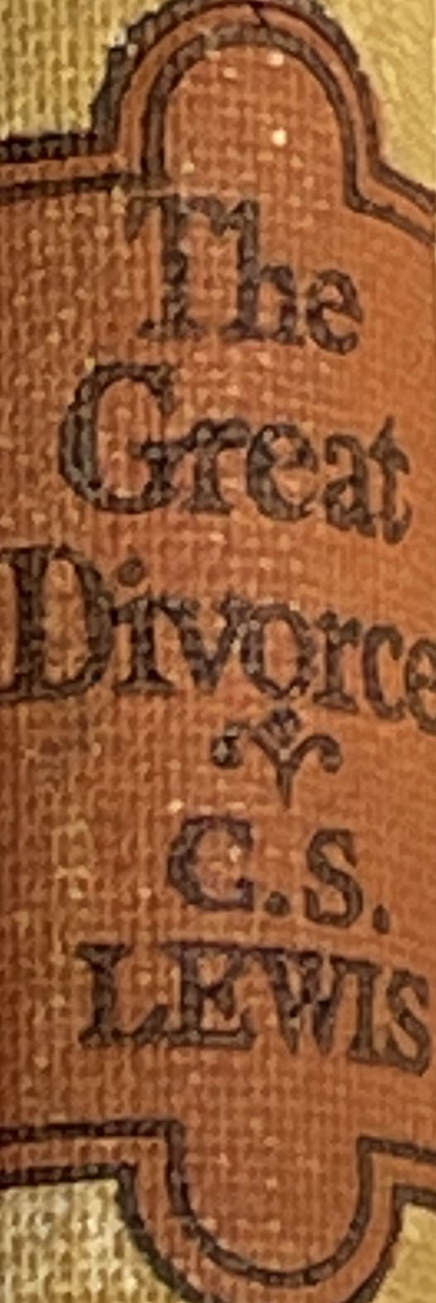
Dec, December 14, 2022
St. Philip’s Church
The Rev’d Brian K. McGreevy, J.D., Facilitator
The Great Divorce:
C.S. Lewis on God’s Truth
or Your Truth

Slide 2
In the presence of God and of Christ Jesus, who will judge the living and the dead, and in view of his appearing and his kingdom, I give you this charge: Preach the word; be prepared in season and out of season; correct, rebuke and encourage—with great patience and careful instruction.
For the time will come when people will not put up with sound doctrine. Instead, to suit their own desires, they will gather around them a great number of teachers to say what their itching ears want to hear. They will turn their ears away from the truth and turn aside to myths. But you, keep your head in all situations, endure hardship, do the work of an evangelist, discharge all the duties of your ministry. (2 Timothy 4:1-4)

Slide 3
How to approach this class:
--On the beach
--Snorkeling
--Scuba diving
--Email list
How to read this book:
--Try reading aloud
--One chapter at a time
AN ANNOUNCEMENT!

Slide 4
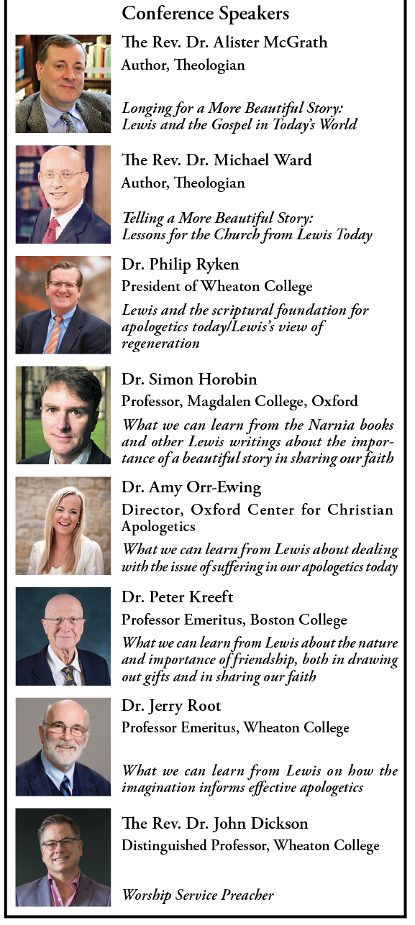
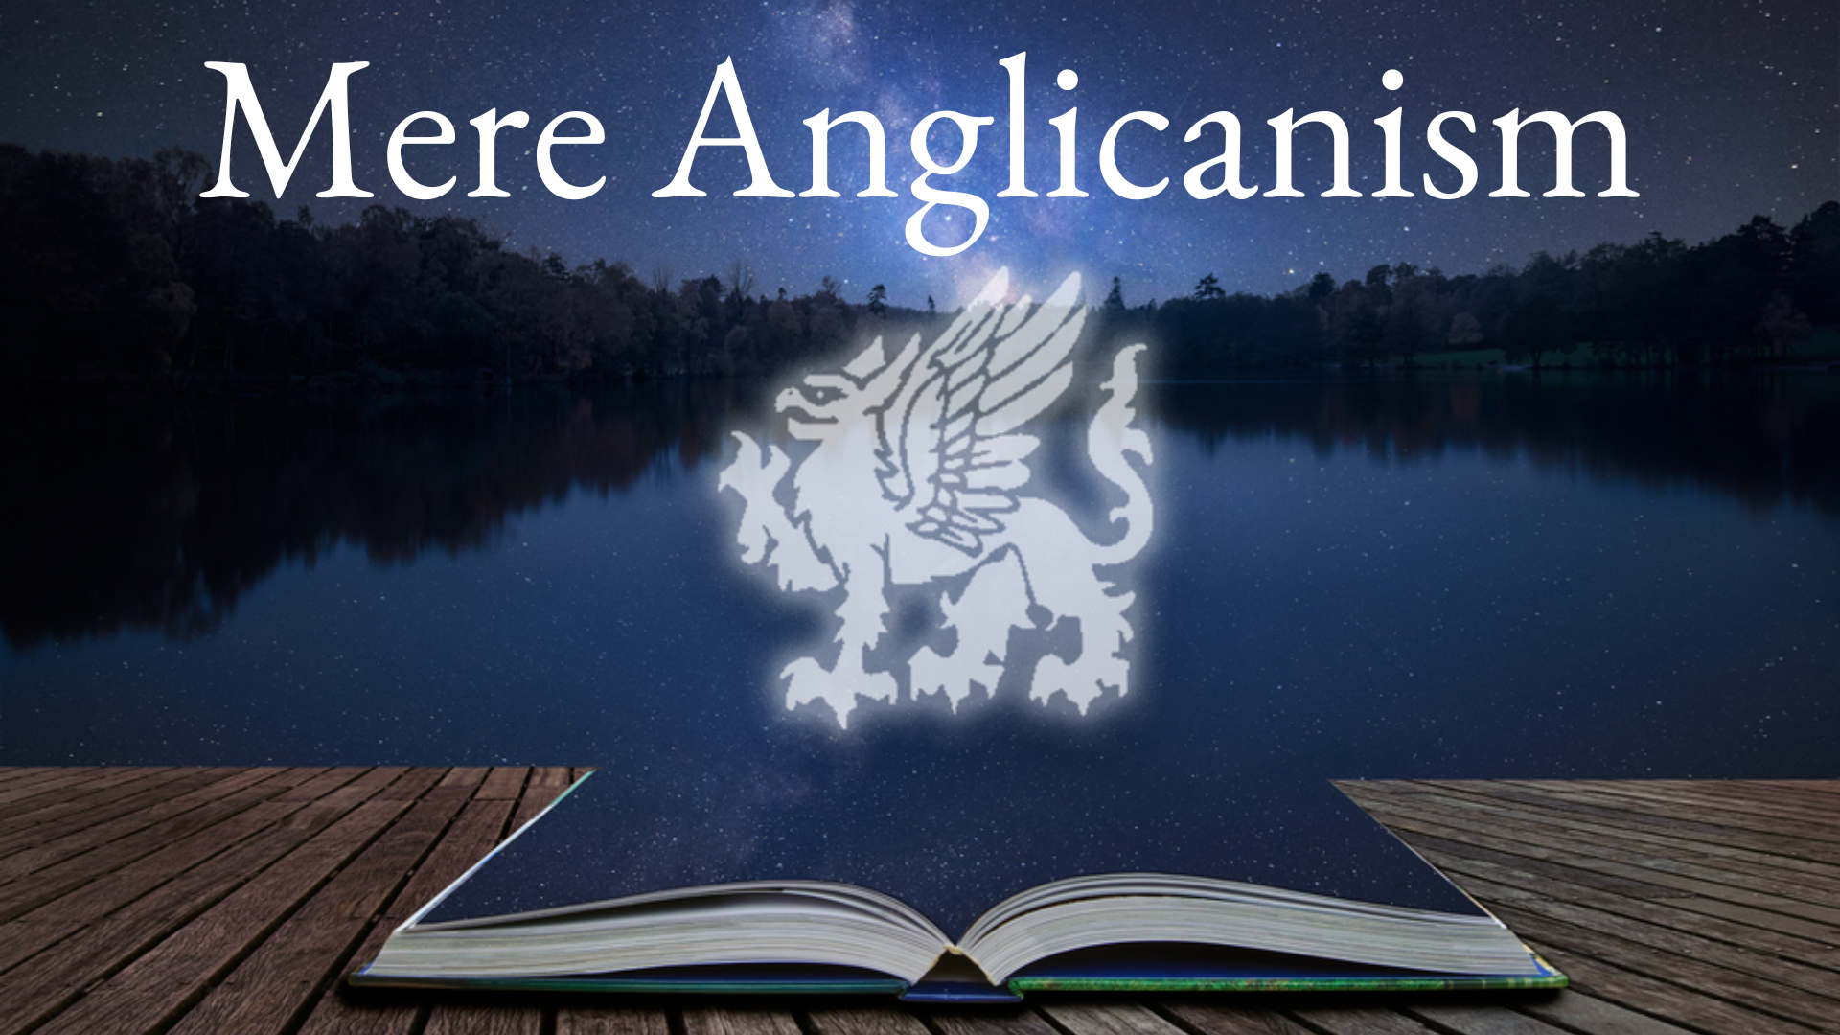
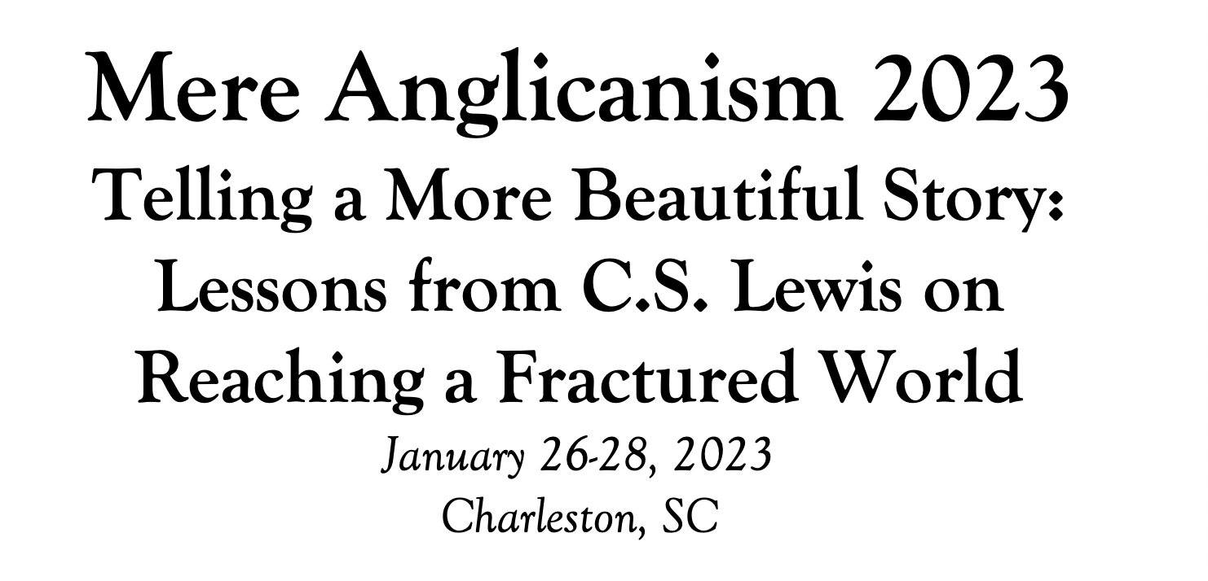

Slide 5
Tonight’s Music!
REVIEW
Why does The Great Divorce merit study today?
--Emphasis on eternal life with a vivid description of the awfulness of Hell and the glorious beauty of Heaven that will fire your heart with longing
--Narcissism and pride are rife in our culture today, and Lewis shows the consequences of both.
--Truth as an absolute is under cultural attack as never before, with the idea of speaking your own truth held up as the highest good. Lewis shows decisively in this story what happens when you hold onto your own ”truth” and refuse to acknowledge God’s Truth.
--Obsession in our culture about our Rights and what we are owed, rather than focusing on servanthood and self-sacrifice
--Clarity about either/or rather than gray view of choices
--A brilliant rebuttal of works righteousness in favor of the centrality of the Cross

Slide 6
SUMMARY OF CHAPTER 6
Lewis is entranced by the beauty of his surroundings and drawn by the robust sound of flowing water, which turns out to be an enormous and spectacular waterfall that is impossibly large by human standards. Lewis sees one of the ghosts, the man named Ikey (who wanted to bring back some solid objects from Heaven to be able to sell in the Grey Town[Hell]), struggling in the bushes and motioning for Lewis to take cover. Lewis notices that Ikey is next to a remarkably beautiful tree covered with golden apples, and that Ikey is trying to collect fruit that has fallen from the tree. He has extreme difficulty in this because of the weight even of the leaves, but eventually manages to pick up a small apple and hide it in his pocket. As soon as he does so, a thunderous voice calls out “Fool! Put it down!” It was a thunderous yet liquid voice, and Lewis realizes that the waterfall itself was speaking and that though it did not cease to look like a waterfall it was also a bright angel who stood, like one crucified, against the rocks and poured himself perpetually down towards the forest with loud joy. The Voice then tells Ikey there is no room in Hell even for the smallest apple and then invites him to stay and learn to eat such apples, saying even the leaves and blades of grass would delight to teach him. Terrified, the ghost flees.

Slide 7
MAJOR THEMES IN CHAPTER 6
The extraordinary Beauty of every aspect of Heaven embraces all the earthly senses and surpasses them.
2. Dimensions and size in Heaven are beyond earthly comprehension.
3. Heaven is the perfection of the original Garden of Eden and reflects not only Genesis but Revelation as well.
4. Heaven is a type of solid Reality that makes anything earthly seem a mere shadow by comparison.
5. The presence and image of Christ permeate every aspect of Heaven.
LEWIS AND THE WATERFALL IMAGE

Slide 8
SUMMARY OF CHAPTER 7
Feeling somewhat unnerved by the presence of the angelic being in the waterfall, Lewis wanders downstream and runs into another ghost, this time a lean, hard-bitten man with an air of reliability, who inquires whether Lewis is going back to the bus to the Grey Town. Lewis says he hasn’t decided, but the ghost says he is going back—that he has seen all there is to see, that it is all propaganda and there never was any real chance of staying, since you can't eat the fruit or drink the water or even walk on the grass. A human being couldn't live in such conditions. He says he traveled extensively on earth and everywhere was just the same—all advertising stunts run by the same people. He says even the Grey Town/Hell is the same way—disappointing and no really interesting people.
Lewis says he prefers the heavenly country and believes you could get acclimatized to it by staying there, but the ghost says that is the same old lie told all through life—that doing the right thing or being disciplined and persevering would lead to a better life. Not so--“They”(the same Old Ring) are running everything and could rescue people but would rather they be miserable.

Slide 9
The ghost says there is no point in being rescued anyway because there is nothing to actually do in either place, since “They” have failed in their obligation to keep people from being bored. Since all the parsons and moralists have got things upside down, they keep on asking people to alter themselves, when instead “They” ought to adjust reality to suit their public. Lewis, depressed, says he will stay anyway, and the ghost leaves him, saying that it will rain soon and that Lewis will then find that the rain pieces him like machine gun shots.
MAJOR THEMES IN CHAPTER 7
1. Pessimism becomes a self-fulfilling prophecy. "What was Pekin like?" "Nothing to it. Just one darn wall inside another. Just a trap for tourists. I've been pretty well everywhere. Niagara Falls, the Pyramids, Salt Lake City, the Taj Mahal-----" "What was it like?" "Not worth looking at. They're all advertisement stunts. All run by the same people. There's a combine, you know, a World Combine, that just takes an Atlas and decides where they'll have a Sight.”

Slide 10
“So are the paths of all who forget God; and the hope of the godless will perish, whose confidence is fragile, and whose trust a spider’s web.(Job 8:13-14) He also who had received the one talent came forward, saying, ‘Master, I knew you to be a hard man, reaping where you did not sow, and gathering where you scattered no seed, so I was afraid, and I went and hid your talent in the ground. Here, you have what is yours.’ But his master answered him, ‘You wicked and slothful servant! You knew that I reap where I have not sown and gather where I scattered no seed? Then you ought to have invested my money with the bankers, and at my coming I should have received what was my own with interest. So take the talent from him and give it to him who has the ten talents. For to everyone who has will more be given, and he will have an abundance. But from the one who has not, even what he has will be taken away. And cast the worthless servant into the outer darkness. In that place there will be weeping and gnashing of teeth.’(Mt. 25:24-30)

Slide 11
2. Cynicism and complaining make it impossible to experience Joy.
"Same old lie. People have been telling me that sortof thing all my life. They told me in the nursery that if I were good I'd be happy. And they told me at school that Latin would get easier as I went on. After I'd been married a month some fool was telling me that there were always difficulties at first, but with Tact and Patience I'd soon 'settle down' and like it! And all through two wars what didn't they say about the good time coming if only I'd be a brave boy and go on being shot at?”
Then they said to Moses, “Is it because there were no graves in Egypt that you have taken us away to die in the wilderness? Why have you dealt with us in this way, bringing us out of Egypt? Is this not the word that we spoke to you in Egypt, saying, ‘Leave us alone that we may serve the Egyptians’? For it would have been better for us to serve the Egyptians than to die in the wilderness.”(Ex. 14:11-12) A wholesome tongue is a tree of life, but perverseness in it breaks the spirit.(Prov. 15:4) From the same mouth come blessing and cursing. My brothers, these things ought not to be so. Does a spring pour forth from the same opening both fresh and salt water? Can a fig tree, my brothers, bear olives, or a grapevine produce figs? Neither can a salt pond yield fresh water. (Jas. 3:10-12)
Source: https://bible.knowing-jesus.com/topics/Cynicism
3. Believing that the purpose of life is to be entertained leads only to despair.
4. Blaming others for everything results in bitter inertia

Slide 12
3. Believing that the purpose of life is to be entertained leads only to despair.
“It's up to the Management to find something that doesn't bore us, isn't it? It's their job. Why should we do it for them? …It's never a new management. You'll always find the same old Ring. I know all about dear, kind Mummie coming up to your bedroom and getting all she wants to know out of you: but you always found she and Father were the same firm really. Didn't we find that both sides in all the wars were run by the same Armament Firms? or the same Firm, which is behind the Jews and the Vatican and the Dictators and the Democracies and all the rest of it. All this stuff up here is run by the same people as the Town. They're just laughing at us.”
I said in my heart, “Come now, I will test you with pleasure; enjoy yourself.” But behold, this also was vanity. I said of laughter, “It is mad,” and of pleasure, “What use is it?” (Eccl. 2:1) And as for what fell among the thorns, they are those who hear, but as they go on their way they are choked by the cares and riches and pleasures of life, and their fruit does not mature.(Lk. 8:14) For many, of whom I have often told you and now tell you even with tears, walk as enemies of the cross of Christ. Their end is destruction, their god is their belly, and they glory in their shame, with minds set on earthly things.(Phil. 3:18-19)

Slide 13
4. Blaming others for everything results in bitter inertia
"There seems to be some idea that if one stays here one would get…well, solider…grow acclimatised." "I know all about that," said the Ghost. "Same old lie…Don't you see that if the official version were true these chaps up here would attack and sweep the Town out of existence? They've got the strength. If they wanted to rescue us they could do it. But obviously the last thing they want is to end their so-called 'war.' The whole game depends on keeping it going.”
Therefore you have no excuse, O man, every one of you who judges. For in passing judgment on another you condemn yourself, because you, the judge, practice the very same things (Rom. 2:1) For I see that you are in the gall of bitterness and in the bond of iniquity.(Acts 8:23) I loathe my life; I will give free utterance to my complaint; I will speak in the bitterness of my soul (Job 10:1) All in vain have I kept my heart clean
and washed my hands in innocence. For all the day long I have been stricken and rebuked every morning…When my soul was embittered, when I was pricked in heart, I was brutish and ignorant; I was like a beast toward you. (Ps. 73)

Slide 14
And now for something completely different…
A Christmas treat from C.S. Lewis

Slide 15
A Lost Fragment of Herodotus
… and beyond this there lies in the ocean, turned towards the west and the north, the island of Niatirb which Hecataeus indeed declares to be the same size and shape as Sicily, but it is larger, and though in calling it triangular a man would not miss the mark. It is densely inhabited by men who wear clothes not very different from other barbarians who occupy the north- western parts of Europe though they do not agree with them in language. These islanders, surpassing all the men of whom we know in patience and endurance, use the following customs.
In the middle of winter when fogs and rains most abound they have a great festival which they call Exmas , and for fifty days they prepare for it in the fashion I shall describe. First of all, every citizen is obliged to send to each of his friends and relations a square piece of hard paper stamped with a picture, which in their speech is called an Exmas-card . But the pictures represent birds sitting on branches, or trees with a dark green prickly leaf, or else men in such garments as the Niatirbians believe that their ancestors wore two hundred years ago riding in coaches such as their ancestors used, or houses with snow on their roofs. And the Niatirbians are unwilling to say what these pictures have to do with the festival, guarding (as I suppose) some sacred mystery. And because all men must send these cards the market-place is filled with the crowd of those buying them, so

Slide 16
that there is great labour and weariness. But having bought as many as they suppose to be sufficient, they return to their houses and find there the like cards which others have sent to them. And when they find cards from any to whom they also have sent cards, they throw them away and give thanks to the gods that this labour at least is over for another year. But when they find cards from any to whom they have not sent, then they beat their breasts and wail and utter curses against the sender; and, having sufficiently lamented their misfortune, they put on their boots again and go out into the fog and rain and buy a card for him also. And let this account suffice about Exmas-cards.
They also send gifts to one another, suffering the same things about the gifts as about the cards, or even worse. For every citizen has to guess the value of the gift which every friend will send to him so that he may send one of equal value, whether he can afford it or not. And they buy as gifts for one another such things as no man ever bought for himself. For the sellers, understanding the custom, put forth all kinds of trumpery, and whatever, being useless and ridiculous, sell as an Exmas gift. And though the Niatirbians profess themselves to lack sufficient necessary things, such as metal, leather, wood and paper, yet an incredible quantity of these things is wasted every year, being made into the gifts.

Slide 17
But during these fifty days the oldest, poorest and the most miserable of citizens put on false beards and red robes and walk in the market-place; being disguised (in my opinion) as Cronos. And the sellers of gifts no less than the purchasers become pale and weary, because of the crowds and the fog, so that any man who came into a Niatirbian city at this season would think that some great calamity had fallen on Niatirb. This fifty days of preparation is called in their barbarian speech the Exmas Rush. But when the day of the festival comes, then most of the citizens, being exhausted with the Rush , lie in bed till noon. But in the evening they eat five times as much supper as on other days and, crowning themselves with crowns of paper, they become intoxicated. And on the day after Exmas they are very grave, being internally disordered by the supper and the drinking and reckoning how much they have spent on gifts and on the wine. For wine is so dear among the Niatirbians that a man must swallow the worth of a talent before he is well intoxicated.
Such, then, are their customs about the Exmas. But the few among the Niatirbians have also a festival, separate and to themselves, called Crissmas , which is on the same day as Exmas. And those who keep Crissmas, doing the opposite to the majority of the Niatirbians, rise early on that day with shining faces and go before sunrise to certain temples where they partake of a sacred

Slide 18
feast. And in most of the temples they set out images of a fair woman with a new-born Child on her knees and certain animals and shepherds adoring the Child. (The reason of these images is given in a certain sacred story which I know but do not repeat.)
But I myself conversed with a priest in one of these temples and asked him why they kept Crissmas on the same day as Exmas; for it appeared to me inconvenient. But the priest replied, “It is not lawful, O Stranger, for us to change the date of Crissmas, but would that Zeus would put it into the minds of the Niatirbians to keep Exmas at some other time or not to keep it at all. For Exmas and the Rush distract the minds even of the few from sacred things. And we indeed are glad that men should make merry at Crissmas; but in Exmas there is no merriment left.”
And when I asked him why they endured the Rush, he replied, “It is, O Stranger, a racket, using (as I suppose) the words of some oracle and speaking unintelligibly to me (for a racket is an instrument which the barbarians use in a game called tennis ). But what Hecataeus says, that Exmas and Crissmas are the same, is not credible. For the first, the pictures which are stamped on the Exmas-cards have nothing to do with the sacred story which the priests tell about Crissmas

Slide 19
And secondly, the most part of the Niatirbians, not believing the religion of few, nevertheless send the gifts and cards and participate in the Rush and drink, wearing paper caps. But it is not likely that men, even being barbarians, should suffer so many and great things in honour of a god they do not believe in. And now, enough about Niatirb.
--C.S. Lewis, 1954

Slide 20
Dec
In the bleak mid-winter Frosty wind made moan,
Earth stood hard as iron, Water like a stone;
Snow had fallen, snow on snow, Snow on snow,
In the bleak mid-winter, Long ago.
Our God, Heav’n cannot hold him Nor earth sustain;
Heav’n and earth shall flee away When he comes to reign:
In the bleak mid-winter A stable-place sufficed
The Lord God Almighty Jesus Christ.
What can I give him, Poor as I am? If I were a shepherd I would bring a lamb,
If I were a Wise Man I would do my part,
Yet what I can I give him, Give my heart.
--Christina Rossetti, Gustav Holst

Slide 21
“I believe, to be sure, that any man who reaches Heaven will find that
what he abandoned (even in plucking out his right eye) has not been lost:
that the kernel of what he was really seeking even in his most depraved wishes
will be there, beyond expectation, waiting for him in 'the High Countries'.”
― C.S. Lewis, The Great Divorce

