Slide 1

November 30, 2022
St. Philip’s Church
The Rev’d Brian K. McGreevy, J.D., Facilitator
The Great Divorce:
C.S. Lewis on God’s Truth
or Your Truth

Slide 2
In the presence of God and of Christ Jesus, who will judge the living and the dead, and in view of his appearing and his kingdom, I give you this charge: Preach the word; be prepared in season and out of season; correct, rebuke and encourage—with great patience and careful instruction.
For the time will come when people will not put up with sound doctrine. Instead, to suit their own desires, they will gather around them a great number of teachers to say what their itching ears want to hear. They will turn their ears away from the truth and turn aside to myths. But you, keep your head in all situations, endure hardship, do the work of an evangelist, discharge all the duties of your ministry. (2 Timothy 4:1-4)

Slide 3
How to approach this class:
--On the beach
--Snorkeling
--Scuba diving
--Email list
How to read this book:
--Try reading aloud
--One chapter at a time
AN ANNOUNCEMENT!

Slide 4
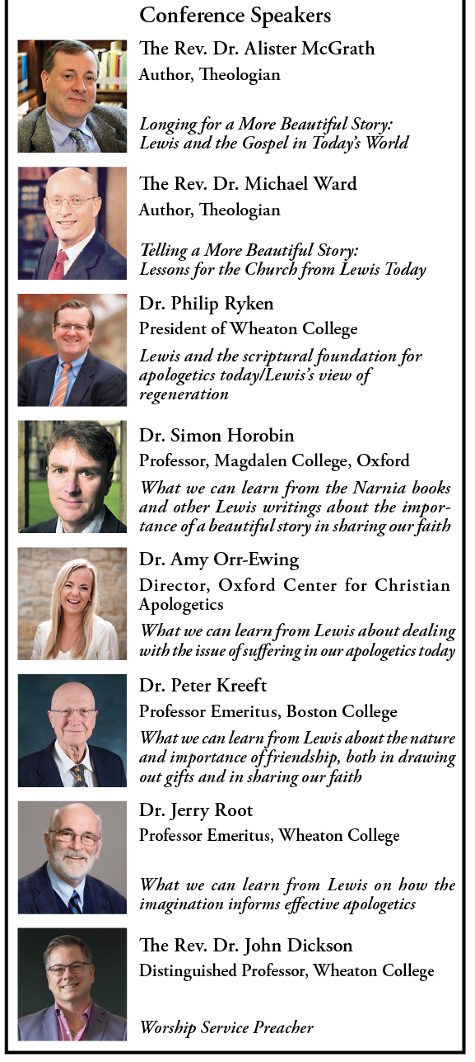
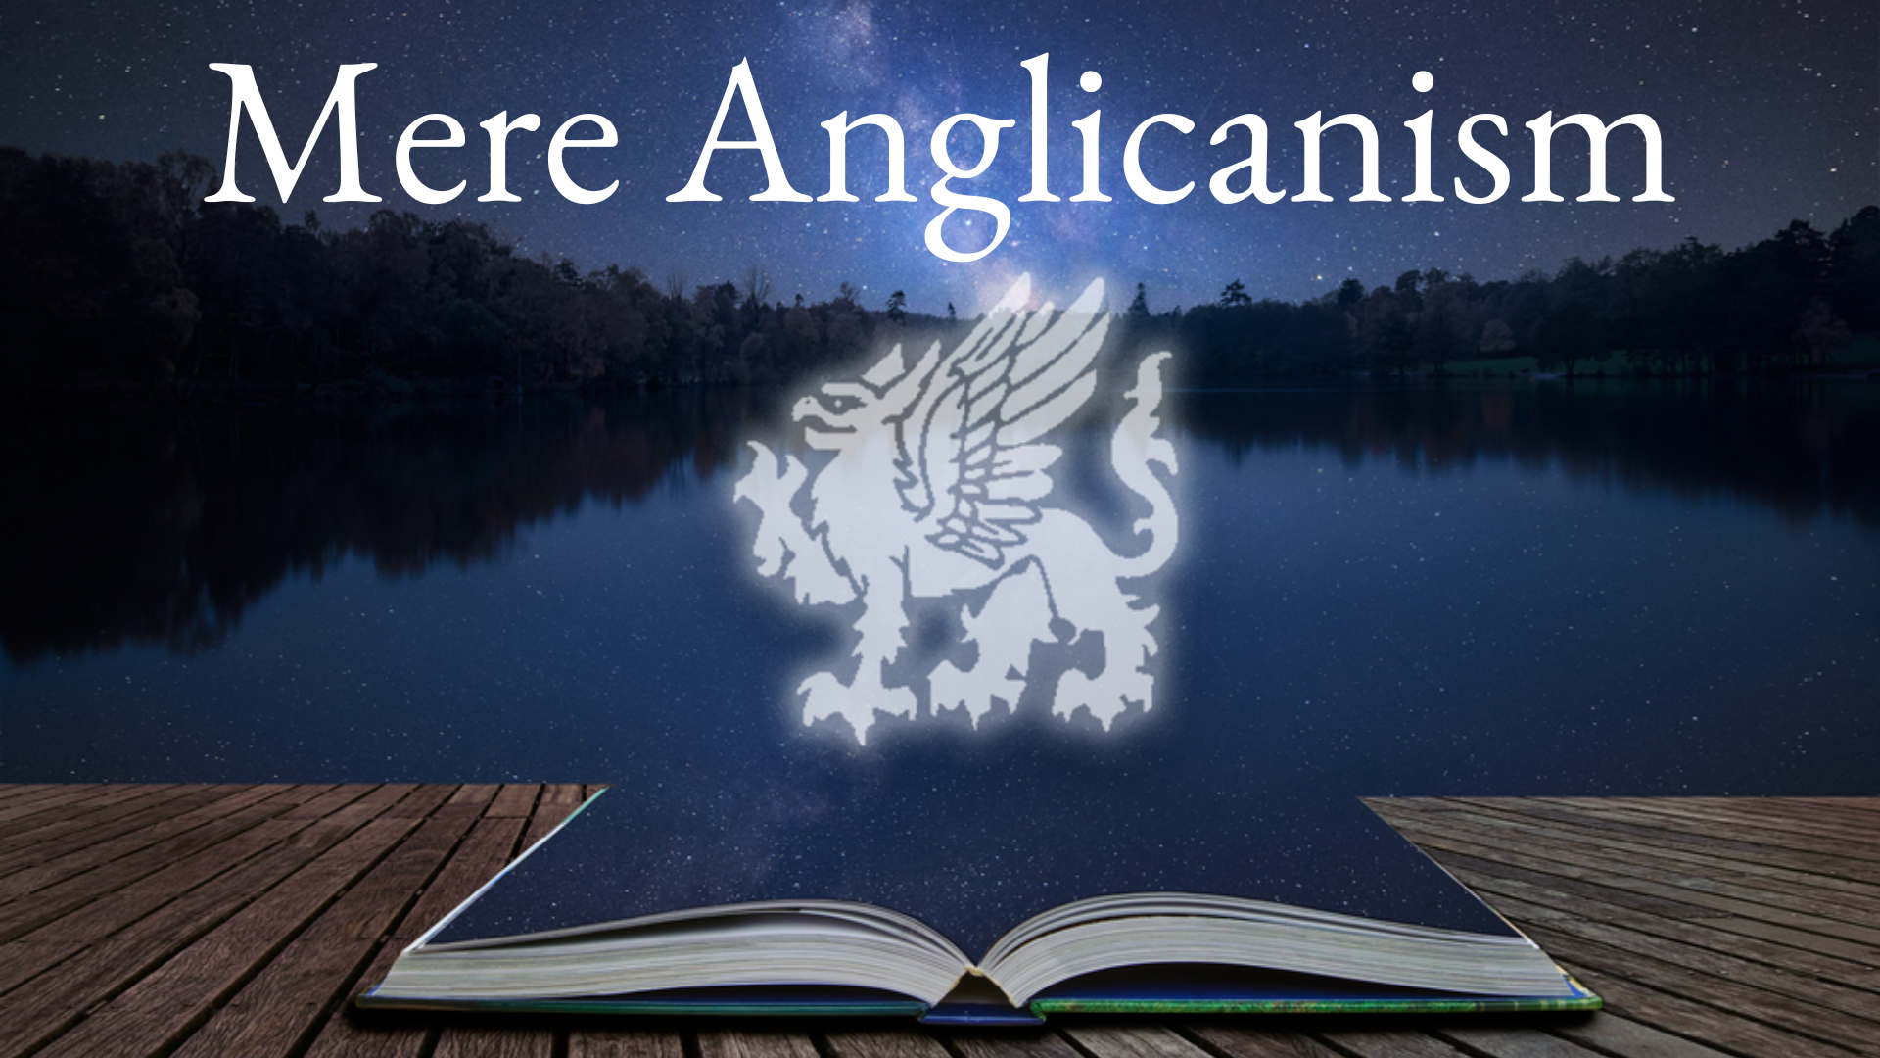
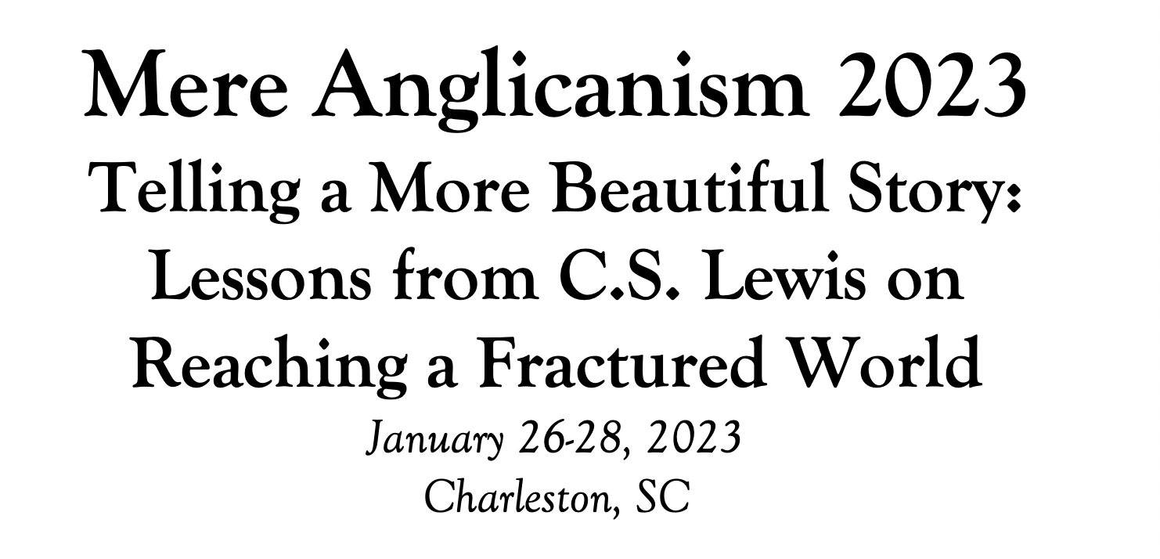

Slide 5
Tonight’s Music!
REVIEW
Why does The Great Divorce merit study today?
--Emphasis on eternal life with a vivid description of the awfulness of Hell and the glorious beauty of Heaven that will fire your heart with longing
--Narcissism and pride are rife in our culture today, and Lewis shows the consequences of both.
--Truth as an absolute is under cultural attack as never before, with the idea of speaking your own truth held up as the highest good. Lewis shows decisively in this story what happens when you hold onto your own ”truth” and refuse to acknowledge God’s Truth.
--Obsession in our culture about our Rights and what we are owed, rather than focusing on servanthood and self-sacrifice
--Clarity about either/or rather than gray view of choices
--A brilliant rebuttal of works righteousness in favor of the centrality of the Cross

Slide 6
SUMMARY OF CHAPTER 4
As the passengers from the bus are greeted by Bright Spirits, we overhear a dialog between the Big Man, who is determined to demand his rights and get what he believes he deserves, and Len, now a Bright Spirit but formerly a worker under the Big Man. Len had committed murder but through grace and the "Bleeding Charity" had come to the heavenly country. Lewis offers piercing insights into the bankruptcy of our own efforts to attain salvation based on our merits.
MAJOR THEMES IN CHAPTER 4
Rights and deserving are impediments to entering Heaven
"Look at me, now," said the Ghost, slapping its chest (but the slap made no noise). "I gone straight all my life. I don't say I was a religious man and I don't sav I had no faults, far from it. But I done my best all my life, see?
Forgiveness and giving up oneself are prerequisites for entering
"I murdered you in my heart, deliberately, for years. I used to lie awake at nights thinking what I'd do to you if ever I got the chance. That is why I have been sent to you now: to ask your forgiveness and to be your servant as long as you need one, and longer if it pleases vou. I was the worst.”

Slide 7
Heaven is a place of great joy and mirth
“He in his turn was followed by one of the bright people. "Don't you know me?" he shouted to the Ghost: and I found it impossible not to turn and attend. The face of the solid spirit--he was one of those that wore a robe-made me want to dance, it was so jocund, so established in its youthfulness. Mirth danced in his eyes as he [spoke].”
Joy-filled obedience and servanthood characterize Heaven
"Only be happy and come with me. Come and show me now," said the other with laughter in his voice. "It will be joy going to the mountains.”
Entering Heaven is entirely dependent on the Bleeding Charity
"What do you keep on arguing for? I'm only telling you the sort of chap I am. I only want my rights. I'm not asking for anybody's bleeding charity."
"Then do. At once. Ask for the Bleeding Charity. Everything is here for the asking and nothing can be bought."
Pride and self-centeredness have no place in Heaven, where humility and servant-heartedness and good humor prevail
"I thought there'd be some damned nonsense. It's all a clique, all a bloody clique. Tell them I'm not coming, see? I'd rather be damned than go along with you. I came here to get my rights, see?

Slide 8
SUMMARY OF CHAPTER 5
Passing two romping lions, Lewis ventures down the bank to a beautiful river, where he sees another of the Bright People in conversation with the fat ghost with the cultured voice who had spoken to him on the bus. The ghost was wearing gaiters and the young spirit, Dick, was naked and almost blindingly white.
The ghost says that Dick was getting very narrow in his theological views and coming to believe in a literal Heaven and Hell. The ghost says the grey town with its “…continual hope of morning with its field for indefinite progress, is, in a sense, Heaven, if one only has eyes to see it.” The spirit, astounded, says that the ghost is in fact in Hell and was sent there for being an apostate. The ghost says no one is sent to Hell for honest opinions sincerely believed and that his rejection of the doctrine of the Resurrection was heroic.
The spirit says all their discussions back in the day were only in accord with what was modern and popular, driven by fear of being out of step with the spirit of the age, and they never actually considered whether the Supernatural might exist and be True.

Slide 9
The spirit tells the ghost he can begin with a clean slate, white as snow and that the Gospel is True—that Christ is in him with power, and that the spirit has come a long way to show this to the ghost. He urges the ghost to repent and believe, but the ghost wants assurances that he can have free inquiry and be useful. The spirit tells him he is not going to a place of questions but to a place of answers, a place where he will not experience truth only with the abstract intellect, but where you can taste it like honey and be embraced by it as by a bridegroom, quenching your thirst.
The spirit says, "We know nothing of religion here: we think only of Christ. We know nothing of speculation. Come and see. I will bring you to Eternal Fact, the Father of all other facthood."
The ghost says that for him God is something purely spiritual--the spirit of sweetness and light and tolerance and service. He says he cannot go with the spirit because he has to give a paper at the Theological Society meeting in Hell, on the topic of how if Christ had lived longer he would have refined his views in a more liberal direction and how his death was such a waste, so much promise cut short. He wanders off humming the hymn “City of God, how broad and far,” saying how much he has found the conversation with his “dear boy” stimulating and provocative.”

Slide 10
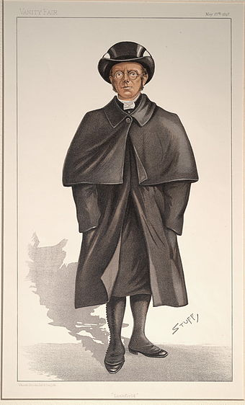
“City of God, how broad and far” is a theologically muddled hymn written in 1860 whose first stanza is as follows:
City of God, how broad and far
outspread thy walls sublime!
The true thy chartered freemen are
of every age and clime:
The hymn’s author, Samuel Johnson, was a Harvard
graduate in Theology, but never was ordained in any denomination. He was mostly associated with the Unitarian Universalist church.

Slide 11
A LITTLE HUMOR "My dear boy, I'm delighted to see you," it was saying to the Spirit, who was naked and almost blindingly white. “Ah, Dick, I shall never forget some of our talks. I expect you've changed your views a bit since then. You became rather narrow-minded towards the end of your life: but no doubt you've broadened out again." "How do you mean?" "Well, it's obvious by now, isn't it, that you weren't quite right. Why, my dear boy, you were coming to believe in a literal Heaven and Hell!" "But wasn't I right?" "Oh, in a spiritual sense, to be sure. I still believe in them in that way. I am still, my dear boy, looking for the Kingdom. But nothing superstitious or mythological. . . ." "Excuse me. Where do you imagine you've been?""Ah, I see. You mean that the grey town with its continual hope of morning (we must all live by hope, must we not?), with its field for indefinite progress, is, in a sense, Heaven, if only we have eyes to see it? That is a beautiful idea." "I didn't mean that at all. Is it possible you don't know where you've been?" "Now that you mention it, I don't think we ever do give it a name. What do you call it?" "We call it Hell." "There is no need to be profane, my dear boy. I may not be very orthodox, in your sense of that word, but I do feel that these matters ought to be discussed simply, and seriously, and reverently. Go on, my dear boy, go on. That is so like you. No doubt you'll tell me why, on your view, I was sent there. I'm not angry." "But don't you know? You went there because you are an apostate.”

Slide 12
MAJOR THEMES IN CHAPTER 5
1. Beware of theology that is overly inclusive at the expense of clarity.
“Ah, Dick, I shall never forget some of our talks. I expect you've changed your views a bit since then. You became rather narrow-minded towards the end of your life: but no doubt you've broadened out again." "How do you mean?" "Well, it's obvious by now, isn't it, that you weren't quite right. Why, my dear boy, you were coming to believe in a literal Heaven and Hell!" "But wasn't I right?" "Oh, in a spiritual sense, to be sure. I still believe in them in that way. I am still, my dear boy, looking for the Kingdom.”
For the time will come when people will not put up with sound doctrine. Instead, to suit their own desires, they will gather around them a great number of teachers to say what their itching ears want to hear. They will turn their ears away from the truth and turn aside to myths. (2 Timothy 4:2-3)

Slide 13
2. Beware of church teaching that appears to be faddish or focused on the spirit of the age.
“Honest opinions fearlessly followed-they are not sins. [My opinions] were not only honest but heroic. I asserted them fearlessly. When the doctrine of the Resurrection ceased to commend itself to the critical faculties which God had given me, I openly rejected it. I preached my famous sermon. I defied the whole chapter. I took every risk." "What risk? What was at all likely to come of it except what actually came-popularity, sales for your books, invitations, and finally a bishopric? Let us be frank. Our opinions were not honestly come by. We simply found ourselves in contact with a certain current of ideas and plunged into it because it seemed modern and successful. At College, you know, we just started automatically writing the kind of essays that got good marks and saying the kind of things that won applause. When, in our whole lives, did we honestly face, in solitude, the one question on which all turned: whether after all the Supernatural might not in fact occur? We were afraid of crude salvationism, afraid of a breach with the spirit of the age, afraid of ridicule, afraid of real spiritual fears and hopes.” I am amazed that you are so quickly deserting Him who called you by the grace of Christ, for a different gospel; which is really not another; only there are some who are disturbing you and want to distort the gospel of Christ. (Gal. 1:6-7)
Source: https://bible.knowing-jesus.com/topics/Heresies

Slide 14
3. Remember that clergy of whatever rank are fallible and can be completely wrong theologically.
"Go on, my dear boy, go on. That is so like you. No doubt you'll tell me why, on your view, I was sent there. I'm not angry." "But don't you know? You went there because you are an apostate.”…"Of course. Having allowed oneself to drift, unresisting, unpraying, accepting every half-conscious solicitation from our desires, we reached a point where we no longer believed the Faith. Just in the same way, a jealous man, drifting and unresisting, reaches a point at which he believes lies about his best friend: a drunkard reaches a point at which (for the moment) he actually believes that another glass will do him no harm. The beliefs are sincere in the sense that they do occur as psychological events in the man's mind. If that's what you mean by sincerity they are sincere, and so were ours. But errors which are sincere in that sense are not innocent.”
Woe to you, scribes and Pharisees, hypocrites! For you shut the kingdom of heaven in people's faces. For you neither enter yourselves nor allow those who would enter to go in.Woe to you, scribes and Pharisees, hypocrites! For you travel across sea and land to make a single proselyte, and when he becomes a proselyte, you make him twice as much a child of hell as yourselves.Woe to you, blind guides.” (Matt. 23: 13-15)

Slide 15
4. Test everything against the Word of God.
I can promise you none of these things. No sphere of usefulness: you are not needed there at all. No scope for your talents: only forgiveness for having perverted them. No atmosphere of inquiry, for I will bring you to the land not of questions but of answers, and you shall see the face of God.""Ah, but we must all interpret those beautiful words in our own way! For me there is no such thing as a final answer. The free wind of inquiry must always continue to blow through the mind, must it not? Trove all things' . . . to travel hopefully is better than to arrive." "If that were true, and known to be true, how could anyone travel hopefully? There would be nothing to hope for." "But you must feel yourself that there is something stifling about the idea of finality? Stagnation, mydear boy, what is more soul-destroying than stagnation?" "You think that, because hitherto you have experienced truth only with the abstract intellect. I will bring you where you can taste it like honey and be embraced by it as by a bridegroom. Your thirst shall be quenched.”
Now the Berean Jews were of more noble character than those in Thessalonica, for they received the message with great eagerness and examined the Scriptures every day to see if what Paul said was true. (Acts 17:11). Sanctify them in the truth; your word is truth. (John 17:7)

Slide 16
5. Absolute Truth is real and beautiful, and Christ is the center of all Truth and Reality
"We know nothing of religion here: we think only of Christ. We know nothing of speculation. Come and see. I will bring you to Eternal Fact, the Father of all other facthood. Hitherto you have experienced truth only with the abstract intellect. I will bring you where you can taste it like honey and be embraced by it as by a bridegroom. Your thirst shall be quenched.”
And the Word became flesh and dwelt among us, and we have seen his glory, glory as of the only Son from the Father, full of grace and truth. (Jn. 1:14) Every word of God proves true; he is a shield to those who take refuge in him. (Prov. 30:5) The law of the Lord is perfect, reviving the soul; the testimony of the Lord is sure, making wise the simple; the precepts of the Lord are right, rejoicing the heart; the commandment of the Lord is pure, enlightening the eyes; the fear of the Lord is clean, enduring forever; the statutes of the Lord are true, and righteous altogether. More to be desired are they than gold, even much fine gold; sweeter also than honey
and drippings of the honeycomb. (Psalm 19: 7-10)

Slide 17
6. Beware of conceptions of God that focus only on love and tolerance at the expense of Truth.
“These great mysteries cannot be approached in that way. If there were such a thing (there is no need to interrupt, my dear boy) quite frankly, I should not be interested in it. It would be of no religious significance. God, for me, is something purely spiritual. The spirit of sweetness and light and tolerance-and, er, service, Dick, service. We mustn't forget that, you know.”
Anyone who goes too far and does not abide in the teaching of Christ, does not have God; the one who abides in the teaching, he has both the Father and the Son. (2 John 1:9) That which was from the beginning, which we have heard, which we have seen with our eyes, which we looked upon and have touched with our hands, concerning the word of life— ² the life was made manifest, and we have seen it, and testify to it and proclaim to you the eternal life, which was with the Father and was made manifest to us— ³ that which we have seen and heard we proclaim also to you, so that you too may have fellowship with us; and indeed our fellowship is with the Father and with his Son Jesus Christ. (I John 1:1-3)

Slide 18
Blessed be the God and Father of our Lord Jesus Christ, which according to his abundant mercy hath begotten us again unto a lively hope by the resurrection of Jesus Christ from the dead, To an inheritance incorruptible, and undefiled, that fadeth not away, reserved in heaven for you, Who are kept by the power of God through faith unto salvation ready to be revealed at the last time.
But as he which hath called you is holy, so be ye holy in all manner of conversation. Pass the time of your sojourning here in fear. Love one another with a pure heart fervently. See that ye love one another. Love one another with a pure heart fervently: Being born again, not of corruptible seed, but of incorruptible, by the word of God. For all flesh is as grass, and all the glory of man as the flower of grass. The grass withereth, and the flower thereof falleth away.
But the Word of the Lord endureth for ever. Amen.
S.S. Wesley (1833)

Slide 19
“I believe, to be sure, that any man who reaches Heaven will find that
what he abandoned (even in plucking out his right eye) has not been lost:
that the kernel of what he was really seeking even in his most depraved wishes
will be there, beyond expectation, waiting for him in 'the High Countries'.”
― C.S. Lewis, The Great Divorce

