Slide 1
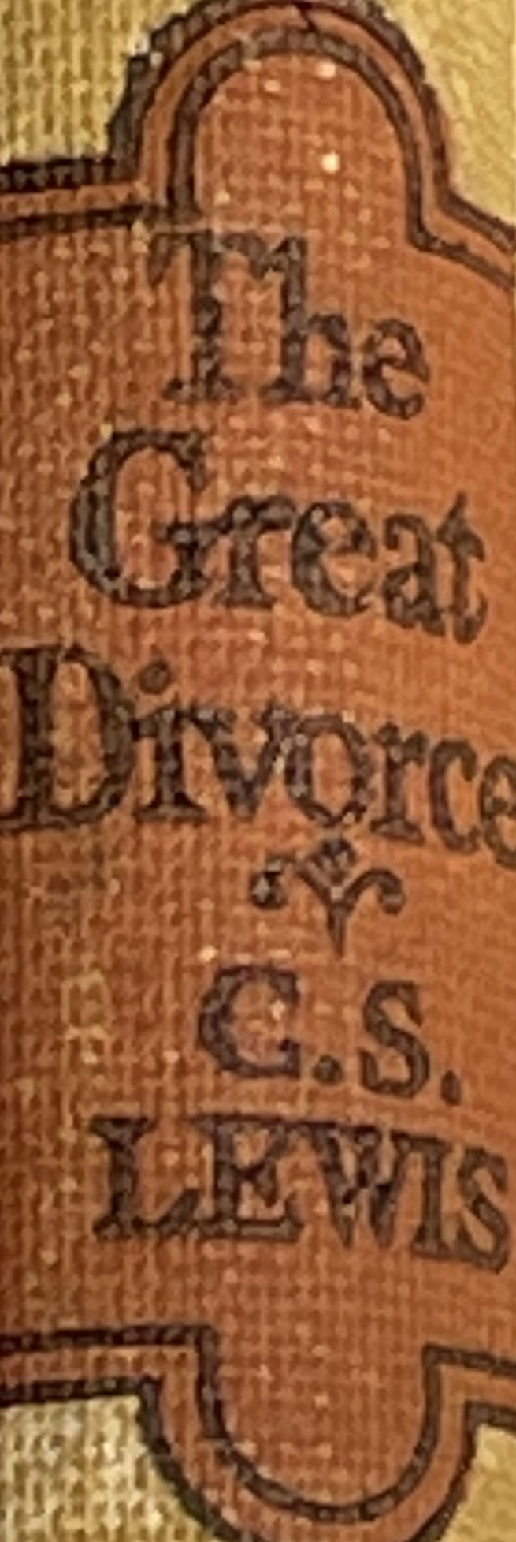
November 9, 2022 St. Philip’s Church The Rev’d Brian K. McGreevy, J.D., Facilitator
The Great Divorce:
C.S. Lewis on God’s Truth
or Your Truth

Slide 2
In the presence of God and of Christ Jesus, who will judge the living and the dead, and in view of his appearing and his kingdom, I give you this charge: Preach the word; be prepared in season and out of season; correct, rebuke and encourage—with great patience and careful instruction.
For the time will come when people will not put up with sound doctrine. Instead, to suit their own desires, they will gather around them a great number of teachers to say what their itching ears want to hear. They will turn their ears away from the truth and turn aside to myths. But you, keep your head in all situations, endure hardship, do the work of an evangelist, discharge all the duties of your ministry. (2 Timothy 4:1-4)

Slide 3
How to approach this class: --On the beach --Snorkeling --Scuba diving --Email list How to read this book: --Try reading aloud --One chapter at a time
AN ANNOUNCEMENT!

Slide 4
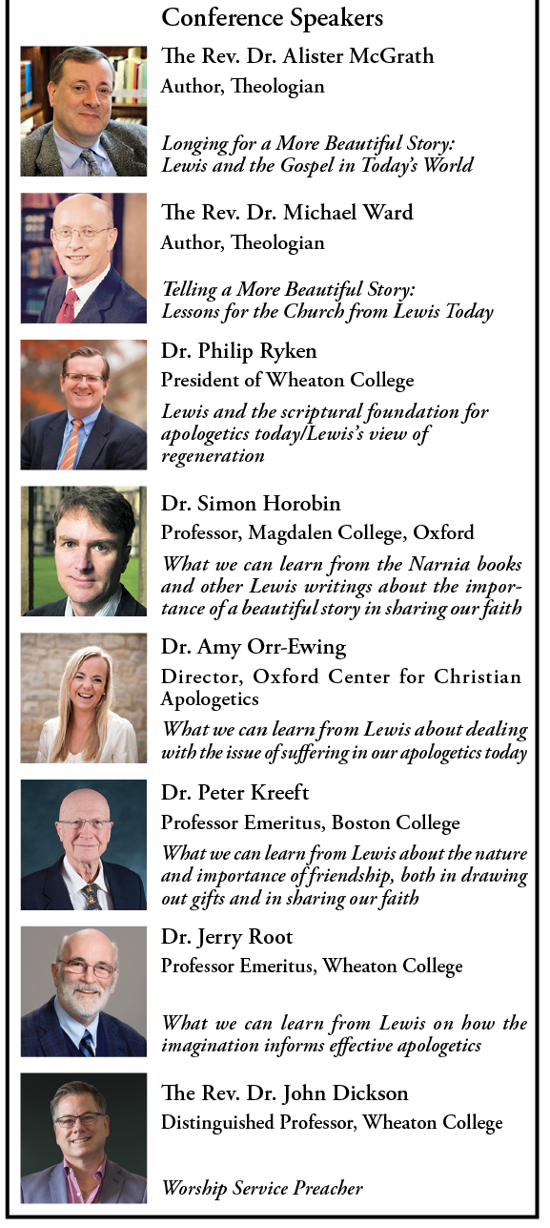
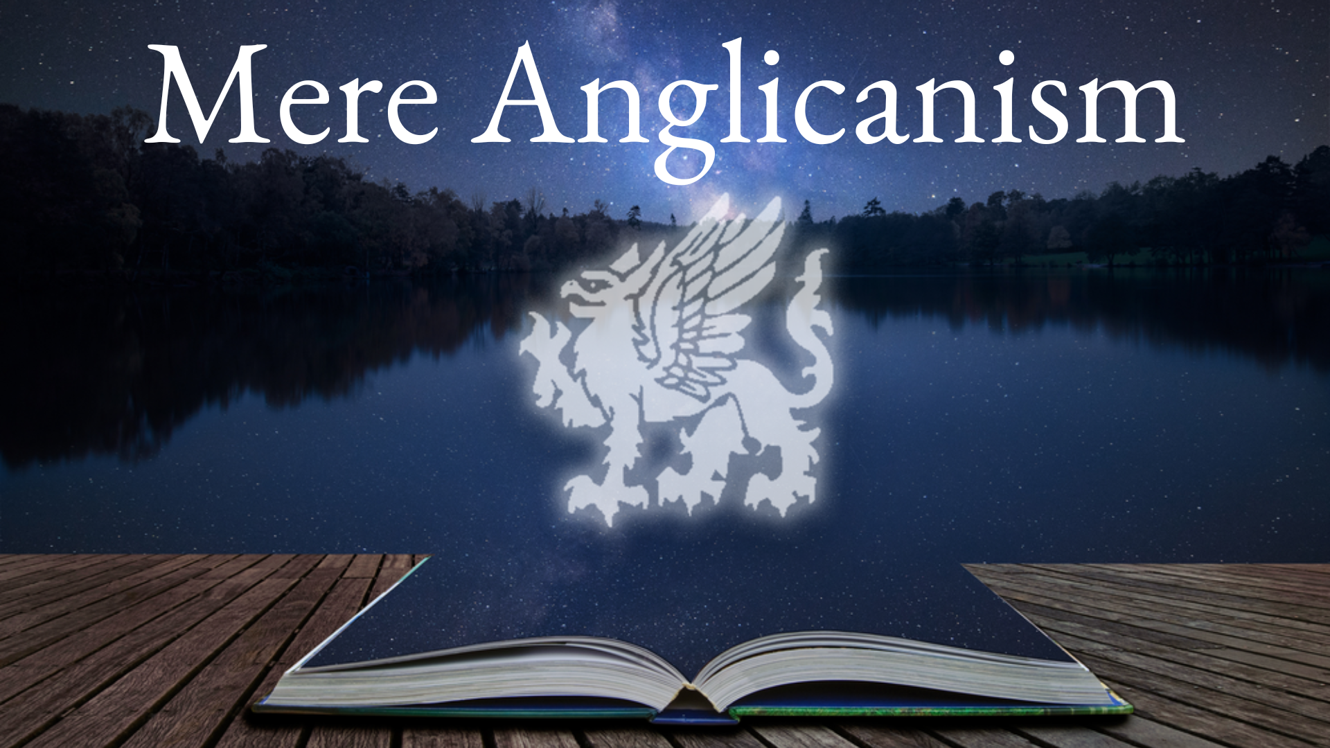
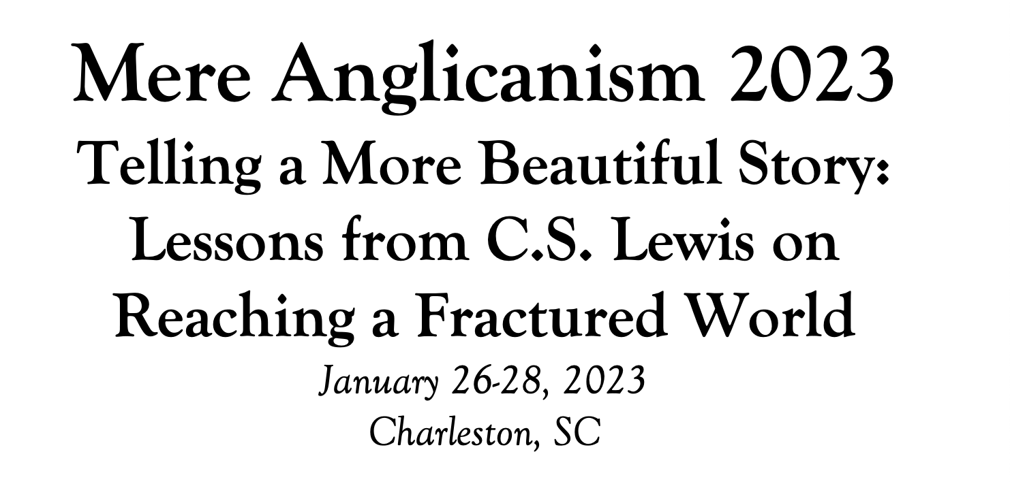

Slide 5
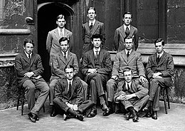
Tonight’s Music!
REVIEW
Why does The Great Divorce merit study today?
--Emphasis on eternal life with a vivid description of the awfulness of Hell and the glorious beauty of Heaven that will fire your heart with longing
--Narcissism and pride are rife in our culture today, and Lewis shows the consequences of both.
--Truth as an absolute is under cultural attack as never before, with the idea of speaking your own truth held up as the highest good. Lewis shows decisively in this story what happens when you hold onto your own ”truth” and refuse to acknowledge God’s Truth.
--Obsession in our culture about our Rights and what we are owed, rather than focusing on servanthood and self-sacrifice
--Clarity about either/or rather than gray view of choices
--A brilliant rebuttal of works righteousness in favor of the centrality of the Cross

Slide 6
SUMMARY OF CHAPTER TWO
The Tousle-Headed Poet—blaming others, oppressed
Violent quarrels—stampede, knives, gunshots—seemed somehow normal
The Intelligent-looking Man—grey town, villains of old, bring something real, fear of Dark
The Cultured Man--half-light leading to new dawn of a spiritual city of freedom
The Light--revealing both Beauty and ugliness
MAJOR THEMES IN CHAPTER TWO
1. The importance of perspective
2. The danger of blaming others for our misfortunes
3. Constant quarrelsome speech easily leads to casual violence
4. Light reveals Truth, whether showing Beauty or exposing Evil

Slide 7
SUMMARY OF CHAPTER 3
The bus climbs over the rim of a cliff and lands in a beautiful country of green grass and a broad river
--light and coolness drenching like a summer morning, a lark singing
--a larger and wider space beyond description, sense of freedom but also sense of exposure
The light gives a new perspective
--the narrator and fellow passengers are transparent ghosts, stains on the air
--OR the light, the trees, the grass were different—so much solider than any on earth
--grass and dewdrops undisturbed by passengers walking, grass and flowers impossible to lift or break
Passengers huddled together, some fleeing back to bus in terror, others wanting a schedule
--driver says no one need return to the bus or grey town unless they so desire
--some are expecting to be met by someone
Vast solitude of Greenness and light, mountains and high cities in the distance, steep forests and valleys
--height so enormous that it is impossible to describe
Bright shapes in the distance are seen to be people coming to meet the bus, with the ground trembling under their step and sweet aromas as they walk on the grass
--massive and radiant and ageless people of grandeur, some naked, some robed

Slide 8
POSSIBLE INFLUENCES ON CHAPTER 3
The parable of Lazarus and the rich man: “There was a rich man who was dressed in purple and fine linen and lived in luxury every day. At his gate was laid a beggar named Lazarus, covered with sores and longing to eat what fell from the rich man’s table. Even the dogs came and licked his sores. The time came when the beggar died and the angels carried him to Abraham’s side. The rich man also died and was buried. In Hades, where he was in torment, he looked up and saw Abraham far away, with Lazarus by his side. So he called to him, ‘Father Abraham, have pity on me and send Lazarus to dip the tip of his finger in water and cool my tongue, because I am in agony in this fire.’ But Abraham replied, ‘Son, remember that in your lifetime you received your good things, while Lazarus received bad things, but now he is comforted here and you are in agony. And besides all this, between us and you a great chasm has been set in place, so that those who want to go from here to you cannot, nor can anyone cross over from there to us.’He answered, ‘Then I beg you, father, send Lazarus to my family,for I have five brothers. Let him warn them, so that they will not also come to this place of torment.’ Abraham replied, ‘They have Moses and the Prophets; let them listen to them.’ “‘No, father Abraham,’ he said, ‘but if someone from the dead goes to them, they will repent.’ He said to him, ‘If they do not listen to Moses and the Prophets, they will not be convinced even if someone rises from the dead.’” Luke 16:19-31
The green country and the beautiful mountains in J.R.R. Tolkien’s story Leaf by Niggle: “Be­fore long he found that the path on which he had started had disappeared, and [he] was rolling along over a marvellous turf. It was green and close; and yet he could see every blade distinctly… You could go on and on, but not perhaps for ever. There were the Mountains in the background. They did get nearer, very slowly…He was going to learn about…the high pasturages, and look at a wider sky, and walk ever further and further towards the Mountains, always uphill.”

Slide 9
POSSIBLE INFLUENCES ON CHAPTER 3 (cont’d)
The Celestial City in John Bunyan’s Pilgrim’s Progress:
“The talk they had with the Shining Ones was about the glory of the place; who told them that the beauty and glory of it was inexpressible. "There," said they, "is the Mount Zion, the heavenly Jerusalem; the innumerable company of angels; and the spirits of just men made perfect. “You are going now," said they, "to the Paradise of God; wherein you shall see the tree of life, and eat of the never fading fruits thereof. And when you come there, you shall have white robes given you; and your walk and talk shall be every day with the King, even all the days of eternity.”
The description of Heaven in Frodo’s dream in The Fellowship of the Ring and Gandalf’s answer in The Return of the King, in Tolkien’sThe Lord of the Rings trilogy:
“Frodo heard a sweet singing running in his mind: a song that seemed to come like a pale light behind a grey rain-curtain and growing stronger to turn the veil all to glass and silver, until at last it was all rolled back, and a far green country opened before him under a swift sunrise.”
[Gandalf replied,] “The grey rain-curtain of this world rolls back, and all turns to silver glass, and then you see it. “What? Gandalf? See what?” “White shores, and beyond, a far green country under a swift sunrise.”

Slide 10
MAJOR THEMES IN CHAPTER 3
The beauty and strength and solidity of Heaven “At last the top of the cliff became visible like a thin line of emerald green stretched tight as a fiddle-string. Presently we glided over that top: we were flying above a level, grassy country through which there ran a wide river… through the open door there came to me in the fresh stillness the singing of a lark. I got out. The light and coolness that drenched me were like those of summer morning, early morning a minute or two before the sunrise, only that there was a certain difference. I had the sense of being in a larger space, perhaps even a larger sort of space, than I had ever known before: as if the sky were further off and the extent of the green plain wider than they could be on this little ball of earth. I had got "out" in some sense which made the Solar System itself seem an indoor affair I noticed that the grass did not bend under their feet: even the dew drops were not disturbed... It was the light, the grass, the trees that were different; made of some different substance, so much solider than things in our country that men were ghosts by comparison.”
“Then the angel showed me the river of the water of life, bright as crystal, flowing from the throne of God and of the Lamb through the middle of the street of the city; also, on either side of the river, the tree of life with its twelve kinds of fruit, yielding its fruit each month. The leaves of the tree were for the healing of the nations. No longer will there be anything accursed, but the throne of God and of the Lamb will be in it, and his servants will worship him. They will see his face, and his name will be on their foreheads. And night will be no more. They will need no light of lamp or sun, for the Lord God will be their light, and they will reign forever and ever.” (Rev. 22:1-5)
“For he was looking forward to the city that has foundations, whose designer and builder is God.”(Hebrews 11:8)

Slide 11
MAJOR THEMES IN CHAPTER 3
The beauty of heavenly beings “Because they were bright I saw them while they were still very distant, and at first I did not know that they were people at all. Mile after mile they drew nearer. The earth shook under their tread as their strong feet sank into the wet turf. A tiny haze and a sweet smell went up where they had crushed the grass and scattered the dew. Some were naked, some robed. But the naked ones did not seem less adorned, and the robes did not disguise in those who wore them the massive grandeur of muscle and the radiant smoothness of flesh. Some were bearded but no one in that company struck me as being of any particular age.”
“Beloved, now we are children of God, and it has not appeared as yet what we shall be. We know that, when He appears, we shall be like Him, because we shall see Him just as He is.” (I John 3:2) “Christ will transform our lowly body that it may be conformed to His glorious body, according to the working by which He is able even to subdue all things to Himself.” (Phil. 3:21)
“His countenance was like lightning, and his clothing as white as snow.” (Mt. 28:3)

Slide 12
“I believe, to be sure, that any man who reaches Heaven will find that
what he abandoned (even in plucking out his right eye) has not been lost:
that the kernel of what he was really seeking even in his most depraved wishes
will be there, beyond expectation, waiting for him in 'the High Countries'.” ― C.S. Lewis, The Great Divorce

