Slide 1

November 2, 2022
St. Philip’s Church
The Rev’d Brian K. McGreevy, J.D., Facilitator
The Great Divorce:
C.S. Lewis on God’s Truth
or Your Truth

Slide 2
In the presence of God and of Christ Jesus, who will judge the living and the dead, and in view of his appearing and his kingdom, I give you this charge: Preach the word; be prepared in season and out of season; correct, rebuke and encourage—with great patience and careful instruction.
For the time will come when people will not put up with sound doctrine. Instead, to suit their own desires, they will gather around them a great number of teachers to say what their itching ears want to hear. They will turn their ears away from the truth and turn aside to myths. But you, keep your head in all situations, endure hardship, do the work of an evangelist, discharge all the duties of your ministry. (2 Timothy 4:1-4)

Slide 3
How to approach this class:
--On the beach
--Snorkeling
--Scuba diving
--Email list
How to read this book:
--Try reading aloud
--One chapter at a time
AN ANNOUNCEMENT!

Slide 4
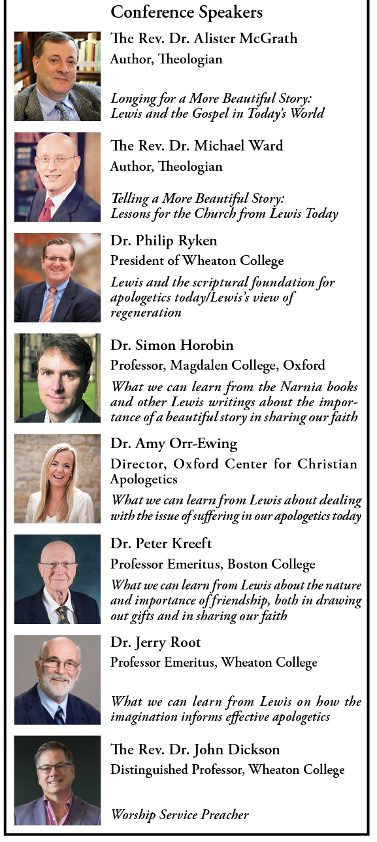
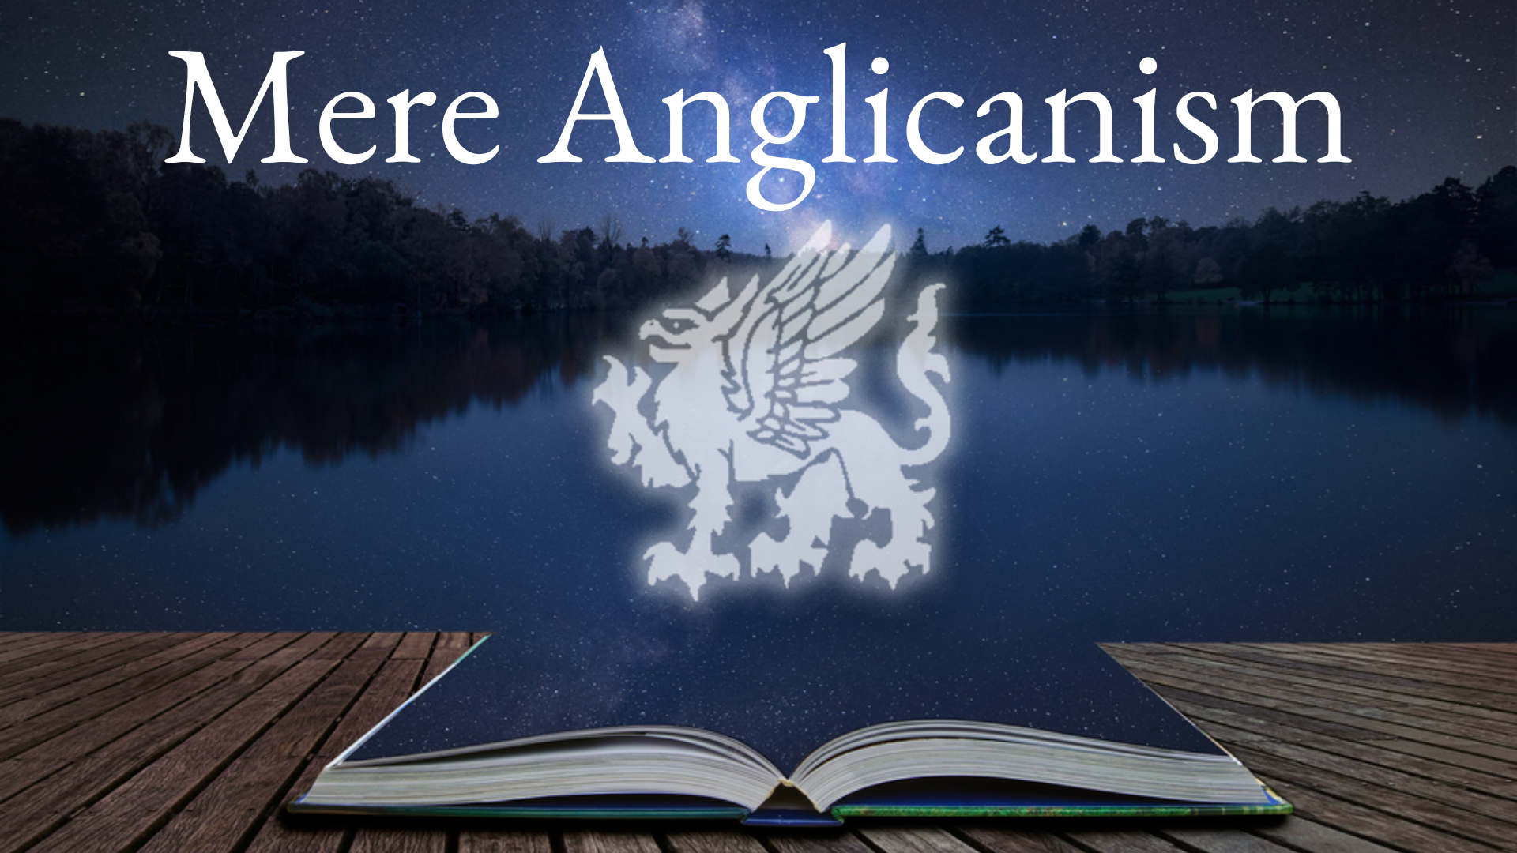
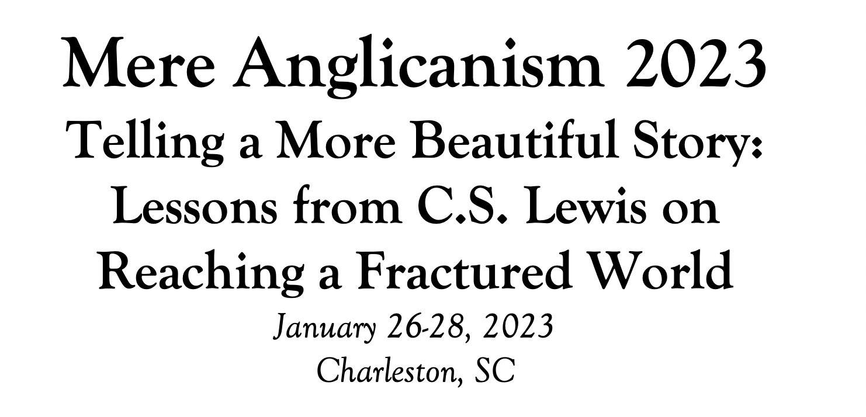

Slide 5
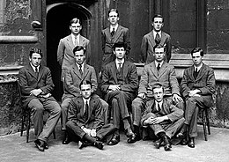
Tonight’s Music!
REVIEW
Why does The Great Divorce merit study today?
--Emphasis on eternal life with a vivid description of the awfulness of Hell and the glorious beauty of Heaven that will fire your heart with longing
--Narcissism and pride are rife in our culture today, and Lewis shows the consequences of both.
--Truth as an absolute is under cultural attack as never before, with the idea of speaking your own truth held up as the highest good. Lewis shows decisively in this story what happens when you hold onto your own ”truth” and refuse to acknowledge God’s Truth.
--Obsession in our culture about our Rights and what we are owed, rather than focusing on servanthood and self-sacrifice
--Clarity about either/or rather than gray view of choices
--A brilliant rebuttal of works righteousness in favor of the centrality of the Cross

Slide 6
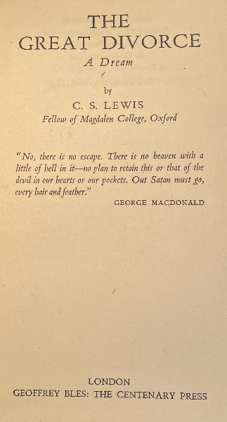
MAJOR THEMES IN THE PREFACE
1. You can’t have it all.
2. Choices matter, and you may be called to renounce things on the journey.
3. Repentance and a new start are prerequisites for the journey.
4. Anything we leave behind will pale in the face of what God has in store. 5. This story is a fantasy and a supposal, not a factual description of the after-life.
MAJOR THEMES IN CHAPTER ONE
Bad choices can have lasting consequences.
Now the works of the flesh are evident: sexual immorality, impurity, sensuality, idolatry, sorcery, enmity, strife, jealousy, fits of anger, rivalries, dissensions, divisions, envy, drunkenness, orgies, and things like these. I warn you, as I warned you before, that those who do such things will not inherit the kingdom of God. But the fruit of the Spirit is love, joy, peace, patience, kindness, goodness, faithfulness, gentleness, self-control; against such things there is no law. (Galatians 5:19-23)
2. The children of darkness disdain the children of light.
And this is the judgment: the light has come into the world, and people loved the darkness rather than the light because their works were evil. For everyone who does wicked things hates the light and does not come to the light, lest his works should be exposed. But whoever does what is true comes to the light, so that it may be clearly seen that his works have been carried out in God. (Jn. 3:19-21)

Slide 7
Some of Lewis’s likely inspirations seen in Chapter One
The Refrigerium
“Did ye never hear of the Refrigerium? A man with your advantages might have read of it in Prudentius, not to mention Jeremy Taylor.” George MacDonald in Ch. 9 of The Great Divorce
Prudentius: an early Roman Christian poet, author of hymns like “Of the Father’s Love Begotten” and “Earth Has Many a Noble City”—Lewis knew his work well.
Jeremy Taylor: a 17th century Anglican divine whose 1650 sermon “Christ’s Advent to Judgment”talks about the Catholic idea of the Refrigerium mentioned in Prudentius– the idea that the damned are given occasional repose from the torments of Hell by being granted “days off” in other places.
“The Celestial Omnibus”—short story by E.M. Forster (1911)
Forster was a well-known and popular British author some twenty years older than Lewis
This short story focuses on a boy with a strong sense of wonder who sees a sign at a bus stop saying “To Heaven.” His pseudo-intellectual parents and their friends mock him. The boy actually finds the bus and travels to Heaven and is overcome with wonder at its beauty. One of his parents’ snobbish friends goes with the boy the next time but finds a different bus, where Dante is the guide and where there is a quotation from the Inferno slightly altered to say “Abandon self-importance” rather than “Abandon hope.”

Slide 8
SUMMARY OF CHAPTER TWO
The Tousle-Headed Poet
--not appreciated by parents nor by five schools he attended, never fit it
--oppressed by Capitalism so his true genius was never recognized
--treated unfairly by stern, bourgeois father who never gave him a large enough allowance
--unappreciated/mistreated by girlfriend interested in monogamy and bourgeois prejudices
--similarities to young Lewis?
--threw himself under a train
THEN
Violent quarrels—stampede, knives, gunshots—seemed somehow normal
THEN
The Intelligent-looking Man
--grey town is endless because of perpetual quarreling and moving on
--time and distance are extreme-- the bus stop is thousands of miles from the Civic Centre where newcomers arrive from earth. All the passengers were living near the bus stop: but they took centuries-of our time-to get there
--well-known villains of the past live there, but only on the outer fringes light years away (Tamberlaine, Genghis Khan, Julius Caesar, Henry V); only Napoleon has actually been seen by anyone, alone in a huge Empire-style house and pacing as he muttered 'It was Soult's fault. It was Ney's fault. It was Josephine's fault. It was the fault of the Russians. It was the fault of the English.'

Slide 9
--No one has needs because you can get whatever you want by imagining it. There’s no economic basis for any community life.
--if I can bring back any real commodity to sell from the bus trip, there would be demand for it and that scarcity would help build a society, draw people closer together, and perhaps allow the formation of a police force for safety in numbers.
--houses don’t keep out the rain but they give the feeling of safety
--eventually it is going to get Dark, a frightening prospect, because “They” may appear
THEN
The Cultured Man
--no evidence twilight is ever going to turn to night
--half-light is actually promise of a new dawn of a spiritual city where man will be free from matter
THEN
The Light
--light reveals a beautiful blue and radiant abyss outside the bus, whose brightness stings the eyes, along with fresh and delicious air
--light inside the bus cruelly reveals faces gaunt, distorted, and faded, that seemed they might even be destroyed by the light as it grew stronger

Slide 10
MAJOR THEMES IN CHAPTER TWO
The importance of perspective
--“We were now so high that all below us had become featureless. But fields, rivers, or mountains I did not see, and I got the impression that the grey town still filled the whole field of vision.
--"It will be dark presently," he mouthed. "You mean the evening is really going to turn into a night in the end?" He nodded. "What's that got to do with it?" said I. "Well ... no one wants to be out of doors when that happens.”
--”There is not a shred of evidence that this twilight is ever going to turn into a night. There has been a revolution of opinion on that in educated circles…All the nightmare fantasies of our ancestors are being swept away. What we now see in this subdued and delicate half-light is the promise of the dawn: the slow turning of a whole nation towards the light…But we look on this spiritual city-for with all its faults it is spiritual- as a nursery in which the creative functions of man, now freed from the clogs of matter, begin to try their wings.”
And do not be conformed to this world, but be transformed by the renewing of your mind, so that you may prove what the will of God is, that which is good and acceptable and perfect. (Romans 12:2) Set your mind on the things above, not on the things that are on earth. (Col. 3:2)
2. The danger of blaming others for our misfortunes
--”He appeared to be a singularly ill-used man. His parents had never appreciated him and none of the five schools at which he had been educated seemed to have made any provision for a talent and temperament such as his. To make matters worse he had been exactly the sort of boy in whose case the examination system works out with the maximum unfairness and absurdity. It was not until he reached the university that he began to recognise that all these injustices did not come by chance but were the inevitable results of …Capitalism,which did not merely enslave the workers, it also vitiated taste and vulgarised intellect: hence our educational system and hence the lack of "Recognition" for new genius.”

Slide 11
--”It was Soult's fault. It was Ney's fault. It was Josephine's fault. It was the fault of the Russians. It was the fault of the English.' Like that all the time. Never stopped for a moment. A little, fat man and he looked kind of tired. But he didn't seem able to stop it.”
Do everything without complaining or arguing so that you may be blameless and pure, children of God without fault in a crooked and perverse generation, in which you shine as lights in the world as you hold forth the Word of Life (Philippians 2:14-16) Why do you see the speck that is in your brother's eye, but do not notice the log that is in your own eye? (Matt. 7:3) When a man's folly brings his way to ruin, his heart rages against the Lord. (Prov. 19:3) For by the grace given to me I say to everyone among you not to think of himself more highly than he ought to think, but to think with sober judgment, (Rom. 12:3)
3. Constant quarrelsome speech easily leads to casual violence
--"One of the quarrels which were perpetually simmering in the bus had boiled over and for a moment there was a stampede. Knives were drawn: pistols were fired: but it all seemed strangely innocuous and when it was over I found myself unharmed.”
What causes fights and quarrels among you? Don't they come from your desires that battle within you? You want something but don't get it. You kill and covet, but you cannot have what you want. (James 4:1) Remind them of these things, and charge them before God not to quarrel about words, which does no good, but only ruins the hearers. Do your best to present yourself to God as one approved, a worker who has no need to be ashamed, rightly handling the word of truth. But avoid irreverent babble, for it will lead people into more and more ungodliness, and their talk will spread like gangrene. (2Timothy 2:14-16)
4. Light reveals Truth, whether showing Beauty or exposing Evil
--“It began to grow light in the bus. The greyness outside the windows turned from mud-colour to mother of pearl, then to faintest blue, then to a bright blueness that stung the eyes. We seemed to be floating in a pure vacancy. There were no lands, no sun, no stars in sight: only the radiant abyss.”

Slide 12
--“the bus was full of light. It was cruel light. I shrank from the faces and forms by which I was surrounded. They were all fixed faces, full not of possibilities but of impossibilities, some gaunt, some bloated, some glaring with idiotic ferocity, some drowned beyond recovery in dreams; but all, in one way or another, distorted and faded. One had a feeling that they might fall to pieces at any moment if the light grew much stronger.”
And this is the judgment: the light has come into the world, and people loved the darkness rather than the light because their works were evil. (Jn. 3:19) For God, who said, “Let light shine out of darkness,” has shone in our hearts to give the light of the knowledge of the glory of God in the face of Jesus Christ. (2 Cor. 4:6)

Slide 13
“I believe, to be sure, that any man who reaches Heaven will find that what he abandoned (even in plucking out his right eye) has not been lost: that the kernel of what he was really seeking even in his most depraved wishes will be there, beyond expectation, waiting for him in 'the High Countries'.”
― C.S. Lewis, The Great Divorce

