Slide 1
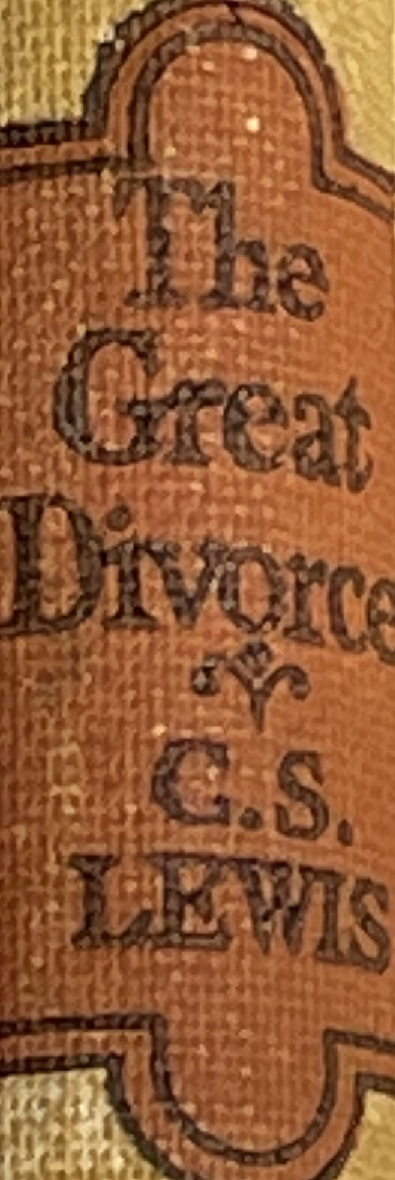
September 21, 2022 St. Philip’s Church The Rev’d Brian K. McGreevy, J.D., Facilitator
The Great Divorce:
C.S. Lewis on God’s Truth
or Your Truth

Slide 2
In the presence of God and of Christ Jesus, who will judge the living and the dead, and in view of his appearing and his kingdom, I give you this charge: Preach the word; be prepared in season and out of season; correct, rebuke and encourage—with great patience and careful instruction.
For the time will come when people will not put up with sound doctrine. Instead, to suit their own desires, they will gather around them a great number of teachers to say what their itching ears want to hear. They will turn their ears away from the truth and turn aside to myths. But you, keep your head in all situations, endure hardship, do the work of an evangelist, discharge all the duties of your ministry. (2 Timothy 4:1-4)

Slide 3
How to approach this class: --On the beach --Snorkeling --Scuba diving --Email list How to read this book: --Try reading aloud --One chapter at a time

Slide 4
Tonight’s music!
I. Who was C.S. Lewis?
II. Why does The Great Divorce merit study today?
III. Review of Context: England in Wartime --Other works Lewis was writing during this same period --The RAF ministry of Lewis and its impact on his writing
IV. Front matter:
--The title
--The frontispiece
--The preface

Slide 5
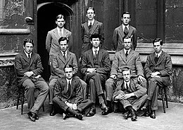
I. Who was C.S. Lewis?
--Born in Belfast, Northern Ireland in 1898 --Painful and dysfunctional childhood --Oxford 1917 --Despair and bitterness after World War I --A brilliant Triple First in Moderations (Greek and Latin Literature), Greats (Philosophy and Ancient History), and English --Brilliant, proud, and aggressive atheism --Worldly success: elected Fellow of Magdalen in 1925, first works published Sehnsucht
--Met J.R.R. Tolkien in 1926 at Merton College English faculty meeting --Addison’s Walk, True Myth, and conversion to Christian faith in 1931 --The Inklings begin --Revised English syllabus by Lewis and Tolkien accepted by Oxford University: 1933

Slide 6
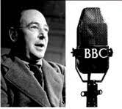
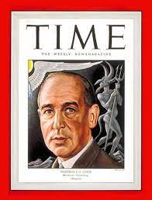
--Lewis invited to write the volume on 16th Century English Literature for the Oxford History of English Literature 1935 --Prize for Literature: The Allegory of Love (a study in medieval tradition) 1937 --The Screwtape Letters 1941 --Mere Christianity broadcasts begin during the Blitz
--Honorary Doctor of Divinity from University of St. Andrews 1944 --Elected Fellow of the Royal Society of Literature --Featured on cover of TIME Magazine, over 1 million copies of his then 15 books have sold 1947 --Writes first of Chronicles of Narnia 1950, completes all seven by 1955 --Elected to but declines Order of the British Empire (OBE) --Accepts Chair of Medieval and Renaissance Literature at Cambridge 1954
--Dies November 22, 1963, having published over 50 nonfiction works and more than 20 works of fiction, in addition to several volumes of poetry and numerous academic essays
II. Why does The Great Divorce merit study today?
III. Review of Context --England in Wartime --Other works Lewis was writing during this same period --The RAF ministry of Lewis and its impact on his writing
IV. Front matter:
--The title
--The frontispiece
--The preface

Slide 7
II. Why does The Great Divorce merit study today?
--an overview of the story
--Emphasis on eternal life with a vivid description of the awfulness of Hell and the glorious beauty of Heaven that will fire your heart with longing
--Narcissism and pride are rife in our culture today, and Lewis shows the consequences of both. As one scholar put it, “They prefer their own sinful obsessive selves to the loss of self which is necessary before they can be saved.”
--Truth as an absolute is under cultural attack as never before, with the idea of speaking your own truth held up as the highest good. Lewis shows decisively in this story what happens when you hold onto your own ”truth” and refuse to acknowledge God’s Truth.
--Obsession in our culture about our Rights and what we are owed, rather than focusing on servanthood and self-sacrifice
--Clarity about either/or rather than gray view of choices
--A brilliant rebuttal of works righteousness in favor of the centrality of the Cross
“Lewis’s genius lay in his ability to show how a Christian viewpoint was able to offer a more satisfactory explanation of common human experience than its rivals, especially the atheism he had once himself so enthusiastically advocated.”—Dr. Alister McGrath, Andreas Idreos Chair of Science and Religion, Oxford University
--The preface

Slide 8
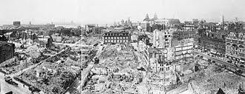
III. England in Wartime: A Lewis Timeline
1939 Lewis begins writing The Problem of Pain at the request of Ashley Sampson of Centenary Press Civilian evacuations from London begin Responding to Hitler’s aggression, England and France declare war on Germany 1940 Rationing begins in England Lewis publishes The Problem of Pain, which is read and lauded by the Rev. James Welch, Head of Religious Broadcasting for the BBC
Nazis invade France, Belgium, and the Netherlands; Churchill named Prime Minister
Dunkirk evacuation begins Lewis has the idea for The Screwtape Letters Battle of Britain begins First German air raids on London During the 8 months of the Blitz, 43,000 civilians were killed. One of every six Londoners was made homeless and at least 1.1 million houses and flats were damaged or destroyed.
1941 Lewis gives first wartime RAF talk
The Screwtape Letters appears in serial form in The Guardian

Slide 9
Lewis delivers The Weight of Glory sermon in Oxford First BBC talk by Lewis
Lewis delivers Ballard Matthews Lectures on Milton at University College in Wales
1942
Lewis organizes first meeting of Oxford Socratic Club
Lewis delivers a regular series of talks live on the BBC which later become the core of Mere Christianity
Baedeker Blitz begins
Lewis publishes The Screwtape Letters
Lewis publishes A Preface to Paradise Lost
1943
Allied invasion of Italy from North Africa commences
Lewis delivers Riddell Memorial Lectures at University of Durham, subsequently published as The Abolition of Man
Lewis continues BBC and RAF talks
Lewis publishes Christian Behavior
Women between 19 and 50 called up to work in aircraft and munitions plants

Slide 10
1944
The Great Divorce was published in weekly installments in the Anglican newspaper The Guardian
Lewis publishes Perelandra
“Baby Blitz” night bombing of Southern England begins
Flying bomb and rocket attacks on London intensify
Lewis continues BBC and RAF talks June 6, 1944—D-Day invasion of Normandy
1945
That Hideous Strength published March 29, 1945—Final German bombing raid on England May 8, 1945—Churchill declares VE Day as Germany surrenders July 16, 1945—Lewis gives final RAF talk

Slide 11
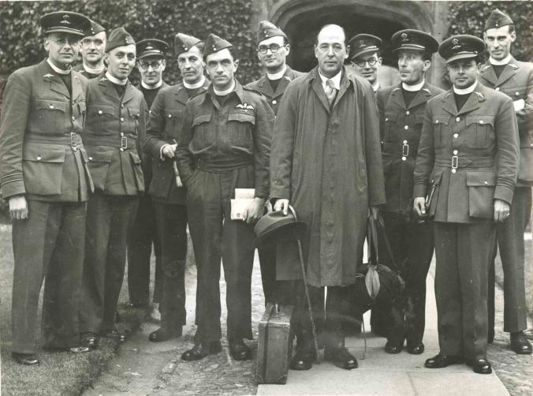
The RAF Ministry of Lewis and its Impact on His Writing
“When Maurice Edwards, chief chaplain of the RAF (Royal Air Force), asked Lewis to speak to the troops about spiritual matters, he readily agreed. Unfortunately Lewis, who had taught philosophy and literature as a tutor at Oxford University since 1924, had no idea how to speak to nonscholarly audiences. In an April 1941 lecture to RAF chaplains, he discussed linguistic analysis in Pauline soteriology. The chaplains fidgeted. One openly did a crossword. Afterward Lewis wrote to a friend that his talk was “a complete failure,” taking comfort in the fact that “God used an ass to convert the prophet.” Lewis learned from his initial failures as a speaker. Reminded that the RAF chaplains were “probing life in the raw and trying to do something about it,” he began choosing more down-to-earth topics. (David Neff, Christian History Magazine No. 116)
“[RAF Chaplain Stuart] Babbage told him that it was very difficult to get the men to come to services and talks of their own volition. The problem was that for the working-class men there was a great stigma, even taboo, about going to church and many felt they couldn’t express their faith. The majority of people at that chapel service in the evening would have been officers, but not exclusively. For the non-officers in attendance, it probably meant a hard time when back in barracks. Lewis said to Babbage in a quiet voice, “It might be helpful if I told them something of what it has cost me to be a Christian.”
“Lewis stood at the lectern. He looked dishevelled in his baggy suit with his dumpy frame, bald head and red nose. He didn’t look much, but his talk that evening was electric. He explained to the listeners that he had had to endure ridicule and ostracism from his friends and colleagues at University for his Christian faith. They were happy for him to be a Christian, but much less happy for him to talk about it and live it out.
Lewis was deeply wounded, even lonely. Lewis spoke about Jesus and the humiliation of the cross, the flies and the beatings. He spoke about the cost of faith and encouraged the men to keep going and not give up. Babbage said it was one of the “most personal and intense and passionate talks” that he’d ever heard. Steve Morse, “C.s. Lewis : The Making of a Relucatnt Christian Superstar,” The Critic, March 2021.

Slide 12
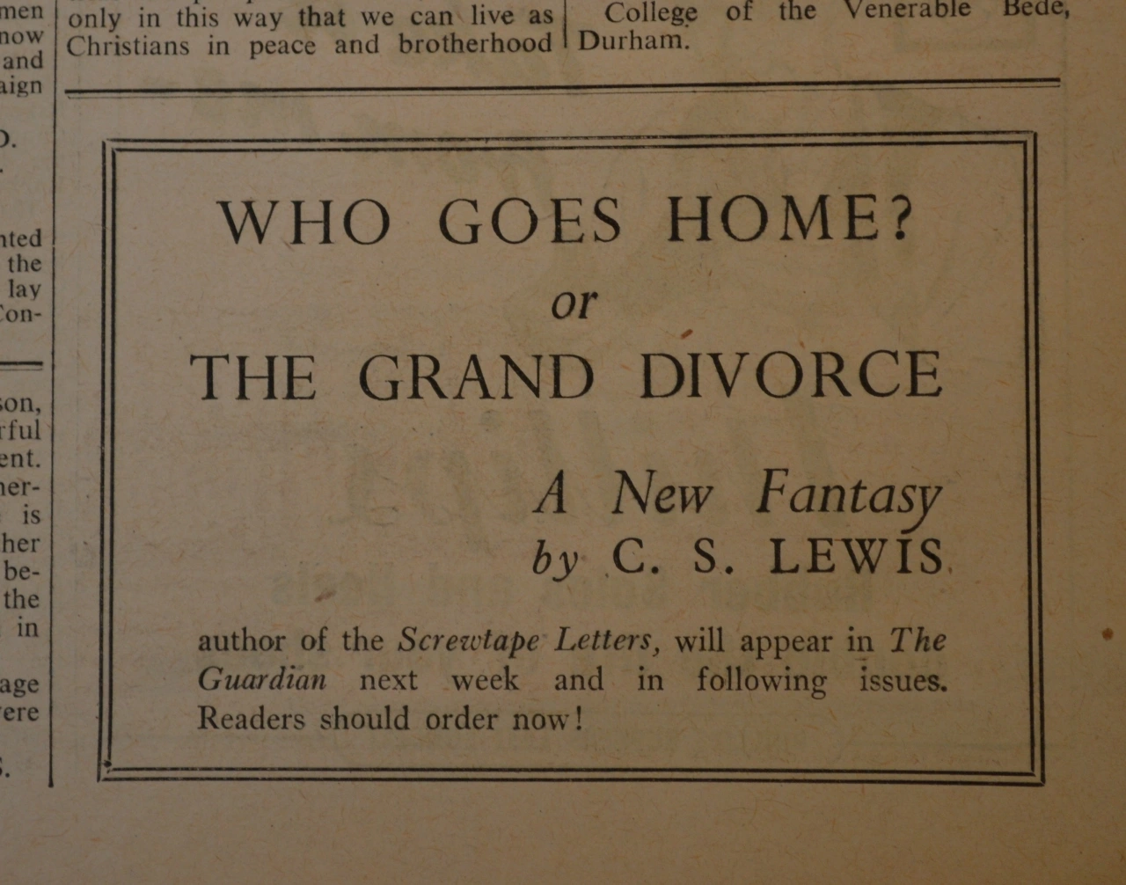
IV. Front matter:
--The title
Originally published as a serial in the Anglican weekly periodical The Guardian, The Great Divorce was originally entitled Who Goes Home? A New Fantasy and also The Grand Divorce: A New Fantasy. The idea of ”home” features prominently in the book, reflecting the longing for home that is perhaps even stronger in our culture today. The Grand Divorce or Great Divorce clearly comes from William Blake’s The Marriage of Heaven and Hell. Blake (1757-1827) was a brilliant writer and painter who many thought was mad, though he had flashes of brilliance. He was fascinated with the Christian faith, but especially in his early life he had very unorthodox beliefs, thinking that restraining any desire or the practice of any kind of self-sacrifice was anathema and not part of true religion, into which he wanted to incorporate a number of ideas from the French Revolution and the Enlightenment. Blake also talked about the energy of desire from Hell as a good thing.
Lewis would have none of that type of syncretism and emphasizes the importance of Choice and its consequences in the book. He posits that there is indeed a chasm between Heaven and Hell and draws out the distinctions. According to scholar Brenton Dickieson, Lewis may have sought a new ttitle because in a letter to his friend Sister Penelope he mentioned that “Who Goes Home?” was taken. Dickieson also believes Lewis may have been influenced in the choice of title by his friend Charles Williams’ poetry collection called The Divorce, where he uses the phrase “the great divorce” to refer to Death,

Slide 13
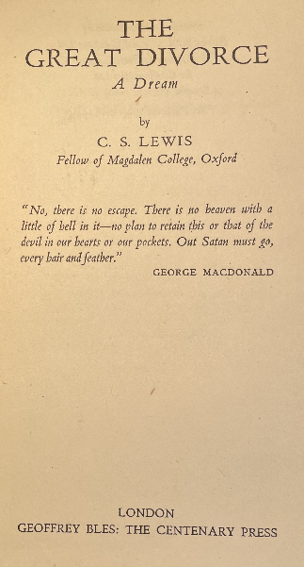
IV. Front matter:
--The frontispiece
The Great Divorce: A Dream
--Quotation from George MacDonald
“No, there is no escape. There is no heaven with a little of hell in it - no place to retain this or that of the devil in our hearts or our pockets. Out Satan must go, every hair and feather.”
--Britannica entry for George MacDonald
George Macdonald (1824-1905) novelist of Scottish life, poet, and writer of Christian allegories of man’s pilgrimage back to God, who is remembered chiefly, however, for his allegorical fairy stories, which have continued to delight children and their elders. He became a Congregational minister, then a free-lance preacher and lecturer. In 1855 he published a poetic tragedy, Within and Without, and after that he made literature his profession. Of his literature for adults, Phantastes: A Faerie Romance for Men and Women (1858) and Lilith (1895) are good examples. Although his best known book for children is At the Back of the North Wind (1871), his best and most enduring works are The Princess and the Goblin (1872) and its sequel, The Princess and Curdie (1873).
---Lewis said that reading George MacDonald’s Phantastes baptized his imagination. In wirting of MacDonald’s influence on him as a Christian writer, Lewis stated, “I have never concealed the fact that I regard him as my master; indeed I fancy I have never written a book in which I did not quote from him.”

Slide 14
IV. Front matter:
--The Preface: stay tuned!
A teaser:
“BLAKE WROTE the Marriage of Heaven and Hell. If I have written of their Divorce, this is not because I think myself a fit antagonist for so great a genius, nor even because I feel at all sure that I know what he meant. But in some sense or other the attempt to make that marriage is perennial. The attempt is based on the belief that reality never presents us with an absolutely unavoidable "either-or"; that, granted skill and patience and (above all) time enough, some way of embracing both alternatives can always be found; that mere development or adjustment or refinement will somehow turn evil into good without our being called on for a final and total rejection of anything we should like to retain.
“This belief I take to be a disastrous error. You cannot take all luggage with you on all journeys; on one journey even your right hand and your right eye may be among the things you have to leave behind. We are not living in a world where all roads are radii of a circle and where all, if followed long enough, will therefore draw gradually nearer and finally meet at the centre: rather in a world where every road, after a few miles, forks into two, and each of those into two again, and at each fork you must make a decision. Even on the biological level life is not like a pool but like a tree. It does not move towards unity but away from it and the creatures grow further apart as they increase in perfection. Good, as it ripens, becomes continually more different not only from evil but from other good.”

Slide 15
“I believe, to be sure, that any man who reaches Heaven will find that what he abandoned (even in plucking out his right eye) has not been lost: that the kernel of what he was really seeking even in his most depraved wishes will be there, beyond expectation, waiting for him in 'the High Countries'.” ― C.S. Lewis, The Great Divorce

