Slide 1
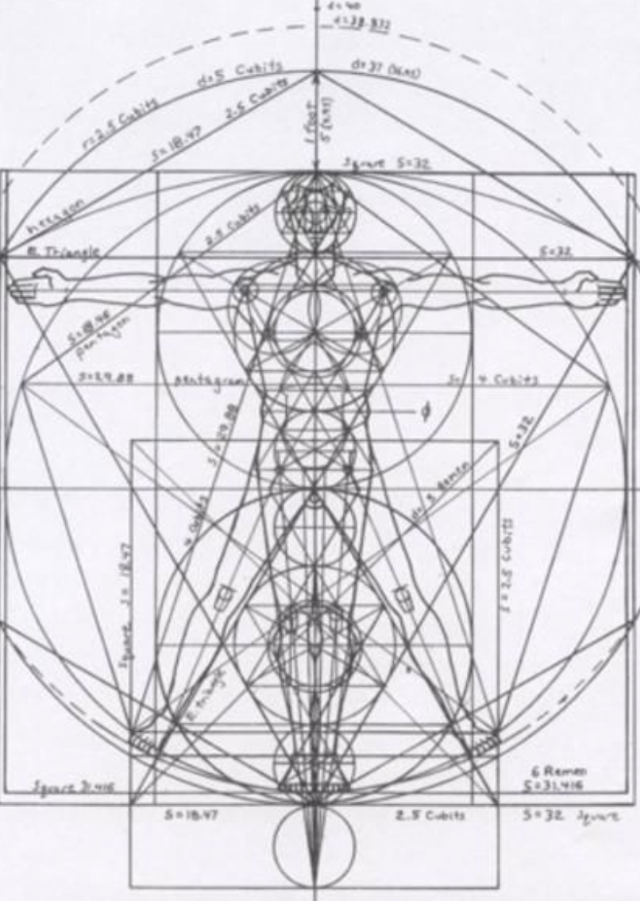
Not as Unwise but as Wise: Reflections from C.S. Lewis's The Abolition of Man and That Hideous Strength on Living Christianly in a Post-Christian World
March 23, 2022 -- St. Philip’s Church
The Rev’d Brian K. McGreevy, J.D., Facilitator

Slide 2
For at one time you were darkness, but now you are light in the Lord.
Walk as children of light (for the fruit of light is found in all that is good and right and true), and try to discern what is pleasing to the Lord. Take no part in the unfruitful works of darkness, but instead expose them. For it is shameful even to speak of the things that they do in secret. But when anything is exposed by the light, it becomes visible, for anything that becomes visible is light. Therefore it says, “Awake, O sleeper,
and arise from the dead, and Christ will shine on you.”
Look carefully then how you walk, not as unwise but as wise,
making the best use of the time, because the days are evil. Therefore do not be foolish,
but understand what the will of the Lord is.
Ephesians 5: 8-17

Slide 3
How to approach this class: --On the beach --Snorkeling --Scuba diving --Email list How to read That Hideous Strength:
--One chapter at a time --Make a chart of characters --Look for and note where themes from The Abolition of Man appear
What we’ll be doing each week:
--Examining context and establishing a framework for appreciating these books
--Unpacking the meaning of Lewis’s works
--Exploring their relevance for today
--Considering how we can respond with practices of Hope and of Wisdom rooted in the Scriptures

Slide 4
REVIEW FROM PREVIOUS CLASSES
Summary: Main theme of each chapter in The Abolition of Man
1. “Men without Chests”: The importance of objective values and the poison of subjectivism
2. “The Way”: Why the Tao, or Natural Law, is the sole source of all value judgments
3. “The Abolition of Man”: “Man’s control of Nature” is in reality a means for some men (Conditioners) to control other men, using Nature as their instrument. To “see through” (deconstruct) all things is not to see at all.
PLOT SUMMARY OF THE RANSOM TRILOGY Adapted from Taylor Dinerman, The Space Review
--“Out of the Silent Planet, tells how Ransom, a Cambridge don on holiday, is kidnapped by the physicist Weston and his partner Devine, a sleazy businessman, and taken to Malacandra (Mars), supposedly as a human sacrifice. --“Perelandra, the name Lewis gives to Venus, is also the title of the second book in the series. Retelling the story of Adam and Eve, it is the most explicitly biblical of the three. Weston plays the role of the serpent sent to tempt the woman who is to become the mother of the world into rejecting God’s will. Ransom is sent by the Oyarsa to challenge the evil one and to save Venus from the fate of Earth.
--“That Hideous Strength combines a sordid tale of intra-university politics, Arthurian legend, and spiritual combat. In a small British University town, one of the colleges finds itself seduced and then engulfed by the newly established National Institute for Coordinated Experiments (N.I.C.E). This organization is secretly controlled by a pair of initiates, who plan to revive the wizard Merlin from his long, enchanted slumber and to use his powers for their own purposes.
TITLE SOURCE
“The shadow of that hyddeous strength, sax myle and more it is of length”
(Sir David Lyndsay: from “Ane Dialog,” describing the Tower of Babel)
“This is a ‘tall story’ about devilry, though it has behind it a serious ‘point’ which I have tried to make in my Abolition of Man.” –from Preface to That Hideous Strength

Slide 5
REVIEW OF CHAPTER 1, “SALE OF COLLEGE PROPERTY”
--Jane and her dreams
--Mark and the Inner Circle at Bracton College
--The proposal to sell Bragdon Wood and Merlin’s Well to the N.I.C.E.
--The Dimbles and rumors of Merlin
REVIEW OF CHAPTER 2, “DINNER WITH THE SUBWARDEN”
--Mark and being included in Feverstone’s confidence in disdain of Curry and Busby
--The N.I.C.E. as the ultimate Inner Circle/Ring , focused on taking over and reconditioning the human race, controlling and subduing Nature, and exerting control over the interplanetary wars
--Jane’s fears and vulnerability, which she later rejects as unworthy
--Mark’s journey to Belbury and Jane’s journey to St. Anne’s-on-the-Hill
REVIEW OF CHAPTER 3, “BELBURY AND ST. ANNE’S-ON-THE-HILL”
--doublespeak at the N.I.C.E.: does Mark have a job or not? Bill Hingest leaving the N.I.C.E.
--Jane’s visit to St. Anne’s and her denial and her aversion to being “interfered with”
--Mark’s introduction to “Fairy” Hardcastle and the role of the N.I.C.E. secret police
--Jane’s resentment of how much she has had to give up in marriage; Mother Dimble’s crisis
REVIEW OF CHAPTER 4, “THE LIQUIDATION OF ANACHRONISMS”
--the N.I.C.E. begin turning people out of their homes and destroying Edgestow’s beauty
--Bill Hingest is murdered the night he leaves the N.I.C.E.
--Mark has a strange conversation with the N.I.C.E. “mad parson” and is assigned a propaganda project on destroying the village of Cure Hardy, only to find he is moved by its beauty
--the invasive force of workers from the N.I.C.E. results in partially destroying the beautiful Fellows Room at Bracton

Slide 6
REVIEW OF CHAPTER 5, “ELASTICITY”
--Mark, frustrated by the doublespeak and lack of clarity at the N.I.C.E., attempts a showdown with Wither, the Deputy Director, that does not go well at all, and Mark fears he may not only lose his position at the N.I.C.E. but also his fellowship at Bracton College. --Fairy Hardcastle warns Mark about complaining and offers him project work writing propaganda to rehabilitate the image of Alcasan, the criminal murderer. It becomes clear that the N.I.C.E. intends to operate through threats and coercion.
--Meanwhile, Jane spends time with Camilla and Arthur Denniston, learning that they now live at St. Anne's, a community run by Mr. Fisher-King, a renowned man incapacitated by a wounded heel. The Dennistons urge Jane to join their company and use her gift of visions to help them for the good of all, but she refuses, wishing to guard her independence.
REVIEW OF CHAPTER 6, “FOG”
--As fog envelops Edgestow and the N.I.C.E., Mark in desperation accepts a job at the N.I.C.E. working on propaganda.
--Mark is admitted to the Inner Circle at the N.I.C.E., learning he can get whatever money he wants from the N.I.C.E. steward. He begins work on propaganda supporting the riots being instigated by the N.I.C.E., suppressing his initial shock and moral repugnance, to assist the N.I.C.E. in getting emergency powers to suppress liberties.
--In the village, Jane sees the man with pince-nez glasses and a pointed beard whom she recognizes from her latest dream. When he gets into a N.I.C.E. car, she immediately decides to go to St. Anne's-on-the-Hill, feeling "a total rejection, or revulsion from, this man on all levels of her being at once.”
REVIEW OF CHAPTER 7, “THE PENDRAGON”
--After fleeing the man in the pince nez from the N.I.C.E., Jane arrives at St. Anne’s and is taken to see the Director.
--Upon entering the Director’s room, Jane’s entire world was unmade, as she is swept away by the Beauty and Holiness and Kingliness of the Director and the house.
--Trying to return home afterwards, Jane is caught up in a riot, arrested by the N.I.C.E. police, tortured by Fairy Hardcastle, and then escapes back to the Manor at St. Anne’s.

Slide 7
REVIEW OF CHAPTER 8, “MOONLIGHT AT BELBURY” --Wither expresses his displeasure to Fairy Hardcastle about her arrest and torture of Jane Studdock and failure to prevent her escape.
--Mark is in good spirits as everyone talks about how well the riots went and smugly enjoys that most don’t know the articles written about it were his propaganda project. --Wither flatters Mark and encourages him to invite Jane out to join them, but Mark refuses, displeasing Wither.
--Mark converses with Filostrato, who advocates getting rid of all organic life on earth and then tells Mark that the Head has survived death, and his brain lives on. He reveals the Head is Francois Alcasan, and then takes Mark to a lab-type room to meet the Head.
REVIEW OF CHAPTER 9, “THE SARACEN’S HEAD”
--Jane is horrified to see the bodiless Head of the N.I.C.E. in her dream and to see her husband Mark bow down to it.
--The Director assures Jane they will try to rescue Mark.
--Mark resolves he must bring Jane to Belbury if he is to save his life.
--Fairy Hardcastle seeks to get Mark to sign a form allowing for Jane’s arrest, arguing that she might be sent to an Asylum for accusing the Fairy of burning her with cigarettes.
--At St. Anne’s, Jane learns the story of Ransom, the Director, and his interplanetary travels and dealings with the eldils, as well as his identity as the Pendragon of Logres.
--The Director holds Council with those at St. Anne’s, stating that that Jane's dreams reveal that the N.I.C.E. have discovered a way of making themselves immortal, but that the Company must wait on the eldils to reveal their plan before taking any action.

Slide 8
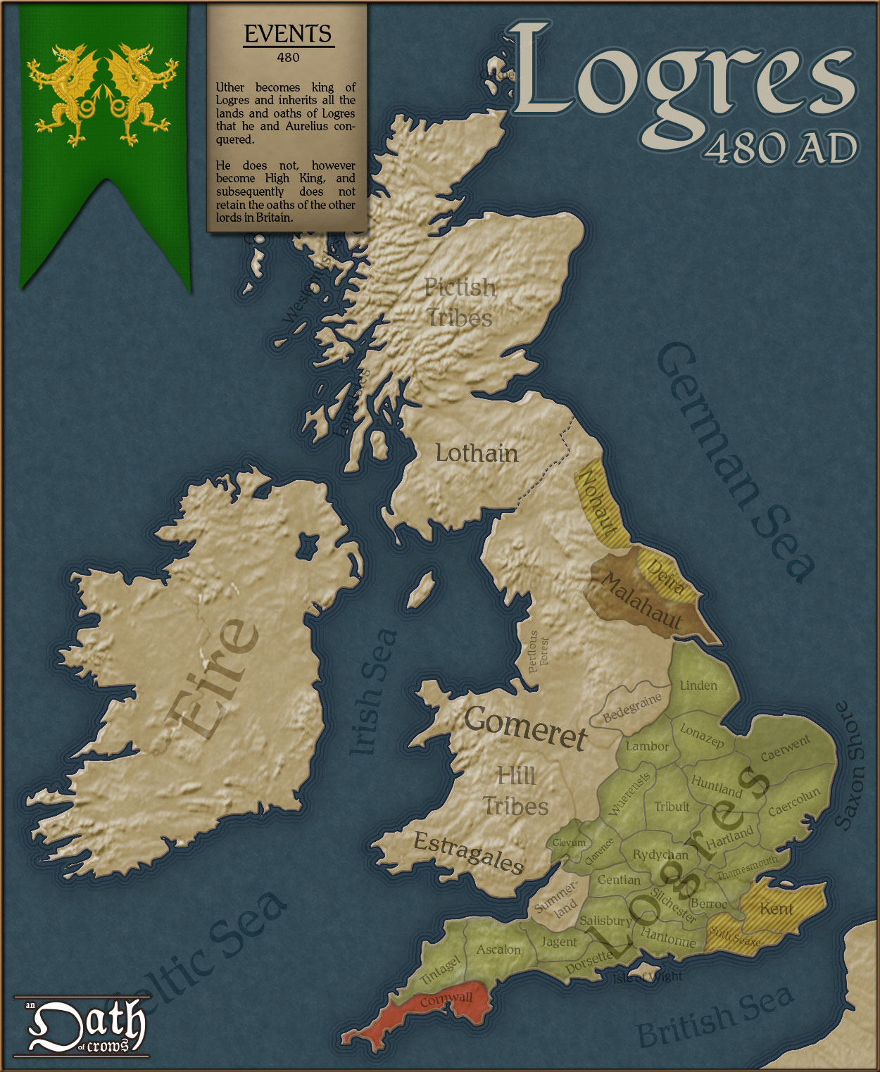
Logres is King Arthur’s realm in the Matter of Britain, the body of medieval literature and legendary material associated with Great Britain and Brittany. It derives from the medieval Welsh word Lloegyr, a name referring to South and Eastern England. In Arthurian contexts, "Logres" is often used to describe territory of the ancient Britons corresponding to the borders of England before the area was taken by the Anglo-Saxons after they began invading in the 5th century. According to Geoffrey of Monmouth’s influential 12th century pseudohistory Historia Regum Britanniae, the realm was named after the legendary king Locrinus, the oldest son of Brutus of Troy. Geoffrey uses the word "Loegria" to describe a province containing most of England excluding Cornwall and possibly Northumberland.
It was described by Chrétien de Troyes in the 12th century as "The Land of Ogres" in his poem Perceval, the Story of the Grail. In various French works, Logres appears as the name of the land or the capital city (otherwise Camelot). Translating and compiling such texts for his Le Morte d'Arthur, Thomas Malory conflated Logres with his contemporary Kingdom of England and usually used just "England" instead, except for the names of some of the Knights of the Round Table. In some medieval works, Logres is the personal domain of Gawain. Logres stands for the ideal and virtuous early Christian “true England” described in Arthurian myths and tales of the Holy Grail.

Slide 9
SUMMARY OF CHAPTER 10, “THE CONQUERED CITY”
D. D. Wither summons Mark to his office, where Wither and Fairy Hardcastle inform him that the N.I.C.E. police found his missing wallet near the body of Bill Hingest. Wither says how fortunate it is that the N.I.C.E. police made this discovery instead of the regular police, since he views the N.I.C.E. as one big happy family. Offended because he knows he was nowhere near the scene of Hingest’s murder, Mark suspects someone in the N.I.C.E. stole his wallet and planted it near Hingest in order to manipulate him with the implicit threat of going to the regular police if he resists their commands. Mark realizes that their real aim is get him to bring Jane to Belbury. Knowing he must warn Jane, Mark starts to flee Belbury but once again encounters Wither or his apparition, but when Mark strikes a blow, the shape mysteriously vanishes. Seeking to go home to Edgestow, Mark learns everyone is fleeing the city as the N.I.C.E. have established a reign of terror in the town, enforced by the N.I.C.E. police. He finds his own home abandoned but notices an unmailed letter from Jane to Mrs. Dimble, so he sets out to see Dr. Dimble in hopes of finding Jane. When Mark demands to know where Jane is, Dimble refuses to tell him in order to protect Jane's safety. Dimble states emphatically that the N.I.C.E. police tortured and burned Jane, seeing that Mark still believes the story Fairy Hardcastle told him that Jane invented this story and is suffering from a nervous breakdown. Mark demands to know why Dimble didn’t go to the regular police if this really happened, but DImble informs him that there are no longer any regular police, that everything is ruled by the Emergency Commissioner, Lord Feverstone, and that Edgestow has become a "conquered and occupied city." While Mark insists on his right to know Jane's whereabouts as her husband, Dimble points out that he is a high ranking official of the N.I.C.E., that the N.I.C.E. is responsible for all manner of horrific acts, and that the N.I.C.E. presents a very real threat to the safety of Jane. DImble begs Mark to leave the N.I.C.E., but while Mark is tempted to do so, he says he must have time to think and leaves. Shortly thereafter, the police arrest Mark for the murder of Bill Hingest.

Slide 10
When Dimble returns to St. Anne's, the Director immediately sends him and Jane back out in response to Jane’s latest dream, which showed a long tunnel with a very gradual ascent with an entrance under a heap of stone that would lead them to Merlin, who has apparently awakened. Only Dimble and the Director know the "Great Tongue;" the Director tells Dimble what he should say and asks him to repeat it. As he does, Jane heart leaps, while everyone is overcome with awe from hearing the language from before the Fall and beyond the Moon. Urging everyone to prayer, the Director asks Jane if she has pledged herself to Maleldil (God). Jane says she doesn’t yet know Maleldil, but she places herself in obedience to the Director, which he says will suffice.
KEY PASSAGES FROM CHAPTER 10, “THE CONQUERED CITY”
“The wakeful night moved all his fears onto a new level. He was, of course, a materialist in theory; and (also in theory) he was past the age at which one can have night fears. But now, as the wind rattled his window hour after hour, he felt those old terrors again: the old exquisite thrill, as of cold fingers delicately travelling down his back. Materialism is in fact no protection. Those who seek it in that hope (they are not a negligible class) will be disappointed. The thing you fear is impossible. Well and good. Can you therefore cease to fear it? Not here and now. And what then? If you must see ghosts, it is better not to disbelieve in them.—emptiness of materialism
“What on earth is all this about?” said Mark. His tone was that which I think almost any man would have used in the circumstances but which policemen are apt to describe as “blustering.” “None of that,” said Miss Hardcastle. “This wallet was found in the grass beside the road about five yards away from Hingest’s body.” “My God!” said Studdock. “You don’t mean… the thing’s absurd.” “There’s no use appealing to me,” said Miss Hardcastle. “I’m not a solicitor, nor a jury, nor a judge. I’m only a policewoman. I’m telling you the facts.” “Do I understand that I’m suspected of murdering Hingest?” “I don’t really think,” said the Deputy Director, “that you need have the slightest apprehension that there is, at this stage, any radical difference between your colleagues and yourself as to the light in which this very painful matter should be regarded. The question is really a constitutional one” —lies, false evidence, coercion, doublespeak

Slide 11
“My dear friend,” said Wither in an antediluvian tone, “there is not the slightest desire on the part of the Committee to insist on defining, in cases of this sort, the powers of action of our own police, much less (what is here in question) their powers of inaction. I do not think anyone had suggested that Miss Hardcastle should be obliged — in any sense that limited her own initiative to communicate to outside authorities, who by their very organisation must be supposed to be less adapted for dealing with such imponderable and quasi-technical inquiries as will often arise, any facts acquired by her and her staff in the course of their internal functioning within the N.I.C.E.” “Do I understand,” said Mark, “that Miss Hardcastle thinks she has facts justifying my arrest for the murder of Mr. Hingest, but is kindly offering to suppress them?”—corruption, lies, injustice
“How does that letter come to be in your hands?” said Mark. “I think, Mr. Studdock,” said the Deputy Director, “it would be very improper to suggest that Miss Hardcastle should give any kind of exposition — in detail, I mean — of the actual working of the Institutional Police. In saying this, I do not mean for one moment to deny that the fullest possible confidence between all the members of the N.I.C.E. is one of the most valuable characteristics it can have, and, indeed, a sine qua non of that really concrete and organic life which we expect it to develop. But there are necessarily certain spheres —not sharply defined, of course, but inevitably revealing themselves in response to the environment and obedience to the indwelling ethos or dialectic of the whole — in which a confidence that involved the verbal interchange of facts would — er-would defeat its own end.”—corruption, blackmail, doublespeak
“Then there’s nothing to be done at present?” said Mark. “No,” said Wither. “No. No immediate action of any official character. It is, of course, very advisable that you should act, as I am sure you will, with the greatest prudence and—er—caution for the next few months. As long as you are with us, Scotland Yard would, I feel, see the inconvenience of trying to act unless they had a very clear case indeed. It is no doubt probable that some—er—some trial of strength between the ordinary executive and our own organisation will take place within the next six months; but I think it very unlikely they would choose to make this a test case.”—threats, coercion, corruption

Slide 12
“And now that Mrs. Studdock is going to join you here this temporary captivity — I am using that word, you will understand, in a metaphorical sense — will not be a serious hardship. You must look upon this as your home, Mr. Studdock.” “Oh... that reminds me, Sir,” said Mark. “I’m not really quite sure about having my wife here. As a matter of fact, she’s not in very good health—” “But surely, in that case, you must be all the more anxious to have her here?” “I don’t believe it would suit her, Sir.” The D.D.’s eyes wandered and his voice became lower. “I had almost forgotten, Mr. Studdock,” he said, “to congratulate you on your introduction to our Head. It marks an Important transition in your career. We all now feel that you are really one of us in a deeper sense. I am sure nothing is further from your intention than to repel the friendly — the almost fatherly — concern he feels about you. He is very anxious to welcome Mrs. Studdock among us at the earliest opportunity.” “Why?” said Mark suddenly. Wither looked at Mark with an indescribable smile. “My dear boy,” he said. “Unity, you know. The family circle. She’d — she’d be company for Miss Hardcastle!”—captivity, coercion, ludicrous ‘reasoning’
“Scarcely a minute had passed since he had left the D.D.’s office and no one had overtaken him. But yesterday’s adventure was happening over again. A tall, stooped, shuffling, creaking figure, humming a tune, barred his way. Mark had never fought. Ancestral impulses lodged in his body — that body which was in so many ways wiser than his mind — directed the blow which he aimed at the head of his senile obstructor. But there was no impact. The shape had suddenly vanished.”—spiritual warfare, Evil, bodily wisdom
“These were the refugees from Edgestow. Some had been turned out of their houses, some scared by the riots and still more by the restoration of order. Something like a terror appeared to have been established in the town. “They tell me there were two hundred arrests yesterday,” said the landlord. “Ah,” said the young man. “They’re hard cases, those N.I.C.E. police, every one of them. They never ought to have brought those Welsh and Irish.”—human cost of totalitarianism, corruption of justice, stoking of ethnic prejudice

Slide 13
“What struck Mark deeply was the almost complete absence of indignation among the speakers, or even of any distinct sympathy with the refugees. Everyone present knew of at least one outrage in Edgestow; but all agreed that these refugees must be greatly exaggerating. “It says in this morning’s paper that things are pretty well settling down,” said the landlord. “That’s right,” agreed the others. “There’ll always be some who get awkward,” said the potato-faced man. “What’s the good of getting awkward?” asked another, “it’s got to go on. You can’t stop it.”—danger of complacency, failure to see, resignation in the face of Evil
“There was an element in him to which all these exhibitions of power suggested chiefly how much nicer and how much more appropriate it was, all said and done, to be part of the N.I.C.E. than to be an outsider. Even now... had he been taking all this démarche about a murder trial too seriously? Of course, that was the way Wither managed things: he liked to have something hanging over everyone. It was only a way to keep him at Belbury and to make him send for Jane. And when one came to think of it, why not? She couldn’t go on indefinitely living alone. And the wife of a man who meant to have a career and live at the centre of things would have to learn to be a woman of the world.” –pride, Evil, self-deception/rationalization
“I insist on being told where Jane is.” “Do you want her to be taken to Belbury?” Mark winced. It was as if the other had read the very thought he had had in the Bristol half an hour ago. “I don’t see, Dimble,” he said, “why I should be cross-questioned in this way. Where is my wife?” “I have no permission to tell you. She is not in my house nor under my protection. She is well and happy and safe. If you still have the slightest regard for her happiness you will make no attempt to get into touch with her.” “Am I sort of leper or criminal that I can’t even be trusted to know her address?” “Excuse me. You are a member of the N.I.C.E. who have already insulted, tortured, and arrested her. Since her escape she has been left alone only because your colleagues do not know where she is.” “And if it really was the N.I.C.E. police, do you suppose I’m not going to have a very full explanation out of them? Damn it, what do you take me for?” “I can only hope that you have no power in the N.I.C.E. at all. If you have no power, then you cannot protect her. If you have, then you are identified with its policy. In neither case will I help you to discover where Jane is.”—Good v. Evil, self-deception

Slide 14
“Are you already as near the centre of Belbury as that? If so, then you have consented to the murder of Hingest, the murder of Compton. If so, it was by your orders that Mary Prescott was raped and battered to death in the sheds behind the station. It is with your approval that criminals — honest criminals whose hands you are unfit to touch — are being taken from the jails to which British judges sent them on the conviction of British juries and packed off to Belbury to undergo for an indefinite period, out of reach of the law, whatever tortures and assaults on personal identity you call Remedial Treatment. It is you who have driven two thousand families from their homes to die of exposure in every ditch from here to Birmingham or Worcester. It is you who can tell us why Place and Rowley and Cunningham (at eighty years of age) have been arrested, and where they are. And if you are as deeply in it as that, not only will I not deliver Jane into your hands, but I would not deliver my dog.”—complicity in Evil
“Gutter press!” thundered Dimble, who seemed to Mark to be even physically larger than he was a few minutes before. “What nonsense is this? Do you suppose I don’t know that you have control of every paper in the country except one? And that one has not appeared this morning. Its printers have gone on strike. The poor dupes say they will not print articles attacking the people’s institute. Where the lies in all other papers come from you know better than I.” –propaganda, misinformation
“Studdock,” said Dimble. “This is not a time for foolery, or compliments. It may be that both of us are within a few minutes of death. You have probably been shadowed into the college. And I, at any rate, don’t propose to die with polite insincerities in my mouth. I don’t trust you. Why should I? You are the accomplice of the worst men in the world. Your very coming to me this afternoon may be only a trap.” “Nevertheless,” continued Dimble, “knowing all this — knowing that you may be only the bait in the trap, I will take a risk. I will risk things compared with which both our lives are a triviality. If you seriously wish to leave the N.I.C.E., I will help you.” One moment it was like the gates of Paradise opening — then, at once, caution and the incurable wish to temporise rushed back. The chink had closed again. “I — I’d need to think that over,” he mumbled. “There is no time,” said Dimble. “And there is really nothing to think about. I am offering you a way back into the human family. But you must come at once.”—priorities, danger of complicity and fence sitting

Slide 15
“Some sort of van seemed to be standing in the street outside, and there were three or four uniformed men in capes. He remembered afterwards how the wet oilskin shone in the lamplight. A torch was flashed in his face. “Excuse me, Sir,” said one of the men. “I must ask for your name.” “Studdock,” said Mark. “Mark Gainsby Studdock,” said the man, “it is my duty to arrest you for the murder of William Hingest.”—wages of sin, danger of complicity with Evil
“Yes,” said the Director. “We’re going into action at last…the battle has started.” “I have already repeatedly urged,” said MacPhee, “the absurdity of sending out an older man like yourself, that’s done a day’s work forbye, when here am I, a great strapping fellow sitting doing nothing.” “It’s no good, MacPhee,” said the Director, “you can’t go. For one thing you don’t know the language. And for another — it’s time for frankness — you have never put yourself under the protection of Maleldil.” “I am perfectly ready,” said MacPhee, “in and for this emergency, to allow the existence of these eldils of your and of a being called Maleldil whom they regard as their king. And I—” “You can’t go,” said the Director. “I will not send you. It would be like sending a three-year-old child to fight a tank. “—waiting on God’s timing, power of God’s protection
“This is the situation, Dimble. What was under Bragdon was a living Merlin. Yes, asleep, if you like to call it sleep. And nothing has yet happened to show that the enemy have found him…it’s not reached by a shaft and a stair. She dreamed of going through a long tunnel with a very gradual ascent…Jane thinks she can recognise the entrance to that tunnel: under a heap of stones at the end of a copse with — what was it, Jane?” “A white gate, Sir. An ordinary five-barred gate with a cross-piece. But the cross-piece was broken off about a foot from the top. I’d know it again.” “You see, Dimble? There’s a very good chance that this tunnel comes up outside the area held by the N.I.C.E.” “Apparently,” said the Director, “we are almost too late. He was waked already… I think it means that the whole thing has been planned and timed long, long ago,” said the Director. “That he went out of Time, into the parachronic state, for the very purpose of returning at this moment.”—God as outside of Time, eternal purposes of God

Slide 16
“Dimble, only you know the Great Tongue. If there was eldilic power behind the tradition he represented he may understand it. Even if he does not understand it he will, I think, recognise it. That will teach him he is dealing with Masters. There is a chance that he will think you are the Belbury people — his friends. In that case you will bring him here at once. You understand, Dimble? Your revolver in your hand, a prayer on your lips, your mind fixed on Maleldil. Then, if he stands, conjure him.”—the eternal power of God’s Kingdom, the power of the word--Logos
“What shall I say in the Great Tongue?” “Say that you come in the name of God and all angels and in the power of the planets from one who sits today in the seat of the Pendragon and command him to come with you. Say it now.” And Dimble, who had been sitting with his face drawn, and rather white, between the white faces of the two women, and his eyes on the table, raised his head, and great syllables of words that sounded like castles came out of his mouth. Jane felt her heart leap and quiver at them. Everything else in the room seemed to have been intensely quiet; even the bird, and the bear, and the cat, were still, staring at the speaker. The voice did not sound like Dimble’s own: it was as if the words spoke themselves through him from some strong place at a distance — or as if they were not words at all but present operations of God, the planets, and the Pendragon. For this was the language spoken before the Fall and beyond the Moon and the meanings were not given to the syllables by chance, or skill, or long tradition, but truly inherent in them as the shape of the great Sun is inherent in the little waterdrop. This was Language herself, as she first sprang at Maleldil’s bidding out of the molten quicksilver of the star called Mercury on Earth, but Viritrilbia in Deep Heaven.”—power and beauty of Logos
“And if he comes with you, all is well. If he does not — why then, Dimble, you must rely on your Christianity. Do not try any tricks. Say your prayers and keep your will fixed in the will of Maleldil. I don’t know what he will do. But stand firm. You can’t lose your soul, whatever happens; at least, not by any action of his.” “Yes,” said Dimble. “I understand.”—focusing on Christ and God’s will, standing firm in faith, security in Christ

Slide 17
“You are all right, child?” said Ransom. “I think so, Sir,” said Jane. Her actual state of mind was one she could not analyse. Her expectation was strung up to the height; something that would have been terror but for the Joy, and Joy but for the terror, possessed her — an all-absorbing tension of excitement and obedience. Everything else in her life seemed small and commonplace compared with this moment. “Do you place yourself in the obedience,” said the Director, “in obedience to Maleldil?” “Sir,” said Jane, “I know nothing of Maleldil. But I place myself in obedience to you.” “It is enough for the present,” said the Director. “This is the courtesy of Deep Heaven: that when you mean well, He always takes you to have meant better than you knew. It will not be enough for always. He is very jealous. He will have you for no one but Himself in the end. But for tonight, it is enough.”—Joy in being obedient to God’s will even in danger, sorting of priorities, the grace of God and His desire for us

Slide 18
THEMES THAT APPEAR IN CHAPTER 10
--emptiness of materialism
--lies, false evidence, coercion, doublespeak
--corruption, lies, injustice
--corruption, blackmail, doublespeak
--threats, coercion, corruption
--captivity, coercion, ludicrous ‘reasoning’
--spiritual warfare, Evil, bodily wisdom
--human cost of totalitarianism, corruption of justice, stoking of ethnic prejudice
--danger of complacency, failure to see, resignation in the face of Evil
--pride, Evil, self-deception/rationalization
--Good v. Evil, self-deception
--complicity in Evil
--propaganda, misinformation
--priorities, danger of complicity and fence sitting
--wages of sin, danger of complicity with Evil
--waiting on God’s timing, power of God’s protection
--God as outside of Time, eternal purposes of God
--the eternal power of God’s Kingdom, the power of the word--Logos
--power and beauty of Logos
--focusing on Christ and on God’s will, standing firm in faith, security in Christ
--Joy in being obedient to God’s will even in danger, sorting of priorities, the grace of God and His desire for us

Slide 19
Practices of Hope and of Wisdom
Finally, brothers, whatever is true, whatever is honorable, whatever is just, whatever is pure, whatever is lovely, whatever is commendable, if there is any excellence, if there is anything worthy of praise, think about these things. What you have learned and received and heard and seen in me—practice these things, and the God of peace will be with you.—Phil. 4:8-9
Watch your life, your companions, and your beliefs closely for conformity to the Word of God. Watch your life and doctrine closely. Persevere in them, because if you do, you will save both yourself and your hearers. (I Tim. 4:16) He is in the way of life who heeds correction, but he who forsakes reproof leads others astray.(Prov. 10:17)
Do not be taken in by propaganda and the wisdom of the world. For the wisdom of this world is folly with God. For it is written, “He catches the wise in their craftiness.” and again, “The Lord knows the thoughts of the wise, that they are futile.” So let no one boast in men. (I Cor. 3:19-21)
Hold fast to a Biblical view of identity and reject all forms of racial and ethnic prejudice. There is neither Jew nor Gentile, neither slave nor free, nor is there male and female, for you are all one in Christ Jesus. (Gal. 3:28) After this I looked, and there before me was a great multitude that no one could count, from every nation, tribe, people and language, standing before the throne and before the Lamb. They were wearing white robes and were holding palm branches in their hands. (Rev. 7:9) But anyone who hates a brother or sister is in the darkness and walks around in the darkness. They do not know where they are going, because the darkness has blinded them. (I John 2:11)
Wait on God’s timing rather than relying on your own. Wait for the Lord; be strong and take heart and wait for the Lord. (Ps. 27:14) The Lord is not slow in keeping his promise, as some understand slowness. Instead he is patient with you, not wanting anyone to perish, but everyone to come to repentance. (2 Peter 3:9)
Seek the Joy of being in the center of the will of God, even in times of fear. May the God of hope fill you with all joy and peace as you trust in him, so that you may overflow with hope by the power of the Holy Spirit. (Rom. 15:13) Therefore, since we are surrounded by such a great cloud of witnesses, let us throw off everything that hinders and the sin that so easily entangles. And let us run with perseverance the race marked out for us, fixing our eyes on Jesus, the pioneer and perfecter of our faith, who for the joy set before him endured the cross, scorning its shame, and sat down at the right hand of the throne of God. Consider him who endured such opposition from sinners, so that you will not grow weary and lose heart.(Heb. 12:1-3)

Slide 20
I WAITED FOR THE LORD
I waited for the Lord, He inclined unto me, He heard my complaint. O blest are they that hope and trust in him.
Psalm 40:1
--Felix Mendelssohn (1809-1847)
Honorable Mention:
“Forty” by U2
“I Will Wait” by Mumford and Sons

Slide 21
For at one time you were darkness, but now you are light in the Lord.
Walk as children of light (for the fruit of light is found in all that is good and right and true),
and try to discern what is pleasing to the Lord. Take no part in the unfruitful works of darkness,
but instead expose them. For it is shameful even to speak of the things that they do in secret.
But when anything is exposed by the light, it becomes visible, for anything that becomes visible is light.
Therefore it says, “Awake, O sleeper, and arise from the dead,
and Christ will shine on you.”
Look carefully then how you walk, not as unwise but as wise,
making the best use of the time, because the days are evil. Therefore do not be foolish,
but understand what the will of the Lord is.
Ephesians 5: 8-17

