Slide 1
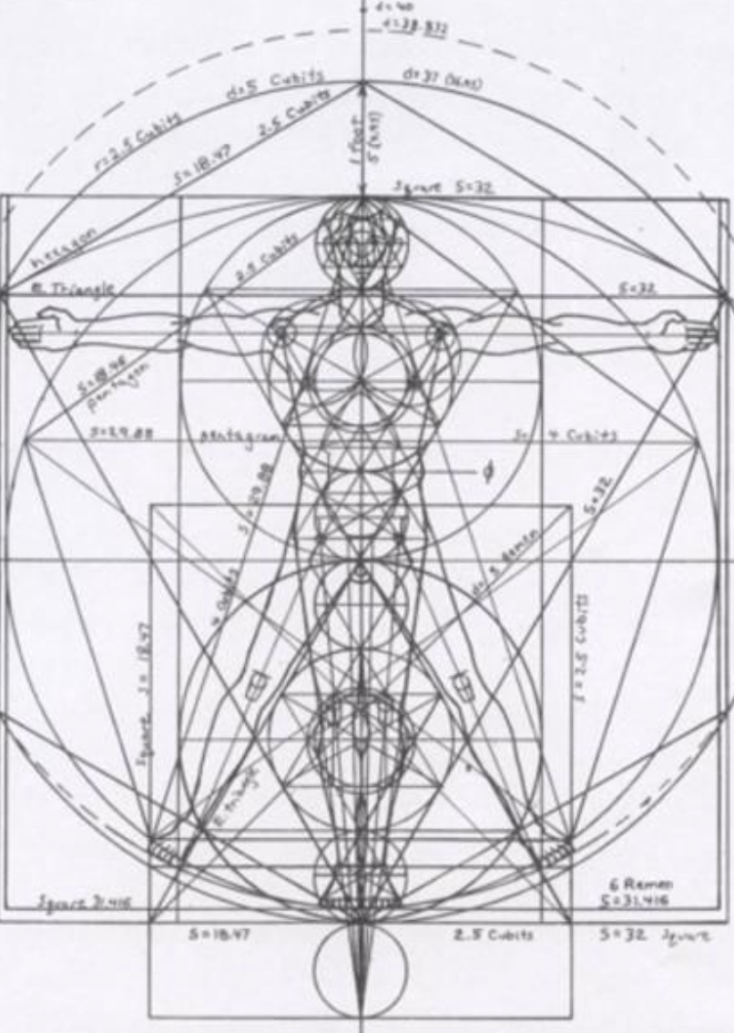
Not as Unwise but as Wise: Reflections from C.S. Lewis's The Abolition of Man and That Hideous Strength on Living Christianly in a Post-Christian World
December 8, 2021 -- St. Philip’s Church
The Rev’d Brian K. McGreevy, J.D., Facilitator

Slide 2
For at one time you were darkness, but now you are light in the Lord.
Walk as children of light (for the fruit of light is found in all that is good and right and true), and try to discern what is pleasing to the Lord. Take no part in the unfruitful works of darkness, but instead expose them. For it is shameful even to speak of the things that they do in secret. But when anything is exposed by the light, it becomes visible, for anything that becomes visible is light. Therefore it says, “Awake, O sleeper,
and arise from the dead, and Christ will shine on you.”
Look carefully then how you walk, not as unwise but as wise,
making the best use of the time, because the days are evil. Therefore do not be foolish,
but understand what the will of the Lord is.
Ephesians 5: 8-17

Slide 3
How to approach this class: --On the beach --Snorkeling --Scuba diving --Email list How to read That Hideous Strength:
--One chapter at a time --Make a chart of characters --Look for and note where themes from The Abolition of Man appear
What we’ll be doing each week:
--Examining context and establishing a framework for appreciating these books
--Unpacking the meaning of Lewis’s works
--Exploring their relevance for today
--Considering how we can respond with practices of Hope and of Wisdom rooted in the Scriptures

Slide 4
REVIEW FROM PREVIOUS CLASSES
Summary: Main theme of each chapter in The Abolition of Man
1. “Men without Chests”: The importance of objective values and the poison of subjectivism
2. “The Way”: Why the Tao, or Natural Law, is the sole source of all value judgments
3. “The Abolition of Man”: “Man’s control of Nature” is in reality a means for some men (Conditioners) to control other men, using Nature as their instrument. To “see through” (deconstruct) all things is not to see at all.
PLOT SUMMARY OF THE RANSOM TRILOGY Adapted from Taylor Dinerman, The Space Review
--“Out of the Silent Planet, tells how Ransom, a Cambridge don on holiday, is kidnapped by the physicist Weston and his partner Devine, a sleazy businessman, and taken to Malacandra (Mars), supposedly as a human sacrifice. Once on Mars he escapes, hides in a Martian village, and learns to speak the local language. He learns that each planet has its own tutelary spirit—essentially an angel or archangel—called an Oyarsa, who rules under the authority of God. Earth, unfortunately, is the central battleground between Good and Evil and is ruled by a fallen angel, a dark Oyarsa.
--“Perelandra, the name Lewis gives to Venus, is also the title of the second book in the series. Retelling the story of Adam and Eve, it is the most explicitly biblical of the three. Weston plays the role of the serpent sent to tempt the woman who is to become the mother of the world into rejecting God’s will. Ransom is sent by the Oyarsa to challenge the evil one and to save Venus from the fate of Earth.
--“That Hideous Strength combines a sordid tale of intra-university politics, Arthurian legend, and spiritual combat. In a small British University town, one of the colleges finds itself seduced and then engulfed by the newly established National Institute for Coordinated Experiments (N.I.C.E). This organization is secretly controlled by a pair of initiates, who plan to revive the wizard Merlin from his long, enchanted slumber and to use his powers for their own malevolent purposes. To find him they need the services of a ‘seer’; Jane Studdock, the wife of Mark Studdock, a shallow young sociologist entrapped by promises of power, money, and above all membership in the secret, elite clique that controls the N.I.C.E. Ransom leads a small eccentric company of friends who, with the aid of the Oyarsa, take on and defeat them.”
--

Slide 5
Cosmology of Deep Heaven
The Bent One (the Oyarsa of Earth) rebelled against Maleldil and all the eldila of Deep Heaven (Outer Space). In response to this act, the Bent One suffered confinement on Earth where he first inflicted great evil. Thus he made Earth a Silent Planet, cut off from the Oyéresu of other planets, hence the name 'Thulcandra', the Silent Planet.
--Eldila
The eldila (singular eldil) are super-human extraterrestrial creatures like angels; they can manifest in corporeal forms.
--Oyarsa
The Oyéresu of other worlds are like Archangels and have characteristics like those of the corresponding Classical gods; for instance, the Oyarsa of Jupiter gives a feeling of merriment (joviality).”
--Hnau
Hnau is a word in the Old Solar language which refers to "rational animals" such as Humans.
--Old Solar language
The language spoken before the Fall and beyond the Moon and the meanings were not given to the syllables by chance, or skill, or long tradition, but truly inherent in them as the shape of the great Sun is inherent in the little waterdrop.

Slide 6
“The shadow of that hyddeous strength, sax myle and more it is of length”
(Sir David Lyndsay: from “Ane Dialog,” describing the Tower of Babel)
“Plenty of people in our age do entertain the monstrous dreams of power that Mr. Lewis attributes to his characters, and we are within sight of the time when such dreams will be realizable”
[“The Scientist Takes Over”, Review of C. S. Lewis, That Hideous Strength (1945)
by George Orwell, Manchester Evening News, 16 August 1945]
This is a “tall story” about devilry, though it has behind it a serious “point” which I have tried to make in my Abolition of Man. –from Preface to That Hideous Strength
CHARACTERS IN ORDER OF APPEARANCE
Jane (Tudor) Studdock “She had not been to church since her schooldays until she went there six months ago to be married.” Jane married Mark six months before the story begins, leaving behind a career she enjoyed. Since then, she works on her doctoral thesis on John Donne, but makes no progress. Before marriage, they had endless talks, but since marriage, she feels alone in solitary confinement. She does not wish for children, as they would impede her career as a scholar. She has nightmares of a man beheaded by having his head twisted off by some other men speaking French. She is disturbed when she sees a picture in a newspaper of precisely what she dreamed. Her dream also includes an ancient bearded Druidical man.
Francois Alcasan - An Arabian radiologist who poisoned his wife. He was beheaded for this crime. However, before his execution, Jane sees him in a dream being beheaded by twisting his head off. Jane saw in a man in a dream approach him and speak with him in French (which she did not understand).

Slide 7
Merlin - the ancient Druidical bearded man in a mantle from Arthurian days who also appears in Jane’s dream. Merlin has a pagan past but has also been deeply influenced by early British Christianity.
Mark (Gainsby) Studdock - A Fellow in Sociology for 5 years at Bracton College. He talks with Sub-Warden Curry and discovers, to his delight, he is now part of the inner circle, the “progressive element.” He married his wife Jane six months ago, and they are drifting apart. Mark learns that Lord Feverstone influenced Mark’s appointment to Bracton.
Sub-Warden Curry - Curry serves as the effective head of Bracton College, who thinks the NICE "marks the beginning of a new era - the really scientific era." Curry wants to cultivate Mark to use him to support his agenda for the college that he is working on with Lord Feverstone.
Lord Feverstone - His real name is Dick Divine, who has appeared in the prior stories of the Space Trilogy as a villain. Mark discovers Feverstone as the person responsible for getting his position at Bracton College over another prospect, Denniston. Once Curry and Busby, the Bursar, leave, Mark discovers Feverstone holds them in disdain, but finds them useful in running He joins in cultivating Mark as part of the inner circle of the “progressive element” in the college.
Arthur Denniston - an old friend of Mark’s from university who is also a sociologist and Mark’s professional rival. When explaining to Mark why they chose him over Denniston, Sub-Warden Curry says, “One sees now that Denniston would never have done. Most emphatically not. A brilliant man at that time, of course, but he seems to have gone quite off the rails since then with all his Distributivism and what not. They tell me he’s likely to end up in a monastery.”
The Dimbles—a professor of English literature at Northumberland College and his wife, with whom Jane Studdock studied and socialized as a college student. The Dimbles live adjacent to Bragdon Wood.

Slide 8
SUMMARY OF SECTIONS 1 AND 2 OF CHAPTER 1, “SALE OF COLLEGE PROPERTY”
Adapted from scholar Rudolf Rentzel
Jane married Mark Studdock six months ago, and things are not what she imagined they would be. They have no children so Jane can remain independent and pursue her work on John Donne, though she left the job she enjoyed. Jane glances at a picture she sees in the newspaper, which immediately reminds her of a recent dream she had that turned into a nightmare which terrorized her. The newspaper reported about the execution of Alcasan, an Arabian radiologist who poisoned his wife and was executed by beheading for his crime. In her dream, Jane saw Alcasan (not knowing who he was) being beheaded by twisting his head off. Then Jane saw a different head of an ancient British, druidical man being dug up in a churchyard. Jane thought he was dead, but she then saw him come to life and begin talking in something that sounded vaguely like Spanish to her. Terrified, Jane woke up and could not sleep any further.
Meanwhile, Mark, a Fellow of Bracton College, talks with Sub-Warden Curry and is invited into what he sees as the inner circle, the “progressive element”-- something he has desired for quite some time. However, Mark also discovers that his appointment as a Fellow at the college had to do with the considerable influence of Lord Feverstone, someone who spends most of his time in London. Apparently, Mark learns, without Feverstone's influence, many favored another scholar named Denniston. Until now, Mark imagined he was selected on his own merits, and it disturbs him to discover otherwise. (Feverstone's name is Dick Devine, a name from the first book in the trilogy where he appears as a villainy character.)

Slide 9
NOTES AND THEMES
--The Disembodied Head (no Chest)
--Sociology and “Real” Science
--Gender Roles (Platonic v. Corporeal notions of Love)
--The Inner Ring
C.S. LEWIS AND THE INNER RING—EXCERPTS FROM THE 1944 ESSAY To nine out of ten of you the choice which could lead to scoundrelism will come, when it does come, in no very dramatic colours. Obviously bad men, obviously threatening or bribing, will almost certainly not appear. Over a drink, or a cup of coffee, disguised as triviality and sandwiched between two jokes, from the lips of a man, or woman, whom you have recently been getting to know rather better and whom you hope to know better still—just at the moment when you are most anxious not to appear crude, or naïf or a prig—the hint will come. It will be the hint of something which the public, the ignorant, romantic public, would never understand: something which even the outsiders in your own profession are apt to make a fuss about: but something, says your new friend, which “we”—and at the word “we” you try not to blush for mere pleasure—something “we always do.”
“And you will be drawn in, if you are drawn in, not by desire for gain or ease, but simply because at that moment, when the cup was so near your lips, you cannot bear to be thrust back again into the cold outer world. It would be so terrible to see the other man’s face—that genial, confidential, delightfully sophisticated face—turn suddenly cold and contemptuous, to know that you had been tried for the Inner Ring and rejected. And then, if you are drawn in, next week it will be something a little further from the rules, and next year something further still, but all in the jolliest, friendliest spirit. It may end in a crash, a scandal, and penal servitude; it may end in millions, a peerage and giving the prizes at your old school. But you will be a scoundrel.“That is my first reason. Of all the passions, the passion for the Inner Ring is most skillful in making a man who is not yet a very bad man do very bad things.’”

Slide 10
“The quest of the Inner Ring will break your hearts unless you break it. But if you break it, a surprising result will follow…If in your spare time you consort simply with the people you like, you will again find that you have come unawares to a real inside: that you are indeed snug and safe at the centre …This is friendship. Aristotle placed it among the virtues. It causes perhaps half of all the happiness in the world, and no Inner Ring can ever have it.”
SUMMARY OF SECTIONS 3 AND 4 OF CHAPTER 1, “SALE OF COLLEGE PROPERTY”
Adapted from scholar Rudolf Rentzel
Sub-Warden Curry wanted to talk with Mark Studdock about the upcoming meeting of the Fellows that day, and specifically about a motion for the College to sell Bragdon Wood, a secluded, walled-in, peaceful area of well-tended grass (by sheep) and trees, with an ancient well in the middle, smack in the middle of the College. Ancient legend claims that the Wood is the burial site for Merlin and that the well was named for him. An organization named the National Institute of Co-ordinated Experiments (N.I.C.E.) made a generous offer to purchase Bragdon Wood to construct a new headquarters building to house their operations. The NICE presents itself as a new organization which fuses the power of the State and the laboratory to create a place where thoughtful people could make a better world free from the constraints of red tape and with an unlimited, state supported budget. At the meeting, the College Bursar announced that the College's budget looked so woeful, the meager stipend for the Junior Fellows might have to be cut from the amounts already paid. Thus, when the question of the sale of Bradgon Wood to the NICE for a generous amount arose, only the old guard wanted to hang on to this part of the college that had belonged to it since its founding back in 1300. The other Fellows clearly saw the advantage of the sale and the motion easily carried. During the meeting, much of the conversation is characterized by “doublespeak,” a recurring element of the confusion of language theme throughout the book.

Slide 11
The scene switches from the meeting at Bracton College back to the Studdocks’ home. Jane can't focus on her work, being troubled by her dream. She goes out for a walk and to do some shopping. In town, Jane encounters Mrs. Dimble, an old friend, who invites her home for lunch. Mrs. Dimble's husband, Dr. Dimble, is a Fellow at Northumberland, another college of Edgestow University. Jane and her friends used to meet at their house often in their undergraduate days. The Dimbles live in a lovely and ancient cottage by the river next to the wall of Bragdon Wood. Jane learns that the Dimbles are being forced to move, as they rent the cottage from Bracton College, who plan to sell it to the N.I.C.E. along with several other properties, including Bragdon Wood, the small park that contains "Merlin's Well," beneath which Merlin himself is said to be sleeping.
“Over lunch, talk of Merlin's Well leads Dr. Dimble to talk about literary history (his subject) and the Matter of Britain in particular. He remarks about how much historical accuracy there is or could be in the Arthur stories, and describes the half-Celtic, half-Roman society Arthur would have lived in. When he remarks that the Celtic language Arthur spoke would sound "something like Spanish," Jane nearly faints.
Jane then describes her nightmare to the Dimbles, who take it with gratifying seriousness. She asks if they think she should be psychoanalyzed. Dr. Dimble tells her that, if she wants to go to anyone about that dream, he has a name and address he could give her.”—adapted from Earl Wajenberg
KEY PASSAGES
“Though I am Oxford-bred and very fond of Cambridge, I think that Edgestow is more beautiful than either. For one thing it is so small. No maker of cars or sausages or marmalades has yet come to industrialise the country town which is the setting of the University, and the University itself is tiny…There are only two colleges: Northumberland which stands below Bracton on the river Wynd, and Duke’s opposite the Abbey. Bracton takes no undergraduates. It was founded in 1300 for the support of ten learned men whose duties were to pray for the soul of Henry de Bracton and to study the laws of England. The number of Fellows has gradually increased to forty, of whom only six (apart from the Bacon Professor) now study Law and of whom none, perhaps, prays for the soul of Henry de Bracton.”

Slide 12
Beauty
Industrialization
Spiritual purpose
Understanding of Law
“Very few people were allowed into Bragdon Wood. The gate was by Inigo Jones and was the only entry: a high wall enclosed the Wood, which was perhaps a quarter of a mile broad and a mile from east to west. If you came in from the street and went through the College to reach it, the sense of gradual penetration into a holy of holies was very strong. First you went through the Newton quadrangle which is dry and gravelly; florid, but beautiful, Gregorian buildings look down upon it. Next you must enter a cool tunnel-like passage, nearly dark at midday unless either the door into Hall should be open on your right or the buttery hatch on your left, giving you a glimpse of indoor daylight falling on panels, and a whiff of the smell of fresh bread. When you emerged from this tunnel you would find yourself in the medieval College: in the cloister of the much smaller quadrangle called Republic. The grass here looks very green after the aridity of Newton and the very stone of the buttresses that rise from it gives the impression of being soft and alive. Chapel is not far off: the hoarse, heavy noise of the works of a great and old clock comes to you from somewhere overhead. You went along this cloister, past slabs and urns and busts that commemorate dead Bractonians, and then down shallow steps into the full daylight of the quadrangle called Lady Alice. The buildings to your left and right were seventeenth-century work: humble, almost domestic in character, with dormer windows, mossy and grey-tiled. You were in a sweet, Protestant world. You found yourself, perhaps, thinking of Bunyan or of Walton’s Lives. There were no buildings straight ahead on the fourth side of Lady Alice: only a row of elms and a wall: and here first one became aware of the sound of running water and the cooing of wood pigeons. The street was so far off by now that there were no other noises. In the wall there was a door. It led you into a covered gallery pierced with narrow windows on either side. Looking out through these, you discovered that you were crossing a bridge and the dark brown dimpled Wynd was flowing under you. “

Slide 13
“Now you were very near your goal. A wicket at the far end of the bridge brought you out on the Fellows’ bowling green, and across that you saw the high wall of the Wood, and through the Inigo Jones gate you caught a glimpse of sunlit green and deep shadows. I suppose the mere fact of being walled in gave the Wood part of its peculiar quality, for when a thing is enclosed, the mind does not willingly regard it as common.”
Setting the Stage: Beauty, Truth, Goodness
Inigo Jones
Gradual penetration into a Holy of Holies
Medieval/dry aridity of Newton/green grass/Chapel/clock and bells
Dead Bractonians commemorated
Sweet Protestant world/Bunyan/Walton The Lives of Dr. John Donne, Sir Henry Wotton, Mr. Richard Hooker, Mr. George Herbert
Sound of running water
“In the wall there was a door.”
Crossing a bridge
High wall/a thing enclosed/not common
Inigo Jones (15 July 1573 – 21 June 1652) was the first significant architect in the early modern period and the first to employ Vitruvian rules of proportion and symmetry in his buildings (Vitruvius, De architectura, 1st century BC). As the most notable architect in England, Jones was the first person to introduce the classical architecture of Rome and the Italian Renaissance to Britain.

Slide 14
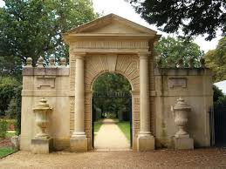
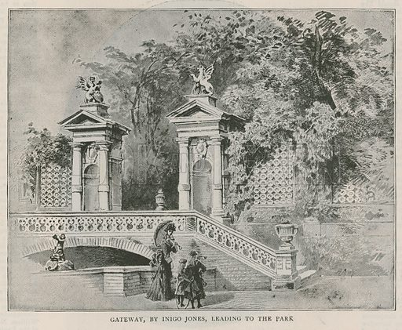
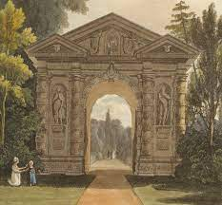

Slide 15
Practices of Hope and of Wisdom
Finally, brothers, whatever is true, whatever is honorable, whatever is just, whatever is pure, whatever is lovely, whatever is commendable, if there is any excellence, if there is anything worthy of praise, think about these things. What you have learned and received and heard and seen in me—practice these things, and the God of peace will be with you.—Philippians 4:8-9
Pray to notice and be alive to and contemplate and praise God for Beauty.
--For how great is God’s goodness, and how great His beauty! (Zech. 9:17)
--And let the beauty of the Lord of God be upon us: and establish thou the work of our hands (Psalm 90:17).
--Out of Zion, the perfection of beauty, God hath shined. (Psalm 50:2)
--Honor and majesty are before Him: strength and beauty are in His sanctuary...O worship the Lord in the beauty of holiness: fear before Him, all the earth (Psalm 96:6,9)
"Too late came I to love thee, O thou Beauty both so ancient and so fresh.” Augustine of Hippo
“The Triune God, Creator of heaven and earth, of all things visible and invisible, is the Fountainhead of Beauty, wherever and in whatsoever shape and form it is experienced. In manifesting Himself to us, God comes in judgement, in mercy, in holiness, in grace: that is, in his splendour and beauty...Scripture overwhelms me when it speaks of the beauty of God's holiness. I was raised up to think that beauty is in the eyes of the beholder, that it is something relative. I was taught that the artistic heart expresses its own intrinsic sense of beauty. Not having thought these things out, I initially assumed that I am autonomous as far as art and creativity are concerned. The case turned out to be otherwise. Truth, goodness and beauty all come down from above: they proceed from God. ”—Paul Mizzi

Slide 16
2. Pursue Advent disciplines.
--Advent wreath
--Advent devotions
--Advent hymns
--Trinity College Advent Sunday service
--Go to church!
3. Read theological poetry to increase your sense of wonder.
The world is charged with the grandeur of God.
It will flame out, like shining from shook foil;
It gathers to a greatness, like the ooze of oil
Crushed. Why do men then now not reck his rod?
Generations have trod, have trod, have trod;
And all is seared with trade; bleared, smeared with toil;
And wears man's smudge and shares man's smell: the soil
Is bare now, nor can foot feel, being shod.
And for all this, nature is never spent;
There lives the dearest freshness deep down things;
And though the last lights off the black West went
Oh, morning, at the brown brink eastward, springs —
Because the Holy Ghost over the bent
World broods with warm breast and with ah! bright wings
(God’s Grandeur—Gerard Manley Hopkins)

Slide 17
For at one time you were darkness, but now you are light in the Lord.
Walk as children of light (for the fruit of light is found in all that is good and right and true),
and try to discern what is pleasing to the Lord. Take no part in the unfruitful works of darkness,
but instead expose them. For it is shameful even to speak of the things that they do in secret.
But when anything is exposed by the light, it becomes visible, for anything that becomes visible is light.
Therefore it says, “Awake, O sleeper, and arise from the dead,
and Christ will shine on you.”
Look carefully then how you walk, not as unwise but as wise,
making the best use of the time, because the days are evil. Therefore do not be foolish,
but understand what the will of the Lord is.
Ephesians 5: 8-17

