Slide 1
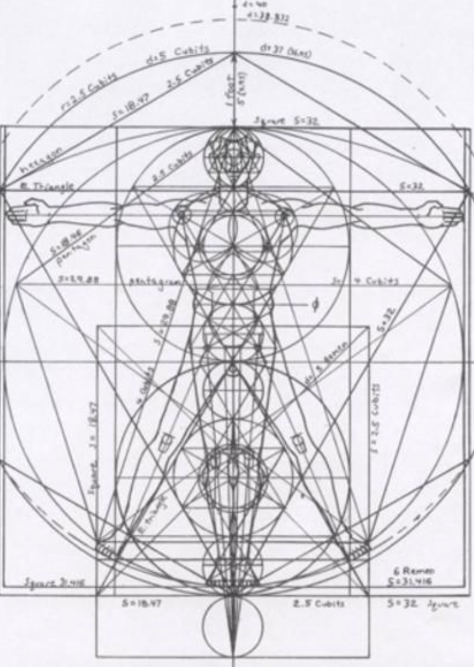
Not as Unwise but as Wise: Reflections from C.S. Lewis's The Abolition of Man and That Hideous Strength on Living Christianly in a Post-Christian World
September 29, 2021 -- St. Philip’s Church
The Rev’d Brian K. McGreevy, J.D., Facilitator

Slide 2
For at one time you were darkness, but now you are light in the Lord.
Walk as children of light (for the fruit of light is found in all that is good and right and true), and try to discern what is pleasing to the Lord. Take no part in the unfruitful works of darkness, but instead expose them. For it is shameful even to speak of the things that they do in secret. But when anything is exposed by the light, it becomes visible, for anything that becomes visible is light. Therefore it says, “Awake, O sleeper,
and arise from the dead, and Christ will shine on you.”
Look carefully then how you walk, not as unwise but as wise,
making the best use of the time, because the days are evil. Therefore do not be foolish,
but understand what the will of the Lord is.
Ephesians 5: 8-17

Slide 3
How to approach this class: --On the beach --Snorkeling --Scuba diving --Email list How to read The Abolition of Man:
--Why it’s not an easy read—original audience and the premises of Natural Law --Try reading aloud --One paragraph at a time
What we’ll be doing each week:
--Examining context and establishing a framework for appreciating these books
--Unpacking the meaning of Lewis’s works
--Exploring their relevance for today
--Considering how we can respond with practices of Hope and of Wisdom rooted in the Scriptures

Slide 4
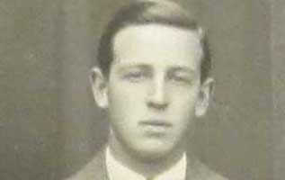
Review of last week’s class:
How did C.S. Lewis come to write these two books, what was the context, and how are these two books connected?
--C.S. Lewis and how his background prepared him for writing these books: converted atheist, philosopher
--The role of the Inklings and Tolkien in conceiving these books
--Context of England at War It is almost impossible for us to understand the fear and dread and sheer difficulty of life in England during this period, but getting a sense of that is vital to understanding how both these books came to be written. Ultimate questions (Is there a God? What is the meaning of life? What happens when I die?) were on everyone’s mind, forced by the awareness that death was raining from the skies and that tomorrow might not come or might mean Nazi rule. It was virtually impossible to be alive without facing these issues.
--The Wager L. [Lewis] said to me one day: ‘Tollers, there is too little of what we really like in stories. I am afraid we shall have to try and write some ourselves.’ We agreed that he should try ‘space-travel’, and I should try ‘time-travel’. His result is well known. My effort, after a few promising chapters, ran dry: it was too long a way round to what I really wanted to make, a new version of the Atlantis legend. The final scene survives as The Downfall of Númenor.
--The Lectures First delivered as the scholarly Riddell Memorial Lectures on February 24 to 26, 1943, in King’s Hall at King’s College, Newcastle (part of Durham University), The Abolition of Man was published later that same year, just after Lewis had finished Perelandra and was conceiving That Hideous Strength.
--Connections Convinced of the crucial importance of the themes in The Abolition of Man, Lewis decided to portray them in the form of a story for the last volume in the Ransom trilogy, which he entitled That Hideous Strength. The title comes from a line in a poem by Sir David Lyndsay called “Ane Dialog” (1555) in which Lyndsay was describing the biblical Tower of Babel (Genesis 11: 1-9): “The shadow of that hideous strength, Six miles and more it is of length.” In the preface to That Hideous Strength, Lewis states, “This is a ‘tall story‘ [pun probably intended] about devilry, though it has behind it a serious ‘point’ which I have tried to make in my Abolition of Man.”
--Reception Viewed by many scholars as one of Lewis’s most important books and seen as even more relevant today than when it was written; uncannily prescient.

Slide 5
Framework and missing pieces: some background for studying The Abolition of Man and That Hideous Strength
The education system is key to Lewis’s understanding of the trends affecting the world. It is no accident that the full title of The Abolition of Man includes this phrase: Reflections on education with special reference to the teaching of English in the upper forms of schools. As Lewis foresaw, dramatic changes were taking place in the educational system that would fundamentally change the world. In our day, we have come to take many of those changes for granted, and we have come (perhaps unwittingly) to accept many of the assumptions underlying those changes. However, in order to see these changes unfolding, we must look back to consider some of the origins and purposes of education as it has traditionally been understood in the Western world.
The Liberal Arts Tradition
Rooted in ancient Greece and the Roman Empire, the liberal arts consisted of the Trivium (grammar, logic, and rhetoric) and the Quadrivium (mathematics, geometry, music, and astronomy), seeking to inculcate Virtue. In the Middle Ages, with the advent of universities, Theology (queen of sciences) was the framework for the liberal arts, while philosophy, history, and classical languages and literature (known as the humanities) were added to the traditional liberal arts. This model lasted well into the 20th century, and was based on a common understanding of education’s purpose expressed well by 18th century German scholar Alexander von Humboldt:
There are undeniably certain kinds of knowledge that must be of a general nature and, more importantly, a certain cultivation of the mind and character that nobody can afford to be without. People obviously cannot be good craftworkers, merchants, soldiers or businessmen unless, regardless of their occupation, they are good, upstanding and – according to their condition – well-informed human beings and citizens. If this basis is laid through schooling, vocational skills are easily acquired later on, and a person is always free to move from one occupation to another…”

Slide 6
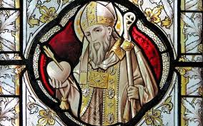
St. Augustine and His Influence
Writing in 386 A.D. in De Academicis, Saint Augustine wrote that part of the answer to the despair of skepticism is found in the Christian conviction that Truth is attainable and that knowledge and wisdom are possible, because all Truth derives from God in His creation and His Law, perfectly revealed in Jesus Christ. Augustine was deeply versed in classical philosophy, especially Plato, and saw its quest for Truth and Virtue (e.g., “for the mind does not require filling like a bottle, but rather, like wood, it only requires kindling to create in it an impulse to think independently and an ardent desire for the Truth”[Plutarch] ) as a quest fulfilled in Christ.
PSALM 19—the Glory of Natural Law and the Word of the Law
The heavens declare the glory of God, and the sky above proclaims his handiwork. Day to day pours out speech, and night to night reveals knowledge. There is no speech, nor are there words, whose voice is not heard. Their voice goes out through all the earth, and their words to the end of the world.
In them he has set a tent for the sun, which comes out like a bridegroom leaving his chamber, and, like a strong man, runs its course with joy. Its rising is from the end of the heavens, and its circuit to the end of them, and there is nothing hidden from its heat.
The law of the Lord is perfect, reviving the soul; the testimony of the Lord is sure, making wise the simple; the precepts the Lord are right, rejoicing the heart; the commandment of the Lord is pure, enlightening the eyes; the fear of the Lord is clean, enduring forever; the rules of the Lord are true, and righteous altogether.
More to be desired are they than gold, even much fine gold; sweeter also than honey and drippings of the honeycomb. Moreover, by them is your servant warned; in keeping them there is great reward.
Who can discern his errors? Declare me innocent from hidden faults. Keep back your servant also from presumptuous sins; let them not have dominion over me. Then I shall be blameless, and innocent of great transgression.
Let the words of my mouth and the meditation of my heart be acceptable in your sight, O Lord, my rock and my redeemer!

Slide 7
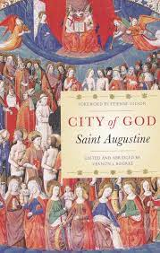
In City of God, Augustine defined virtue as “rightly ordered love” (City of God, XV.23), stating in one work:
“But living a just and holy life requires one to be capable of an objective and impartial evaluation of things: to love things, that is to say, in the right order, so that you do not love what is not to be loved, or fail to love what is to be loved, or have a greater love for what should be loved less, or an equal love for things that should be loved less or more, or a lesser or greater love for things that should be loved equally.” (On Christian Doctrine, I.27-28)
This notion of rightly ordered loves has proved to be foundational to much of Western Christian thought. Dante conceived of the seven deadly sins in terms of disordered love. This understanding of virtue and vice meshes with Scripture’s insistence that love is the fulfillment of the law (Rom 13:8; Gal. 5:14; James 2:8).
Augustine called virtues “the various movements of love,” and described the four cardinal virtues in terms of love:
“I hold that virtue is nothing other than perfect love of God. Now, when it is said that virtue has a fourfold division, as I understand it, this is said according to the various movements of love…We may, therefore, define these virtues as follows: temperance is love preserving itself entire and incorrupt for God; courage is love readily bearing all things for the sake of God; justice is love serving only God, and therefore ruling well everything else that is subject to the human person; prudence is love discerning well between what helps it toward God and what hinders it.“(On the Morals of the Catholic Church, XV.25)
“Tell me. Love, if thou canst, anything which He hath not made. Look round upon the whole creation, see whether in any place thou art held with the birdlime of desire, and hindered from loving the Creator, except it be by that very thing which He hath Himself created, whom thou despisest. But why dost thou love those things, except because they are beautiful? Can they be as beautiful as He by whom they were made? Thou admirest these things, because thou seest not Him: but through those things which thou admirest, love Him whom thou seest not.” (Commentary on the Psalms, on Psalm 80:11)

Slide 8
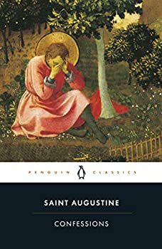
“Beneath Augustine’s conception of virtue as rightly ordered love was a foundational conviction about the nature of reality. Augustine believed that the summum bonum, the highest good, was God himself and that all other goods are lesser goods that flow from his hand, intended to lead us back to him. In the Confessions, for example, Augustine says:
“For there is a joy that is not given to those who do not love you, but only to those who love you for your own sake. You yourself are their joy. Happiness is to rejoice in you and for you and because of you. This is happiness and there is no other. Those who think that there is another kind of happiness look for joy elsewhere, but theirs is not true joy.” (Confessions, X.22)
“In this framework, sin springs from hearts that neglect God as the Supreme Good and seek their happiness in lesser goods. But such people ignore the order and nature of reality. This is the heart of evil: to prefer a lesser good over the Supreme Good, to worship and serve the creature rather the Creator (Rom 1:25).” (adapted from Rev. Brian Hedges)
“These are thy gifts; they are good, for thou in thy goodness has made them. Nothing in them is from us, save for sin when, neglectful of order, we fix our love on the creature, instead of on thee, the Creator.” (City of God, XV.22)
“The foundational distinction between traditional education and modern education is that the ancients believed that education was fundamentally about shaping loves. The liberal arts [are] a central part of a larger and more robust paradigm of classical education that should consist of piety, gymnastic, music, liberal arts, philosophy, and theology, [recovering] the means by which classical educators developed more than just intellectual virtue (by means of the seven liberal arts) but holistically cultivated the mind, body, will, and affections.” (Jain and Clark)

Slide 9
The Foundations of the University: Liberal Arts and Christian Faith
Oxford University (1096), one of the earliest institutions that helped forge modern-day universities, was founded by Christians as an offshoot of the cathedral school and held its first classes in the Church of St. Mary the Virgin. Each college is organized according to the monastic model, with a chapel, dorms, refectory, and gardens. The motto of Oxford, still being used today, comes from Psalm 27:1 and states in Latin, “The Lord is my light.” Oxford’s crest includes three crowns, representing God the Father, God the Son, and God the Holy Spirit. Until the late 19th century, you could not teach or receive a degree from Oxford unless you were a member of the Church of England, and daily worship was required of all students until around World War I. Even today certain Oxford colleges are required to have Anglican clergy as their leaders.
Harvard University (1636), founded for the propagation of the Christian faith, stated in its original mission statement: “Let every student be plainly instructed and earnestly pressed to consider well the end of his life and studies is to know God and Jesus Christ, which is eternal life, and therefore to lay Christ in the bottom, as the only foundation of all sound knowledge and learning.” Harvard adopted the Latin “Veritas Christo et Ecclesiae” motto in 1692, which means “Truth for the Church and Christ.” Originally, the two main books on the Harvard shield faced up while the book at the bottom faced down to show the need for God’s revelation and limits of reason.
Education, and particularly higher education, was part and parcel of the mission of the Church from its earliest days. Universities were unknown in the ancient world and only came into being because the Church started them.

Slide 10
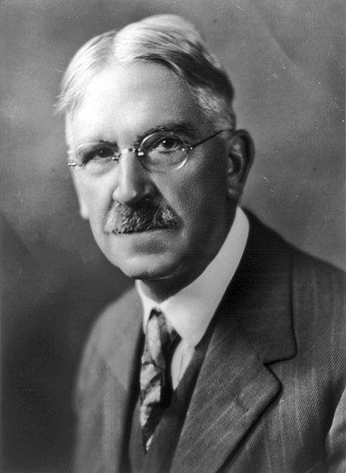
When did the purpose and role of education begin to change?
The Enlightenment in 18th century France, with its emphasis on the role of Reason, coupled with the advent of Darwinism in the 19th century, had the effect of beginning to undermine the philosophical underpinnings of the Christian understanding of education and the nature of knowledge, along with planting the seeds of the supposed conflict between faith and science.
In the United States, Charles Peirce (1839-1914), a professor at Johns Hopkins, pioneered a new philosophical movement that became known as Pragmatism. Pragmatism is a philosophical tradition that considers words and thought as tools and instruments for prediction, problem solving, and action, and rejects the idea that the function of thought is to describe, represent, or mirror Reality.
John Dewey (1859-1952), one of Peirce’s students, became an extremely influential philosopher and educational theorist who rejected the normative epistemology and metaphysics of philosophy in favor of a naturalistic approach that viewed knowledge as arising from an active adaptation of the human organism to its environment. For Dewey, the purpose of this adaptation was largely economic, and therefore the reason to go to school was so you could get a job, and education needed to be re-formed around that goal. Dewey emphasized that education and schooling are instrumental in creating social change and reform.
Yet, even in the midst of these developments, there was still a strong majority in academia that held on to a Christian view of the role of education and the university. Consider the founding statement of Duke University in 1924:
“The aims of Duke University are to assert a faith in the eternal union of knowledge and religion set forth in the teachings and character of Jesus Christ, the Son of God; to advance learning in all lines of truth; to defend scholarship against all false notions and ideals; to develop a Christian love of freedom and truth…”

Slide 11
The quest for truth, grounded in a Christian worldview, has now all but vanished from academia. Prominent academic leaders began sounding the alarm about this trend over 20 years ago. As one commentator puts it, “The greatest threat to academic freedom today comes from within. The barbarians are not at the gates; they are inside the walls. As Benno Schmidt, then president of Yale University, said in a 1991 address: ‘The most serious problems of freedom of expression in our society today exist on our campuses .... The assumption seems to be that the purpose of education is to induce correct opinion rather than to search for wisdom and to liberate the mind.’ That same year, retiring Harvard president Derek Bok expressed a similar concern: ‘What universities can and must resist are deliberate, overt attempts to impose orthodoxy and suppress dissent....In recent years, the threat of orthodoxy has come primarily from within rather than from outside the university.’”
C.S. Lewis points out these same dangers besetting the Academy in The Abolition of Man, but even more powerfully in That Hideous Strength, a novel whose opening scene is a faculty meeting of a prestigious university.
Lewis, of course, was 50 years earlier than the presidents of Harvard and Yale in these realizations!

Slide 12
Whatever Happened to Philosophy?
The study of philosophy has been the linchpin of education since the time of the ancient Greeks. And no wonder—philosophy seeks to discover answers to what have traditionally been considered the most important questions human beings face. The questions philosophy seeks to address include
--Why are we here and what is the meaning of life?
--What is knowledge?
--Can religious belief be justified?
--Does God exist?
--What is the nature of the mind?
--Do humans have free will?
--What is morally right and wrong?
--How should society be organized?
Philosophy was considered THE most important part of education, and was invariably a required part of university studies—answering these questions was the real WHY people went to college. However, over the past 50 years the study of philosophy has shrunk, first being subsumed into a required Western Civilization course, then made optional, and then disdained as IMPRACTICAL (won’t help you get a job), politically incorrect, and harmful (Patriarchy of Dead White Men).
When the Rev. Dr. Martin Luther King was asked by interviewer Alex Haley in 1965 what one book he would choose if he were marooned on a desert island with only one book other than the Bible, what book did he say he would choose? A. Karl Marx’s “The Communist Manifesto” B. Frederick Douglass’ “Narrative of the Life of Frederick Douglass” C. W.E.B. Du Bois’ “The Souls of Black Folk” d. Plato’s “The Republic”

Slide 13
Up until the early 20th century, if you were a university-educated person, you more than likely would have studied philosophy and would have read Aristotle’s Nicomachean Ethics, Plato’s Republic, and Augustine’s City of God.
Who’s Afraid of Epistemology? (and Metaphysics)—and why you need to know these words
Epistemology is the branch of philosophy which studies the nature and scope of knowledge and justified belief. It considers the relationship between knowledge, truth, belief, reason, evidence, and reliability. It answers questions like
--What does knowledge mean?
--How does a person get to know something?
--What is the basis for true knowledge?
Metaphysics is the branch of philosophy which studies being, the nature of existence and reality. Metaphysics seeks to answer such questions as
--What is our place in the universe?
--Why are we here, and what is the meaning of life?
--Does the world really exist?
--Why is there something, rather than nothing?
--What is the nature of space, time, and causality?
Epistemology matters!
--HOW do we know what we know?
--How do we know what’s true?
--How has that changed?

Slide 14
“So he sent the word to slay/And slew the little childer”
Lewis opens the first chapter of The Abolition of Man with this quotation from the 15th century Christmas carol Puer nobis nascitur , which describes King Herod’s command in Matthew 2 to kill all male children two and under. As Lewis scholar Alan Jacobs puts it:
“Surely it must have been a kind of macabre joke on Lewis’s part to preface a critique of textbooks with these lines? But no: Herod could but kill the body; our teachers (Lewis thinks) are killing our children’s souls, and this is the more grievous sin.”
“Lewis is not simply admonishing English schoolmasters to correct a pedagogical error. He is, rather, writing to tackle nothing less than the hegemony of relativism in modern western culture.” Focusing attention on the unattractive destination to which he believes that radical and persistent subjectivism inexorably leads…this book is a warning. Lewis is saying, in essence, “We are on the wrong path, and this is where it will take us, to self-destruction. [In this work] how we might change tack is not his principal concern. The closing sentence of the final lecture—about impending moral blindness—sums up his cautionary purpose.
“In the far more important sense [Abolition] was an attempt, completely against the grain of his own culture, to speak truth to power. In particular it recognized that the real power to open or close the mind rests not with pure philosophers at conversation in the universities, but rather with programmes of mass education and wih the assumptions that lie behind widely used school textbooks.” (Guite Abolition of Man 160)—Adapted from Rev. Dr. Michael Ward, After Humanity

Slide 15
For at one time you were darkness, but now you are light in the Lord.
Walk as children of light (for the fruit of light is found in all that is good and right and true), and try to discern what is pleasing to the Lord. Take no part in the unfruitful works of darkness, but instead expose them. For it is shameful even to speak of the things that they do in secret. But when anything is exposed by the light, it becomes visible, for anything that becomes visible is light. Therefore it says, “Awake, O sleeper,
and arise from the dead, and Christ will shine on you.”
Look carefully then how you walk, not as unwise but as wise,
making the best use of the time, because the days are evil. Therefore do not be foolish,
but understand what the will of the Lord is.
Ephesians 5: 8-17

