Slide 1
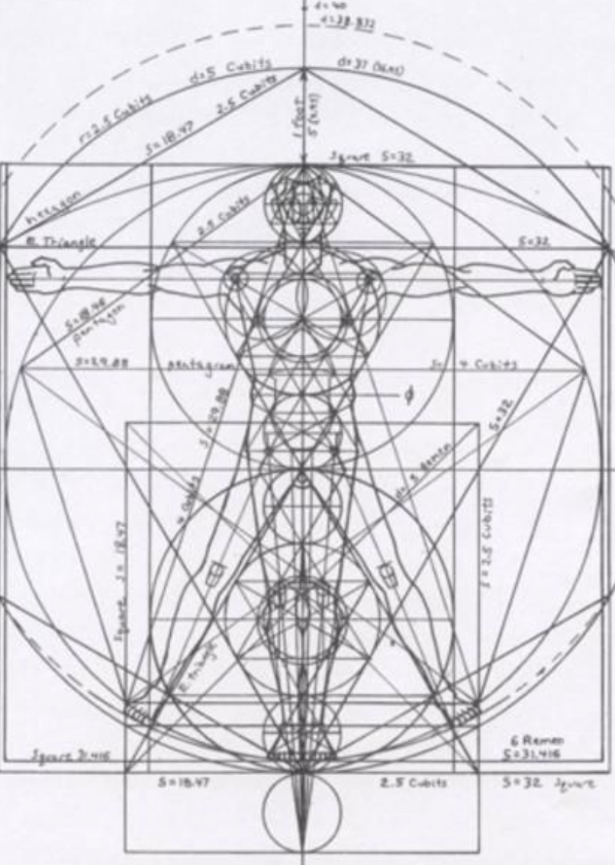
Not as Unwise but as Wise: Reflections from C.S. Lewis's The Abolition of Man and That Hideous Strength on Living Christianly in a Post-Christian World
September 22, 2021 -- St. Philip’s Church
The Rev’d Brian K. McGreevy, J.D., Facilitator

Slide 2
For at one time you were darkness, but now you are light in the Lord.
Walk as children of light (for the fruit of light is found in all that is good and right and true), and try to discern what is pleasing to the Lord. Take no part in the unfruitful works of darkness, but instead expose them. For it is shameful even to speak of the things that they do in secret. But when anything is exposed by the light, it becomes visible, for anything that becomes visible is light. Therefore it says, “Awake, O sleeper,
and arise from the dead, and Christ will shine on you.”
Look carefully then how you walk, not as unwise but as wise,
making the best use of the time, because the days are evil. Therefore do not be foolish,
but understand what the will of the Lord is.
Ephesians 5: 8-17

Slide 3
How to approach this class: --On the beach --Snorkeling --Scuba diving --Email list How to read The Abolition of Man:
--Why it’s not an easy read—original audience and the premises of Natural Law --Try reading aloud --One paragraph at a time
What we’ll be doing each week:
--Examining context and establishing a framework for appreciating these books
--Unpacking the meaning of Lewis’s works
--Exploring their relevance for today
--Considering how we can respond with practices of Hope and of Wisdom rooted in the Scriptures

Slide 4
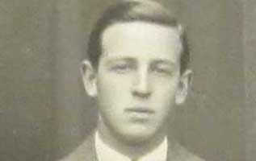
Week 1: Introduction--How did C.S. Lewis come to write these two books, what was the context, and how are these two books connected?
I. C.S. Lewis—a brief introduction --Born in Belfast, Northern Ireland in 1898 -Death of mother followed by terrible experience of schools and of England 1908 --A brilliant tutor discovers a brilliant mind, leading to Oxford in 1917 --Enlists and is on the front line of Battle of the Somme on 19th birthday --Despair and bitterness after World War I --A brilliant Triple First in Moderations (Greek and Latin Literature), Greats (Philosophy and Ancient History), and English --Brilliant, proud, and aggressive atheism; appointment to teach Philosophy at Oxford --Worldly success: elected Fellow of Magdalen in 1925, publication of “Spirits in Bondage” and “Dymer” --Sehnsucht, the impact of a bold friend and the formation of the Inklings --Tolkien, Addison’s Walk, True Myth, and conversion 1931--the Inklings begin --Revised English syllabus developed by Lewis and Tolkien accepted by Oxford University 1933 --Invitation to write the 16th Century English Literature text for the Oxford History of English Literature --Prize for Literature in recognition of The Allegory of Love (a study in medieval tradition) 1937 --The Screwtape Letters 1941 and Mere Christianity broadcasts begin during the Blitz --Riddell Memorial Lectures at University of Durham: The Abolition of Man 1943 --The Great Divorce 1943 and Honorary Doctor of Divinity from University of St. Andrews 1944 --Elected Fellow of the Royal Society of Literature
The Inklings--A group that gathered around C.S. Lewis and J.R.R. Tolkien beginning in the 1930s and lasting for several decades, defined by Lewis as “…an informal club, whose qualifications are a tendency to write, and Christianity.” Building upon a deep Christian faith and a recovery of the transcendentals of Truth, Goodness, and Beauty, the Inklings were unafraid to boldly engage the culture and mounted a counter-cultural offensive about how to live and think Christianly in a post-Christian world. They were deeply invested in recovering a Biblical understanding of fellowship and the power of community. “From its inception, a sense of moral purpose and commitment to a vigorous defense of the Western tradition animated the Inklings. As survivors of the battlefields of the First World War, they understood the measure of what was at stake in their generation: The Inklings were, to a man … comrades who had been touched by war, who viewed life through the lens of war, yet who looked for hope and found it, in fellowship, where so many other modern writers and intellectuals saw only broken narratives, disfigurement, and despair…Far from breaking with tradition, they understood the Great War and its aftermath in the light of tradition, believing, as did their literary and spiritual ancestors, that ours is a fallen world yet not a forsaken one. It was a belief that set them at odds with many of their contemporaries, but kept them in the broad currents of the English literary heritage.” The Fellowship

Slide 5
II. Who were the Inklings?
A group that gathered around C.S. Lewis and J.R.R. Tolkien beginning in the 1930s and lasting for several decades, defined by Lewis as “…an informal club, whose qualifications are a tendency to write, and Christianity.” Composed mostly of Oxford academics, they generally met on Tuesday mornings at the “Eagle and Child” (which they called the “Bird and Baby” or just the “Bird”) and at Lewis’s rooms in Magdalen College on Thursday evenings over the course of many years and engaged in deep discussions of philosophy and theology while sharing their works in progress with one another.
Building upon a deep Christian faith and a recovery of the transcendentals of Truth, Goodness, and Beauty, the Inklings were unafraid to boldly engage the culture and mounted a counter-cultural offensive about how to live and think Christianly in a post-Christian world. They were deeply invested in recovering a Biblical understanding of fellowship and the power of community.
“From its inception, a sense of moral purpose and commitment to a vigorous defense of the Western tradition animated the Inklings. As survivors of the battlefields of the First World War, they understood the measure of what was at stake in their generation: The Inklings were, to a man … comrades who had been touched by war, who viewed life through the lens of war, yet who looked for hope and found it, in fellowship, where so many other modern writers and intellectuals saw only broken narratives, disfigurement, and despair…Far from breaking with tradition, they understood the Great War and its aftermath in the light of tradition, believing, as did their literary and spiritual ancestors, that ours is a fallen world yet not a forsaken one. It was a belief that set them at odds with many of their contemporaries, but kept them in the broad currents of the English literary heritage.” The Fellowship

Slide 6
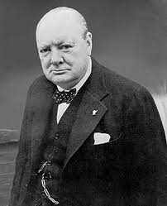
III. Context—Britain in World War II
In the 1930s, the eyes of the world focused on political developments in Germany as Hitler consolidated his grip on the government. There was enormous political tension in England between those who thought appeasement was the best option (led by Prime Minister Neville Chamberlain) and the minority who believed war was inevitable and there could be no compromise with someone like Hitler. As Prime Minister Neville Chamberlain and certain members of the royal family urged pacts with Hitler, Hitler continued to invade other countries so that finally in September 1939 England and France declared war on Germany. --Apocalyptic atmosphere: Nazi plans to invade England were known, with massive bombings as the first part of the strategy: “I expect that the Battle of Britain is about to begin. Upon this battle depends the survival of Christian civilization. Upon it depends our own British life, and the long continuity of our institutions and our Empire. The whole fury and might of the enemy must very soon be turned on us. Hitler knows that he will have to break us in this Island or lose the war. If we can stand up to him, all Europe may be free and the life of the world may move forward into broad, sunlit uplands. But if we fail, then the whole world, including the United States, including all that we have known and cared for, will sink into the abyss of a new Dark Age made more sinister, and perhaps more protracted, by the lights of perverted science. Let us therefore brace ourselves to our duties, and so bear ourselves that, if the British Empire and its Commonwealth last for a thousand years, men will still say, “This was their finest hour.”—Winston Churchill to House of Commons and on BBC, June 18, 1940
Bombings, not just of London but of other cities throughout England, became routine: heaviest in 1940 and 1941 but continuing through 1945, with massive destruction and casualties.

Slide 7
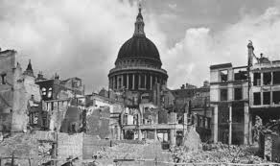
The London Blitz continued through the fall and winter of 1940 and into the new year of 1941. Some 61,000 (mostly civilians) were killed in the bombings, and nearly 400,000 were homeless across Britain. The “Baedeker bombings,” Nazi air raids targeting Britain’s cultural heritage, were unfolding alongside the Nazi bombings of cities and sites associated with the war effort. Lewis was very active in this period, serving as an air raid warden and traveling the country speaking to the RAF. He had the idea for The Screwtape Letters in July of 1940 after hearing a Hitler speech on the radio and published it as a serial soon thereafter. His BBC talks (Mere Christianity) began in August 1941. In 1942 and 1943, Nazi bombing raids continued with significant loss of life, as did U-Boat attacks on British ships. Severe rationing greatly alters daily life in England.
It is almost impossible for us to understand the fear and dread and sheer difficulty of life in England during this period, but getting a sense of that is vital to understanding how both these books came to be written. Ultimate questions (Is there a God? What is the meaning of life? What happens when I die?) were on everyone’s mind, forced by the awareness that death was raining from the skies and that tomorrow might not come or might mean Nazi rule. It was virtually impossible to be alive without facing these issues.
--Film clip from the Imperial War Museum

Slide 8
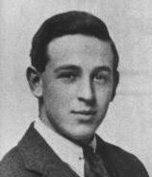
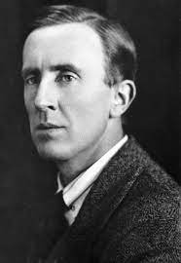
IV. How and when did these books come to be written?
Following Lewis’s conversion to the Christian faith in the early 1930s, Lewis turned his considerable gifts towards writing works that would point to the truth of the Gospel. Tolkien and Lewis challenged each other around 1935 to create deep and hopeful works of the imagination. After a wager where they flipped a coin, the two men agreed that Lewis would write on space travel while Tolkien would deal with time travel: L. [Lewis] said to me one day: ‘Tollers, there is too little of what we really like in stories. I am afraid we shall have to try and write some ourselves.’ We agreed that he should try ‘space-travel’, and I should try ‘time-travel’. His result is well known. My effort, after a few promising chapters, ran dry: it was too long a way round to what I really wanted to make, a new version of the Atlantis legend. The final scene survives as The Downfall of Númenor.
Lewis saw the wager as an opportunity to put into effect one of the things that was to be a hallmark of his writing: ‘supposal’… 'I like the whole interplanetary idea,' he said, 'as a mythology and simply wished to conquer for my own (Christian) point of view what has always hitherto been used by the opposite side.' When some of his readers failed to see what he was 'getting at', he concluded that 'any amount of theology can now be smuggled into people's minds under cover of romance without their knowing it.’ Based on this wager, Lewis began writing what would become known as the Ransom trilogy or Space trilogy: Out of the Silent Planet (1938), Perelandra (1943), and That Hideous Strength (1945). His work took on new urgency with the outbreak of World War II, and he felt called to focus his energies and gifts on works that would point people to the Kingdom of God. During this period he produced numerous essays and books, both fiction and non-fiction, that led to his burgeoning fame as an apologist for the Christian faith.

Slide 9
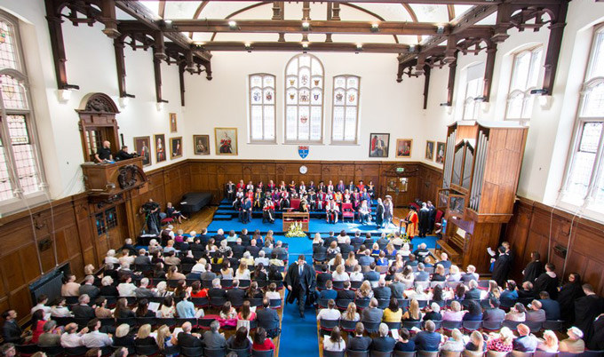
First delivered as the scholarly Riddell Memorial Lectures on February 24 to 26, 1943, in King’s Hall at King’s College, Newcastle (part of Durham University), The Abolition of Man was published later that same year, just after Lewis had finished Perelandra and was conceiving That Hideous Strength.
The Riddell Memorial Lectures were established in 1928 in memory of Sir John Walter Buchanan-Riddell and were to address “a subject concerning the relation between religion and contemporary development of thought.” Lewis’s brother, Warnie, accompanied him to Durham for the three day trip, which was a welcome respite in the dark days of rationing and air raids in World War II, and in his diary recounts how much “Jack” enjoyed this time away in a beautiful town with one of his favorite cathedrals. These lectures were extremely prestigious then, as they are now, and usually featured major public intellectuals and faith leaders.

Slide 10
(
The three lectures Lewis delivered
– “Men without Chests” (the importance of objective values and the poison of subjectivism),
--“The Way” (why the Tao, or Natural Law, is the sole source of all value judgments), and
--“The Abolition of Man” (to “see through” all things is not to see at all)
correspond to the chapters in the published text, which is supplemented with an invaluable appendix entitled “Illustrations of the Tao.”
Convinced of the crucial importance of the themes he addressed in The Abolition of Man, Lewis decided to portray them in the form of a story for the last volume in the Ransom trilogy, which he entitled That Hideous Strength. The title comes from a line in a poem by Sir David Lyndsay called “Ane Dialog” (1555) in which Lyndsay was describing the biblical Tower of Babel (Genesis 11: 1-9): “The shadow of that hideous strength, Six miles and more it is of length.” In the preface to That Hideous Strength, Lewis states, “This is a ‘tall story‘ [pun probably intended] about devilry, though it has behind it a serious ‘point’ which I have tried to make in my Abolition of Man.”
In The Abolition of Man, among many things, Lewis offered his thoughts to a scholarly audience, arguing (without reference to theology) on the purpose of education, the natural law tradition, and the necessity of moral oversight of the institution of science and its practitioners. In That Hideous Strength: A Modern Fairy-Tale for Grown-Ups, first published in 1945, he breathes life into these same ideas in his description of the aggressive vision of the scientific group called the N. I. C. E. (National Institute for Coordinated Experiments), and in his attribution of the N. I. C. E.’s views and actions to the demons, or … “devilry.”

Slide 11
V. Importance of The Abolition of Man
Later in life, Lewis wrote that The Abolition of Man "is almost my favourite among my books, but in general has been almost totally ignored by the public.” Despite Lewis’s assessment that Abolition had been ignored, it has proven to be one of the most important things Lewis ever wrote. The Intercollegiate Review named it one of the five nonfiction books of the 20th century. The National Review ranks it seventh on its list of the top nonfiction books of the 20th century. Professor Alasdair McIntyre, perhaps the most eminent philosopher of this era, was hugely influenced by this work in his seminal volume After Virtue. Ayn Rand certainly didn’t ignore it, though she didn’t much like it--calling it “abysmal scum” and a “cheap, awful, touchy, social-metaphysical mediocrity.”
One fascinating aspect of its reception is that it is widely praised by non-Christian as well as Christian scholars. Renowned atheist philosopher John Gray called Abolition “prescient”, “prophetic”, and as relevant now as when it first came out, “if not more so.” A wide range of Christian scholars have praised it as well: Anglican evangelical scholar Alan Jacobs has called it “the most profound of Lewis’s cultural critiques,” with Joseph Ratzinger (Pope Benedict XVI) praising the “keen accuracy” of its moral diagnosis. A.N. Wilson, Hans Urs von Balthasar, Francis Fukuyama, and Wendell Berry have all praised the book, and as one commentator said, “A book that attracts enthusiastic responses from Catholics, Protestants, and atheists is probably doing something pretty significant.”
years.” For this reason, the work made its way to the second spot in his list of top ten must read books, second only to the Bible.
Later in life, Lewis wrote that The Abolition of Man "is almost my favourite among my books, but in general has been almost totally ignored by the public.”
The Abolition of Man is an all but indispensable introduction to the entire corpus of Lewisiana—Walter Hooper

Slide 12
A final comment from Rev. Dr. Michael Ward, eminent Lewis scholar and author of After Humanity, the most important guide to The Abolition of Man:
“[Lewis is] arguing that moral law is a premise; it’s not a conclusion. We have to accept it as a given; we can’t argue to it, we must argue from it.
“It’s an objective reality which we didn’t make up: we must submit to it, we must surrender to it and grow up within it. It’s like a trellis with which you would train a climbing rose.
“But if you take the opposite view, that we create moral law according to our own subjective preferences, you can do whatever you like—because there’s nothing that is objectively real in the moral world. No, it’s just whatever you happen to choose.
“Happiness consists in conforming oneself to reality, not twisting reality to suit your own convenience, or your own desires. The common modern-day phrase “speaking my truth” connects very precisely with this prophecy that Lewis is making—that we’ll all just determine reality according to our own particular perspective, which leads to moral anarchy and therefore to a “post-truth” world.”

Slide 13
Future Attractions:
The Abolition of Man helps explain the following true story:
“A team of hardworking Italian cleaners thought they were tidying up after a particularly wild opening party on Friday night at the Museum for Modern and Contemporary Art in Bolanzo, Italy. The empty champagne bottles, confetti, and cigarette butts, however, were actually part of an art installation by Milanese artists Goldschmied and Chiari.This isn’t the first time such a mistake has been made, of course. This summer, a Connecticut maintenance worker dismantled and trashed a wood and tile scuplture by New York artist Jim Osman, and a $3.71 million painting by Cui Ruzhuo was thrown out by hotel cleaning staff in Hong Kong this past spring. There’s also the 26-foot-tall Forever Marilyn (a J. Seward Johnson knock-off) that mysteriously wound up in a Chinese dump.”—ARTnet, 10/26/2015
From news outlet The Stream, September 2021:
“The Academy has been corrupted by political ideology. Cancel Culture runs rampant. Scientists conduct Gain-of-Function research that threatens death on a global scale. Once-quiet cities are destroyed in planned riots, which the media describes as mostly peaceful. Merlin comes back from the dead.”
“Wait a minute … Merlin what? I thought you were reading the news! I was all set to hear you mention Covid and murder hornets, but Merlin? Was that on Fox or CNN?”
“Actually, the whole first paragraph occurs in a dystopia written 76 years ago: That Hideous Strength.”

Slide 14
For at one time you were darkness, but now you are light in the Lord.
Walk as children of light (for the fruit of light is found in all that is good and right and true), and try to discern what is pleasing to the Lord. Take no part in the unfruitful works of darkness, but instead expose them. For it is shameful even to speak of the things that they do in secret. But when anything is exposed by the light, it becomes visible, for anything that becomes visible is light. Therefore it says, “Awake, O sleeper,
and arise from the dead, and Christ will shine on you.”
Look carefully then how you walk, not as unwise but as wise,
making the best use of the time, because the days are evil. Therefore do not be foolish,
but understand what the will of the Lord is.
Ephesians 5: 8-17

