Slide 1
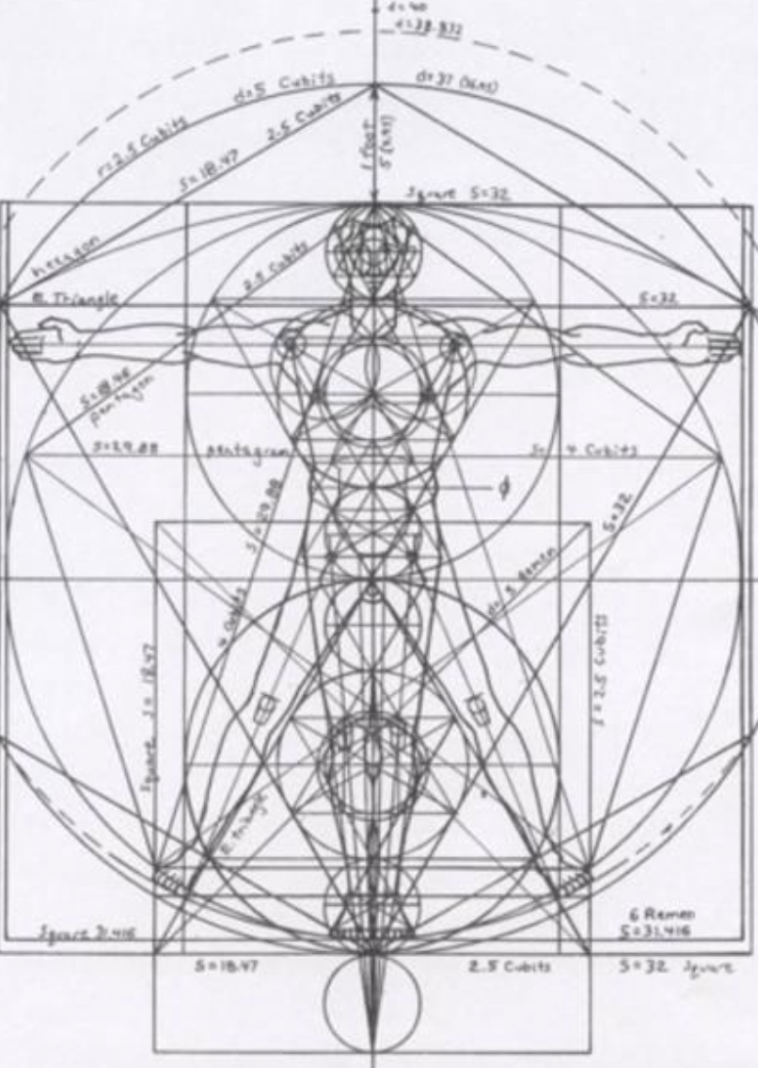
Not as Unwise but as Wise: Reflections from C.S. Lewis's The Abolition of Man and That Hideous Strength on Living Christianly in a Post-Christian World
October 20, 2021 -- St. Philip’s Church
The Rev’d Brian K. McGreevy, J.D., Facilitator

Slide 2
For at one time you were darkness, but now you are light in the Lord.
Walk as children of light (for the fruit of light is found in all that is good and right and true), and try to discern what is pleasing to the Lord. Take no part in the unfruitful works of darkness, but instead expose them. For it is shameful even to speak of the things that they do in secret. But when anything is exposed by the light, it becomes visible, for anything that becomes visible is light. Therefore it says, “Awake, O sleeper,
and arise from the dead, and Christ will shine on you.”
Look carefully then how you walk, not as unwise but as wise,
making the best use of the time, because the days are evil. Therefore do not be foolish,
but understand what the will of the Lord is.
Ephesians 5: 8-17

Slide 3
How to approach this class: --On the beach --Snorkeling --Scuba diving --Email list How to read The Abolition of Man:
--Why it’s not an easy read—original audience and the premises of Natural Law --Try reading aloud --One paragraph at a time
What we’ll be doing each week:
--Examining context and establishing a framework for appreciating these books
--Unpacking the meaning of Lewis’s works
--Exploring their relevance for today
--Considering how we can respond with practices of Hope and of Wisdom rooted in the Scriptures

Slide 4
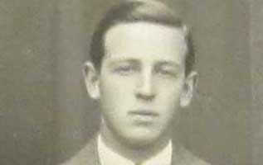
Review from previous classes:
I. How did C.S. Lewis come to write these two books, what was the context, and how are these two books connected?
--C.S. Lewis and how his background prepared him for writing these books: converted atheist, philosopher
--The role of the Inklings and Tolkien in conceiving these books
--Context of England at War
--The Wager
--The Riddell Memorial Lectures
--Connections between the books In the preface to That Hideous Strength, Lewis states, “This is a ‘tall story‘ [pun probably intended] about devilry, though it has behind it a serious ‘point’ which I have tried to make in my Abolition of Man.”
II. Education and its fundamental importance for how we view the world
--Liberal Arts: Trivium (grammar, logic, and rhetoric) and the Quadrivium (mathematics, geometry, music, and astronomy), seeking to inculcate Virtue. In the Middle Ages, with the advent of universities, Theology (queen of sciences) was the framework for the liberal arts, while philosophy, history, and classical languages and literature (known as the humanities) were added to the traditional liberal arts
--St. Augustine: wrote that part of the answer to the despair of skepticism is found in the Christian conviction that Truth is attainable and that knowledge and wisdom are possible, because all Truth derives from God in His creation and His Law, perfectly revealed in Jesus Christ.
In City of God, Augustine defined virtue as “rightly ordered love” (City of God, XV.23), stating in one work:
“But living a just and holy life requires one to be capable of an objective and impartial evaluation of things: to love things, that is to say, in the right order, so that you do not love what is not to be loved, or fail to love what is to be loved, or have a greater love for what should be loved less, or an equal love for things that should be loved less or more, or a lesser or greater love for things that should be loved equally.” (On Christian Doctrine, I.27-28)

Slide 5
“The foundational distinction between traditional education and modern education is that the ancients believed that education was fundamentally about shaping loves. The liberal arts [are] a central part of a larger and more robust paradigm of classical education that …holistically cultivated the mind, body, will, and affections.” (Jain and Clark)
Universities and the Liberal Arts Education, and particularly higher education, was part and parcel of the mission of the Church from its earliest days. Universities were unknown in the ancient world and only came into being because the Church started them. What we think of as the great universities like Oxford and Harvard were robustly Christian in their original mission statements.
Pragmatism was a philosophical movement in the 19th century which hugely impacted the philosophy of education and its purpose, pushing a utilitarian and economic view of education as about jobs and social reform. “The assumption seems to be that the purpose of education is to induce correct opinion rather than to search for wisdom and to liberate the mind.”—Benno Schmidt, President of Yale University, 1991
Whatever Happened to Philosophy? Philosophy was considered THE most important part of education, and was invariably a required part of university studies—answering these questions was the real WHY people went to college. However, over the past 50 years the study of philosophy has shrunk, first being subsumed into a required Western Civilization course, then made optional, and then disdained as IMPRACTICAL (won’t help you get a job), politically incorrect, and harmful (Patriarchy of Dead White Men). Up until the early 20th century, if you were a university-educated person, you more than likely would have studied philosophy and would have read Aristotle’s Nicomachean Ethics, Plato’s Republic, and Augustine’s City of God.
Who’s Afraid of Epistemology? (and Metaphysics)—and why you need to know these words: Epistemology is the branch of philosophy which studies the nature and scope of knowledge and justified belief. It considers the relationship between knowledge, truth, belief, reason, evidence, and reliability. Metaphysics is the branch of philosophy which studies being, the nature of existence and reality.
So he sent the word to slay/And slew the little childer “Surely it must have been a kind of macabre joke on Lewis’s part to preface a critique of textbooks with these lines? But no: Herod could but kill the body; our teachers (Lewis thinks) are killing our children’s souls, and this is the more grievous sin.”—Lewis scholar Alan Jacobs

Slide 6
MEN WITHOUT CHESTS
Gaius, Titius, and The Green Book
Coleridge and the Waterfall: A Deliberate Starting Point Lewis adapts a story from a memoir by Dorothy Wordsworth, recounting a trip she took in 1803 with her brother, William Wordsworth, and his good friend Samuel Taylor Coleridge. Characteristics of Waterfalls and the Biblical Idea of Living Water
--“They have forsaken me, the spring of living water, and have dug their own cisterns, cisterns that cannot hold water” Jeremiah 2:13
LEWIS BELIEVES THAT BEAUTY IS A REAL, OBJECTIVE VALUE WHICH WE CAN BE TAUGHT TO RECOGNIZE AND TO LOVE.
Augustine’s On Christian Doctrine:: “Living a just and holy life requires one to be capable of an objective and impartial evaluation of things: to love things, that is to say, in the right order.” “
“In this enduringly influential book, Lewis defends the objectivity of value, pointing to the universal moral ecology that all great philosophical and religious traditions have acknowledged as self-evident. Though Lewis writes as an apologist for Christianity in many of his other works, he here constructs his argument on purely philosophical grounds, making an anthropological claim, not advancing a theological case. Objective value, he maintains, is humanity’s ethical inheritance, which we can extend and develop but may not properly escape. Insofar as we try to deny or subvert this way of being moral, we make ourselves (and those whom we raise or teach or otherwise influence) essentially less than human. We produce ‘men without chests,’ or in other words, people who have no stable heart, no reliable capacity to liaise between intellect and appetite, no ability to distinguish between what is good in itself and what is good for them. Right thus dissolves into might, and sheer willpower takes the place of reason The result is the erasure of our own true identity, ‘the abolition of man.’”—Rev. Dr. Michael Ward

Slide 7
To help us unpack the major themes of this chapter, we are going to use the analysis developed by Lewis scholar and Christian philosopher Dr. Davey Naugle, who identifies eight key themes in “Men Without Chests”
1: Miseducation—cutting out the soul through the poison of subjectiyism
2: Uncultivated souls---producing “trousered apes” shorn clean of traditional values and noble sentiments
3: Rationale --debunking is easier than scholarly critique, misbeliefs about emotivism, rejecting objective moral value
4: Objective moral values--Lewis offers a survey of representatives from Western and world sources who advocate the objective, universal, timeless principles and truths, or what Lewis calls the Tao (Chinese for “The Way”)
5: Education inside or outside the Tao-- Lewis points out that it makes all the difference in the world if education proceeds inside or outside the Tao. The difference is between “initiation” into the universal human heritage of objective values or “conditioning” to a new, subjective set of practical values by which people are manipulated pawns
6: Trained emotions
Without the aid of trained emotions, the intellect or mind which knows what to do is powerless against the animal organism. Only as the Chest, the seat of emotions and sentiments, is rightly trained to respond in accordance with objective moral values, will it be able to control the baser appetites of the Belly.
7: Men without chests The head rules the belly through the chest — the seat . . . of emotions organized by trained habit into stable sentiments . . . these are the indispensable liaison officers between cerebral man and visceral man. It may even be said that it is by this middle element that man is man: for by his intellect he is mere spirit and by his appetite mere animal.”
8: Moral irony
Given the moral collapse of our culture, we clamour for the qualities that we make it impossible to obtain—we remove the organ but demand the function.

Slide 8
“While the nature of emotional responses is partly visceral and automatic, a man’s sentiments also have to be intentionally educated in order to be congruent — to be more in harmony with Nature. Such training teaches a man to evaluate things as more or less Just, True, Beautiful, and Good, and to proportion his affections as merited.
St. Augustine defines virtue as ordo amoris, the ordinate condition of the affections in which every object is accorded that kind of degree of love which is appropriate to it. Aristotle says that the aim of education is to make the pupil like and dislike what he ought. . . . Plato before him had said the same. The little human animal will not at first have the right responses. It must be trained to feel pleasure, liking, disgust, and hatred at those things which really are pleasant, likeable, disgusting and hateful.”The Tao of Sentiment (from The Art of Manliness Podcast, August 21, 2021)
Eustace Scrubb, Experiment House, and education
Eustace had read all the wrong books!

Slide 9
Unpacking Lewis’s Imagery in “Men Without Chests”
Shelley’s Aeolian Harp (Percy Bysshe Shelly 1792-1822 “A Defense of Poetry”--harp played by wind, after Aeolus, god of the wind)
“Man is an instrument over which a series of external and internal impressions are driven, like the alternations of an ever-changing wind over an Aeolian lyre, which move it by their motion to ever-changing melody. But there is a principle within the human being, and perhaps within all sentient beings, which acts otherwise than in the lyre, and produces not melody alone, but harmony, by an internal adjustment of the sounds or motions thus excited to the impressions which excite them. It is as if the lyre could accommodate its chords to the motions of that which strikes them, in a determined proportion of sound; even as the musician can accommodate his voice to the sound of the lyre.”
Thomas Traherne (1637-1674 English poet, Anglican cleric and theologian, in his work Centuries of Meditations)
“Can you be Holy without accomplishing the end for which you are created? Can you be Divine unless you be Holy? Can you accomplish the end for which you were created, unless you be Righteous, unless you be just in rendering to Things their due esteem? All things were made to be yours, and you were made to prize them according to their value: which is your office and duty, the end for which you were created, and the means whereby you enjoy. The end for which you were created, is that by prizing all that God hath done, you may enjoy yourself and Him in Blessedness.’ (1:12) To conceive aright and to enjoy the world, is to conceive the Holy Ghost, and to see his Love: which is the Mind of the Father. (1:10).’
St. Augustine’s ordo amoris (354- - 430; African Bishop, theologian, philosopher)
“Love itself is to be ordinately loved, because we do well to love that which, when we love it, makes us live well and virtuously. So that it seems to me that it is a brief but true definition of virtue to say, it is the order of love.”(Augustine, City of God, XV.22)
Aristotle (384-322 B.C.; Greek philosopher, author of Nichomachean Ethics)
“In fact pleasures and pains are the things with which moral virtue is concerned, for pleasure causes us to do base actions and pain cause us to abstain from doing noble actions. Hence the importance, as Plato points out, of having been definitely trained from childhood to like and dislike the proper things; this is what good education means.”
educational dictum that the aim of education in to make the pupil love what he ought.”

Slide 10
Plato (427-347 B.C.; Greek philosopher and educator, author of The Republic)
“The well-nurtured youth is one who would see most clearly whatever was amiss in ill-made works of man or ill-grown works of nature, nd with a just distaste would blame and hate the ugly even from his earliest years and would give delighted praise to beauty, receiving it into his soul and being nourished by it, so that he became a man of gentle heart.”
Hinduism’s Rta: “A term occurring in the Vedas, indicating the inherent active power, or truth, which informs and orders the universe and human society. Ṛta therefore underscores all proper cosmic, moral, and ritual activity.”–Oxford Reference
Chinese Tao: “that to which all things in heaven and earth must conform, and to which human nature is akin, so that for man the highest knowledge is to know the Tao and the highest wisdom is to live by it.”—Charles Gore, The Philosophy of the Good Life (1940)
Jewish law: The ancient Jewish Scriptures likewise praise the Law as being ‘True’ (“all His commandments are True’)
Some additional characters
Orbilius refers to E.G. Biaginni, (1889-1978) author of The Reading and Writing of English (1936), which is the other textbook besides The Green Book which Lewis attacks in The Abolition of Man. Orbilius attempts to criticize and debunk some writing about horses but without reference to any objective value (i.e., he fails to compare what purports to be bad writing about horses to any great literary writing about horses and then explain the difference; he prefers just to debunk)
Dr. I.A. Richards (1893-1979) English literary critic and educational theorist who wrote Principles of Literary Criticism (1924). Lewis at least respected Richards for his honest approach: “Richards walks up to our mental front door and rings the bell: you needn’t buy his stuff if you don’t want—‘good morning, no offence.’ The others sneak in, or blunder in, through the scullery.”—Lewis to Dorothy Sayers 7 November 1947

Slide 11
“Richards recalled a lecture he gave at Oxford in the 1920s or early 1930s. Afterwards he went back with his host, C. S. Lewis, to Magdalen College, but Lewis had forgotten to arrange a guest room. Collingwood, Lewis's colleague, was away, however, so Richards could stay in his rooms --only there were no books. Lewis said he would be right back and returned with Principles of Literary Criticism [by Richards]. “Here's something that should put you to sleep,” he said. But Richards could not sleep because the margins were full of Lewis's biting comments.”—John Paul Russo, I.A. Richards
Fellow Inkling Nevill Coghill recalled a conversation Lewis had with philosopher Robert Marett, Rector of Exeter College, Oxford, that reflected Lewis’s belief in the Tao and the peril that came with trying to alter the order of Nature and Natural Law:
“I saw in the papers this morning that there is some scientist fellow in Vienna called Voronoff - some name like that - who has invented a way of splicing the glands of young apes onto old gentlemen, thereby renewing their generative powers! Remarkable, isn't it?”
--Lewis thought. “I would say “unnatural."
“Come, come! Unnatural! What do you mean, unnatural? Voronoff is part of Nature, isn't he? What happens in Nature must surely be natural? Speaking as a philosopher, don't you know. I can attach no meaning to your objections; I don't understand you!”
--“I am sorry, Rector; but I think any philosopher from Aristotle to- say -Jeremy Bentham, would have understood me.”
“ Oh well, we've got beyond Bentham by now I hope. If Aristotle or he had known about Voronoff, they might have changed their ideas. Think of the possibilities he opens up! You'll be an old man yourself one day.”
--“I would rather be an old man than a young monkey.”--Nevill Coghill The Approach to English

Slide 12
Another Lens: The Abolition of Man’s argument as expressed in Mere Christianity
Book I. Right and Wrong as a Clue to the Meaning of the Universe 1. The Law of Human Nature A. Quarreling and what people say A universal and relatable issue! “I was here first” “Come on, you promised” Not merely that the behavior doesn’t please you, nor response of “to hell with your standard” B. Appeal to a standard of behavior which is generally agreed upon The standard is NOT dismissed—rather, the behavior is said not to go against it or an excuse is made. “…They might, of course, fight like animals, but they could not quarrel in the human sense of the word. Quarrelling means trying to show that the other man is in the wrong. And there would be no sense in trying to do that unless you and he had some sort of agreement as to what Right and Wrong are; just as there would be no sense in saying that a footballer had committed a foul unless there was some agreement about the rules of football.” C. The Law of Nature and the Law of Human Nature: humans are subject to multiple natural laws but are only free to disobey one Gravity, chemistry, heredity—we (and animals) are inexorably subject to all of these natural laws, but only we can choose whether to obey the Law of Human Nature D. Idea of decent behavior is obvious to all because Right is a real thing “What was the sense in saying the enemy were in the wrong unless Right is a real thing which the Nazis at bottom knew as well as we did and ought to have practised? If they had had no notion of what we mean by right, then, though we might still have had to fight them, we could no more have blamed them for that than for the colour of their hair.”

Slide 13
E. Morality and moral teaching are remarkably consistent across ages and civilizations “I know that some people say the idea of a Law of Nature or decent behaviour known to all men is unsound, because different civilisations and different ages have had quite different moralities. But this is not true. There have been differences between their moralities, but these have never amounted to anything like a total difference. If anyone will take the trouble to compare the moral teaching of, say, the ancient Egyptians, Babylonians, Hindus, Chinese, Greeks and Romans, what will really strike him will be how very like they are to each other and to our own. Some of the evidence for this I have put together in the appendix of another book called The Abolition of Man.” Examples: cowardice, selfishness, promiscuity F. Those who say they do not believe in a real Right or Wrong will nevertheless appeal to a standard of fairness if things do not go their way “But the most remarkable thing is this. Whenever you find a man who says he does not believe in a real Right and Wrong, you will find the same man going back on this a moment later. He may break his promise to you, but if you try breaking one to him he will be complaining "It's not fair" before you can say Jack Robinson.”
G. Right and Wrong are no more matters of taste or opinion than the multiplication tables, yet no one is successfully and consistently keeping the Law of Nature “I am not preaching, and Heaven knows I do not pretend to be better than anyone else. I am only trying to call attention to a fact; the fact that this year, or this month, or, more likely, this very day, we have failed to practise ourselves the kind of behaviour we expect from other people. There may be all sorts of excuses for us. That time you were so unfair to the children was when you were very tired. That slightly shady business about the money—the one you have almost forgotten—came when you were very hard up. And what you promised to do for old So-and-so and have never done—well, you never would have promised if you had known how frightfully busy you were going to be. And as for your behaviour to your wife (or husband) or sister (or brother) if I knew how irritating they could be, I would not wonder at it—and who the dickens am I, anyway? I am just the same.” (Note Lewis’s disarming honesty and humility here, as well as his deep understanding of human nature and conscience—he has put himself in the same boat with all his readers.) H. We have failed to practice ourselves the kind of behavior we expect from other people When we do not keep the Law of Nature, we immediately begin to come up with self-justificatory excuses. “The question at the moment is not whether they are good excuses. The point is that they are one more proof of how deeply, whether we like it or not, we believe in the Law of Nature. If we do not believe in decent behaviour, why should we be so anxious to make excuses for not having behaved decently? The truth is, we believe in decency so much—we feel the Rule or Law pressing on us so— that we cannot bear to face the fact that we are breaking it, and consequently we try to shift the responsibility. For you notice that it is only for our bad behaviour that we find all these explanations.” I. Two key points: humans know the Law of Nature; they break it “It is only our bad temper that we put down to being tired or worried or hungry; we put our good temper down to ourselves. These, then, are the two points I wanted to make. First, that human beings, all over the earth, have this curious idea that they ought to behave in a certain way, and cannot really get rid of it. Secondly, that they do not in fact behave in that way. They know the Law of Nature; they break it. These two facts are the foundation of all clear thinking about ourselves and the universe we live in.”

Slide 14
(Note Lewis’s disarming honesty and humility here, as well as his deep understanding of human nature and conscience—he has put himself in the same boat with all his readers.) H. We have failed to practice ourselves the kind of behavior we expect from other people; when we do not keep the Law of Nature, we immediately begin to come up with self-justificatory excuses. “The question at the moment is not whether they are good excuses. The point is that they are one more proof of how deeply, whether we like it or not, we believe in the Law of Nature. If we do not believe in decent behaviour, why should we be so anxious to make excuses for not having behaved decently? The truth is, we believe in decency so much—we feel the Rule or Law pressing on us so— that we cannot bear to face the fact that we are breaking it, and consequently we try to shift the responsibility. For you notice that it is only for our bad behaviour that we find all these explanations.” I. Two key points: humans know the Law of Nature; they break it “It is only our bad temper that we put down to being tired or worried or hungry; we put our good temper down to ourselves. These, then, are the two points I wanted to make. First, that human beings, all over the earth, have this curious idea that they ought to behave in a certain way, and cannot really get rid of it. Secondly, that they do not in fact behave in that way. They know the Law of Nature; they break it. These two facts are the foundation of all clear thinking about ourselves and the universe we live in.”

Slide 15
Practices of Hope and of Wisdom
Finally, brothers, whatever is true, whatever is honorable, whatever is just, whatever is pure, whatever is lovely, whatever is commendable, if there is any excellence, if there is anything worthy of praise, think about these things. What you have learned and received and heard and seen in me—practice these things, and the God of peace will be with you.—Philippians 4:8-9
1. Read the right books, starting with the Bible (don’t be like Eustace Scrubb!)
2. Read with others and discuss them, everything from The Wind in the Willows to Dostoevsky (try Crime and Punishment)
3. Add some liturgy to your prayer life
4. Read the Sermon on the Mount (Matthew 5-7) daily for a week and put the “consider” texts into practice

Slide 16
For at one time you were darkness, but now you are light in the Lord.
Walk as children of light (for the fruit of light is found in all that is good and right and true), and try to discern what is pleasing to the Lord. Take no part in the unfruitful works of darkness, but instead expose them. For it is shameful even to speak of the things that they do in secret. But when anything is exposed by the light, it becomes visible, for anything that becomes visible is light. Therefore it says, “Awake, O sleeper,
and arise from the dead, and Christ will shine on you.”
Look carefully then how you walk, not as unwise but as wise,
making the best use of the time, because the days are evil. Therefore do not be foolish,
but understand what the will of the Lord is.
Ephesians 5: 8-17

